Slide 1
Normalisation
What is normalisation?
BTEC Extended Certificate in IT Level 3

Slide 2
Before you start this task, remind yourselves what a database is.
Who uses a databases?
For what purposes?
What is a field Name?
What is a record?
What is a table?
What is a datatype in Access
Can you set up a simple database in Access of your friends using the following field names (First Name, Last Name, Date of Birth, Gender, Address)

Slide 3
For Level 3 BTEC you will explore Databases in detail and later do some programming in access, don’t worry too much its easy and you will be taught how to do it. Can’t wait? Head straight to youtube and check out the following videos: :https://www.youtube.com/watch?v=UrYLYV7WSHM https://www.youtube.com/watch?v=HHDH6N_qjm4&list=RDQMm7HOAgGEnio&start_radio=1
You will normalise a database.
Research and explain what normalisation is?
Why is it important to normalise a database?

Slide 4
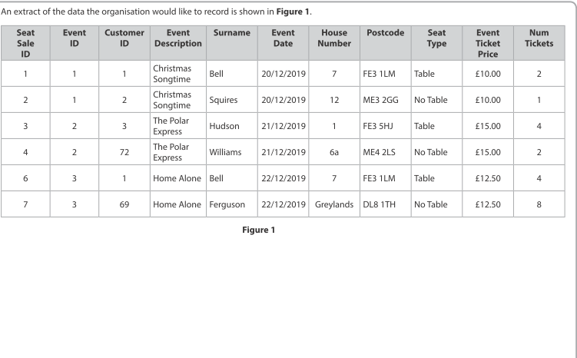
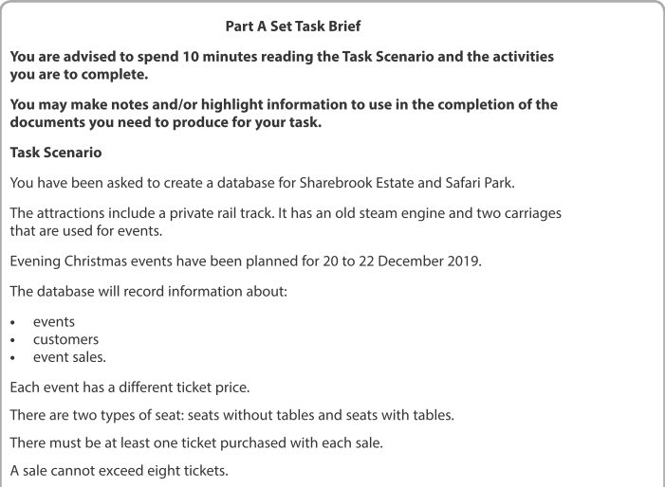
Normalise the Data

Slide 5
There are 5 forms of Database normalisation
Task 1
Research the five different forms of Database normalisation

Slide 6
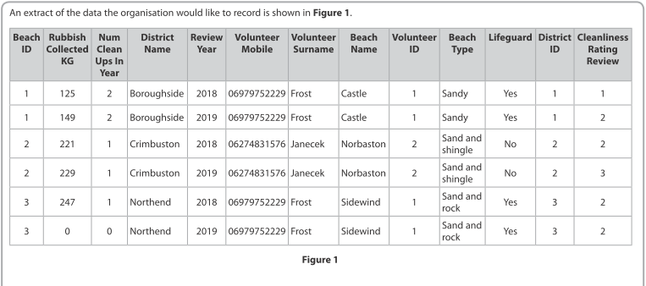
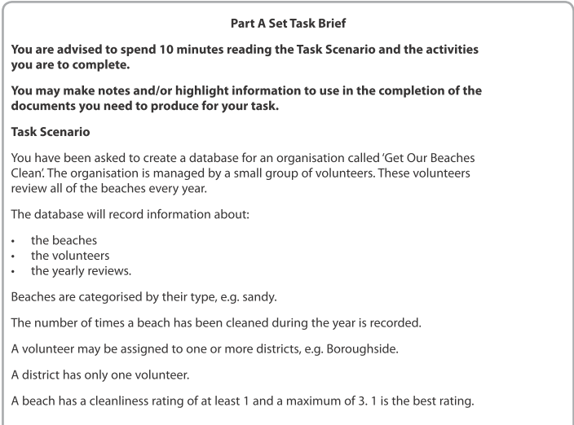
Normalise the Data

Slide 7
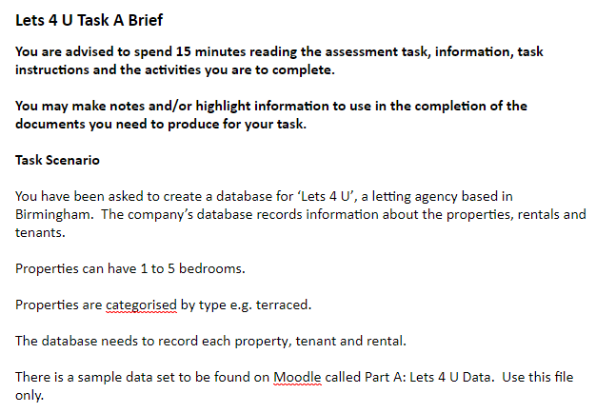
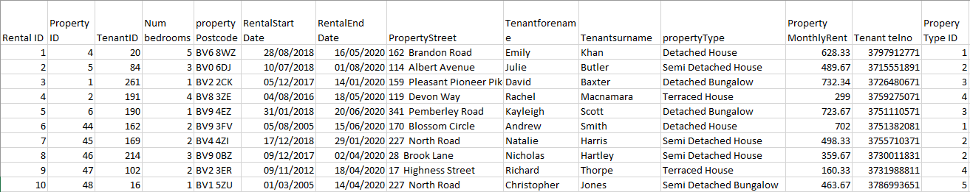
Normalise the Data

Slide 8
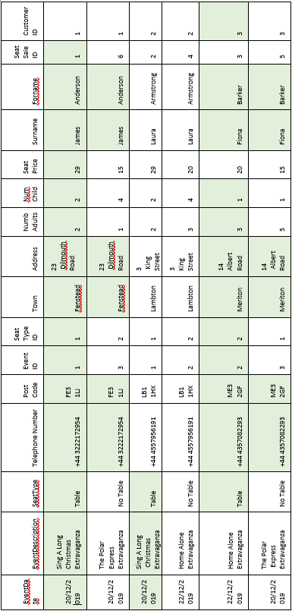
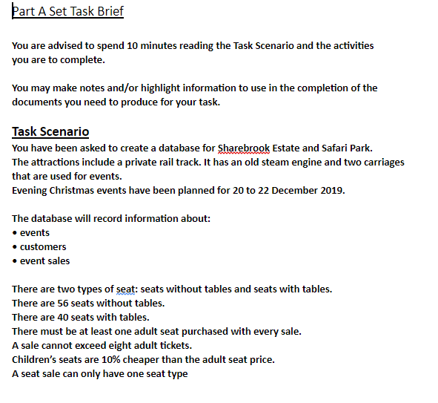
Normalise the Data

Slide 9
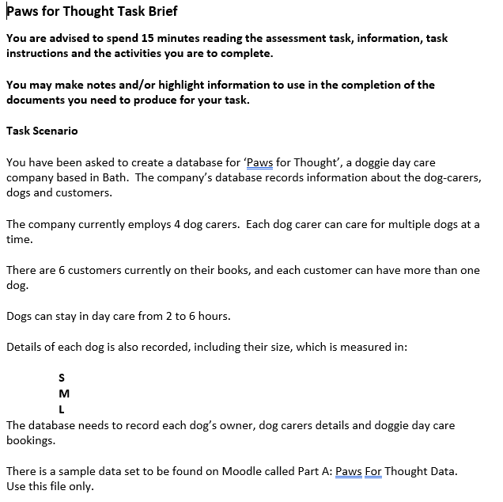
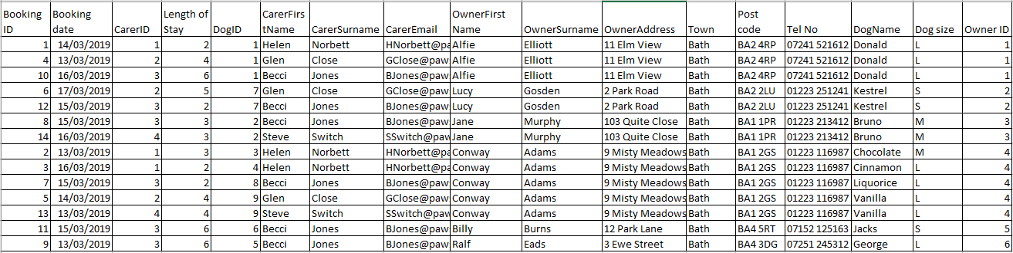
Normalise the Data

Slide 10
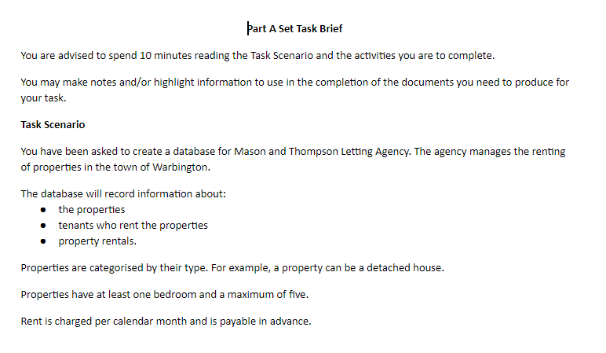
Normalise the Data

Slide 11
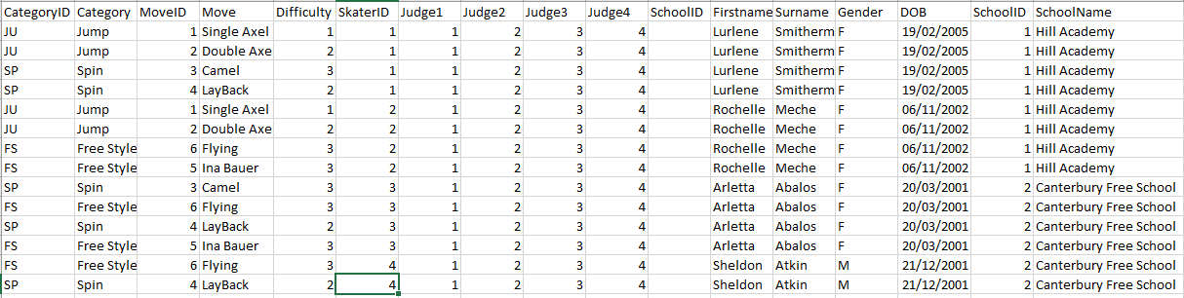
Normalise the Data

Slide 12
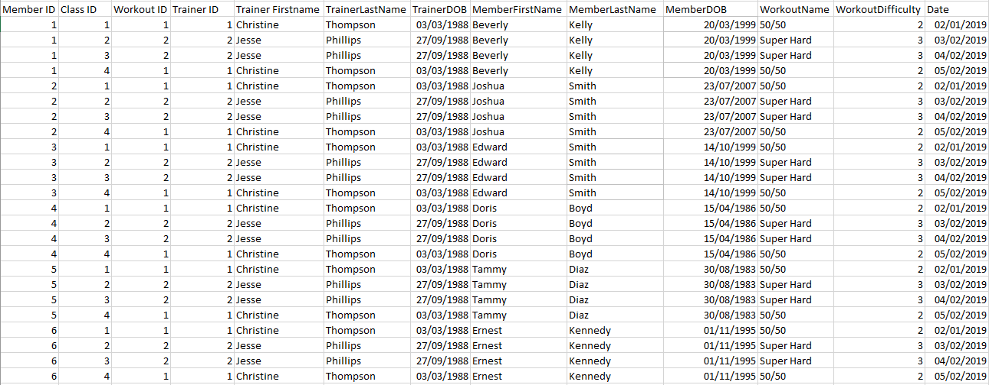
Normalise the Data

Slide 13
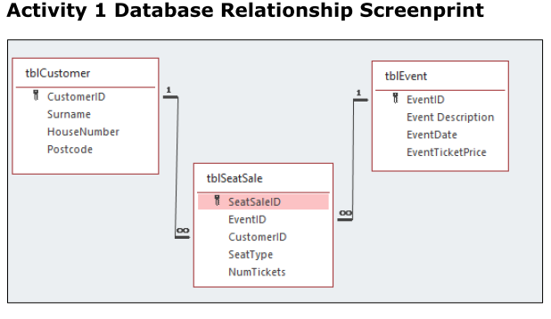
Answers

Slide 14
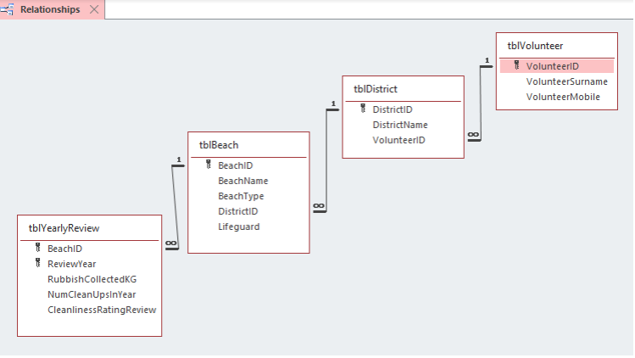
Answers

Slide 15
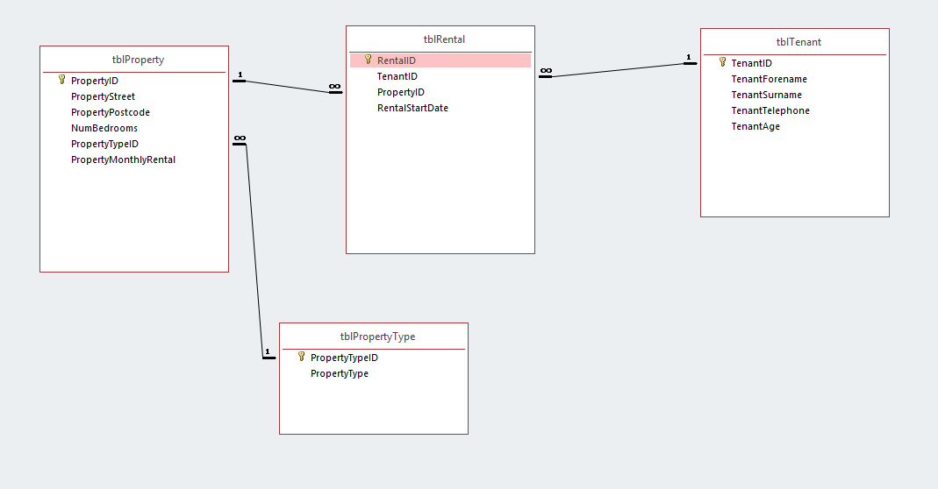
Answers

Slide 16
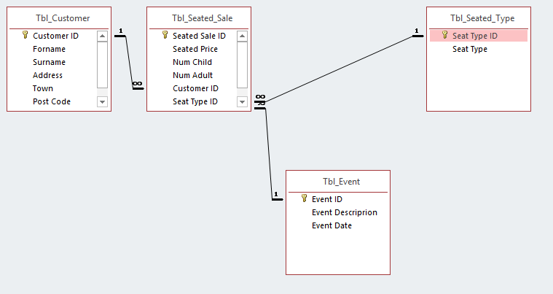
Answers

Slide 17
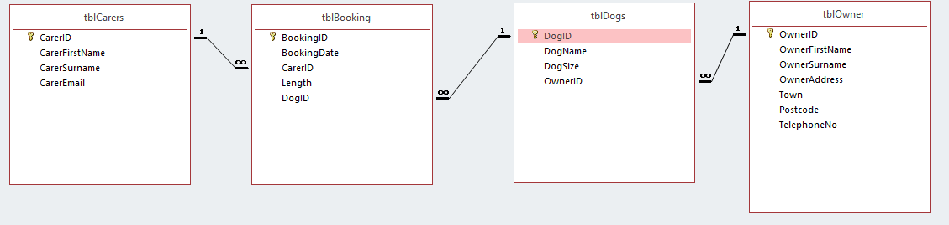
Answers

Slide 18
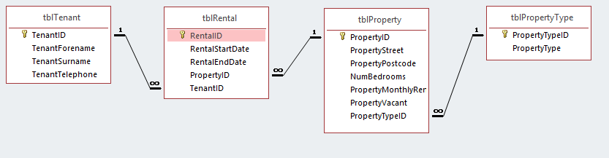
Answers

Slide 19
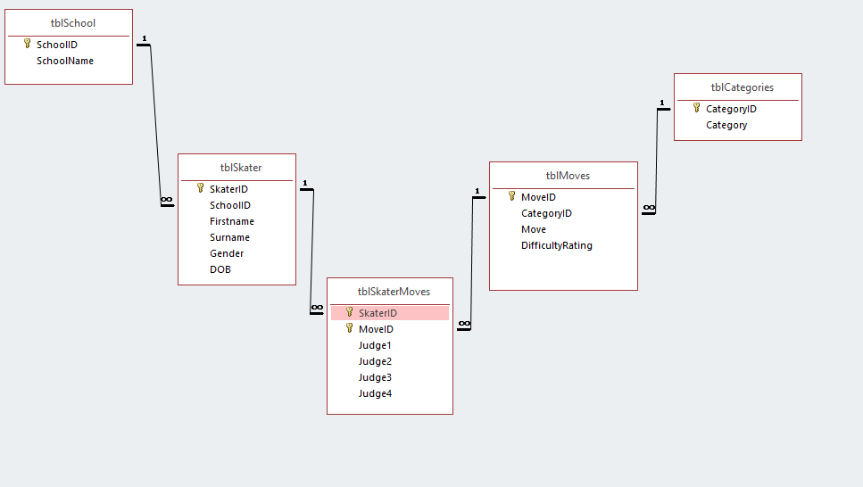
Answers

Slide 20
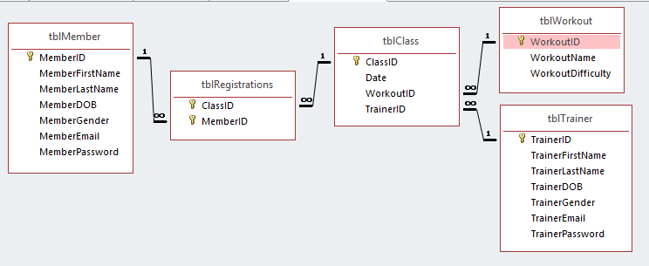
Answers

