Slide 1
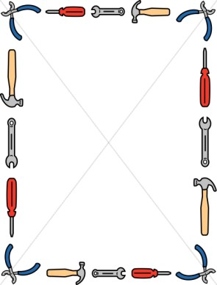
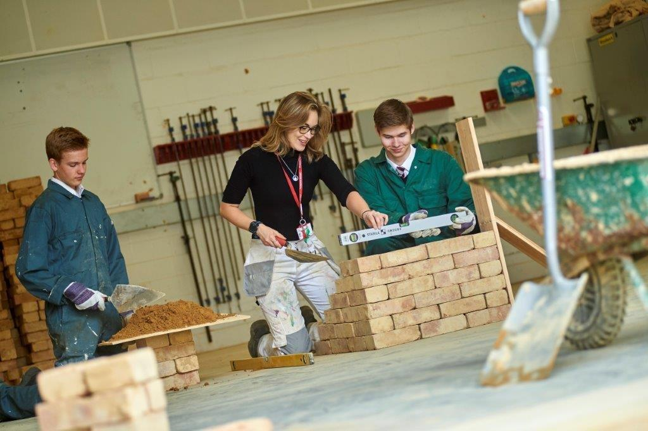
Are you interested in studying Constructing and Maintaining the Built Environment Level 2 Technical Award?
The following tasks are designed to give you an idea what knowledge is required for this course and what areas we will be covering.
Even if you have studied Construction before there is new content which we will not have covered. Complete at least two tasks from this powerpoint and please send completed work (word/powerpoint files and photos of written/creative work are all fine) + any questions you have about Construction to hridgus@prospect.reading.sch.uk Feedback will be given on your work.

Slide 2
Go Construct is a FANTASTIC website. It has information about careers, apprenticeships and open door events. Please look over the website- get INSPIRED and do the following tasks
Complete the Go Construct Ultimate Quiz - https://www.goconstruct.org/learn-about-construction/find-the-role-for-you/ultimate-quiz/ This may help you narrow down an area of interest.
Then make x2 Fact Files on two different construction careers that intertest you. Look at what is required (qualifications/ experience) and what that role does. Also look on the website for companies that might offer apprenticeships or work experience. Good presentation and pictures.

Slide 3
A big part of this course is understanding how a house is built. The processes, the tools used, the careers involved and why different houses are built in different ways.
Watch the TV show GRAND DESIGNS it is on 4oD and there are hundreds of episodes which show houses being built from the ground up. Watch at least 10 episodes and answer the following questions→
What causes delays in building projects? List the reasons
What types of materials can be used to build a house?
Why do we have to insulate a house?
Who designs and draws the original plans of the building? And why is it important we have these plans?
Can you write BASIC step by step list of each stage of building a house?

Slide 4
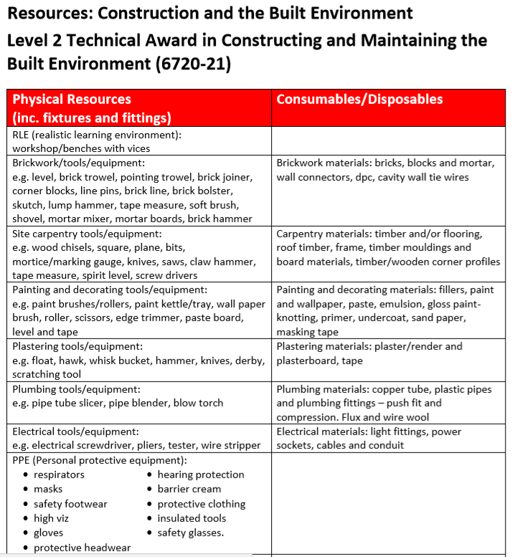
The table on the right shows all the PHYSICAL resources we will be using during the course.
We will be doing up to 5 different practical skills.
Can you please make sure you know what each of these words mean. I know it is a LOT of words.
Task: On the next slide I have set out a template table I would like you to complete:

Slide 5
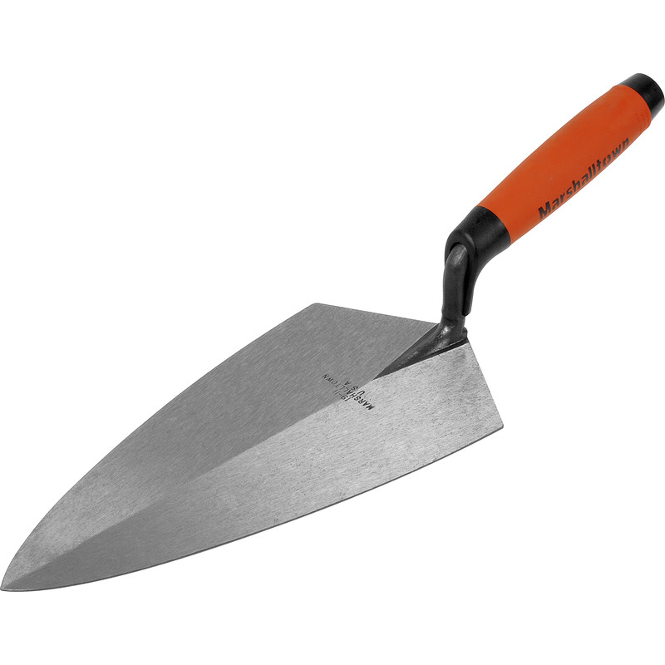
Brickwork
Resource | Function | Picture
Spirit Level
Brick Trowel
Pointing Trowel
Jointer
Corner Blocks
Line Pins
Bolster
Brick Line
Skutch
Lump Hammer
Tape measure
Soft brush
Shovel
Mortar Mixer
Mortar Board
Brick Hammer
This is an example for the Brickwork Key Words:
Please do the same for CARPENTRY,
PAINTING AND DECORATING, PLASTERING, PLUMBING,
ELECTRICAL and PPE

