Slide 1
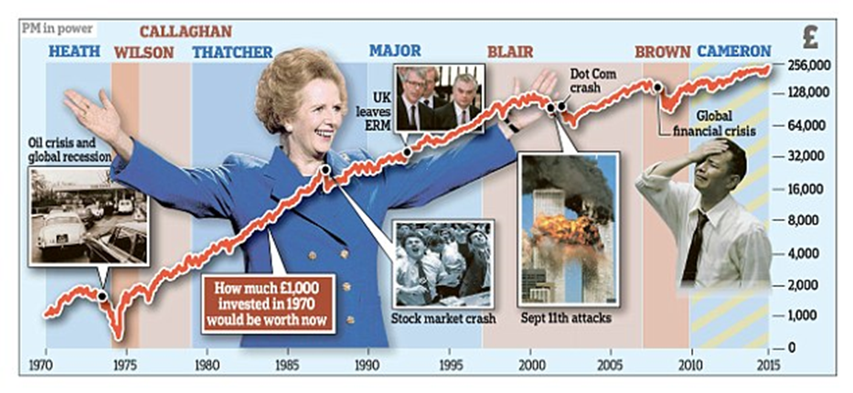
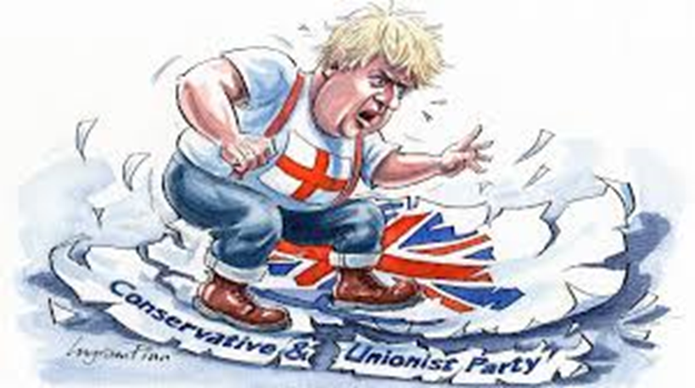
Are you interested in studying A Level Politics ?
These activities are designed to give you a flavour of the key topics we study in Y12 Politics and to start developing your ‘Political understanding ’.
Complete at least one activity from each page each week to get a head-start and see whether Politics is the subject for you.
Please send completed work (word/powerpoint files and photos of written/creative work are all fine) + any questions you have about A Level Politics to cgold@prospect.reading.sch.uk
Feedback will be given on your work.
Thanks for your interest in A Level Politics !

Slide 2
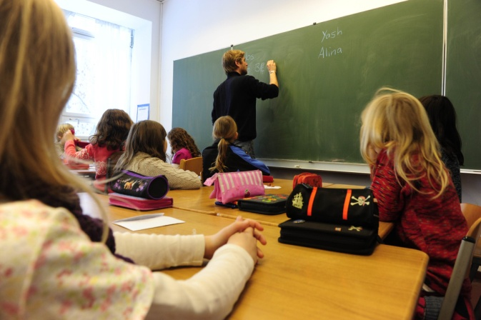
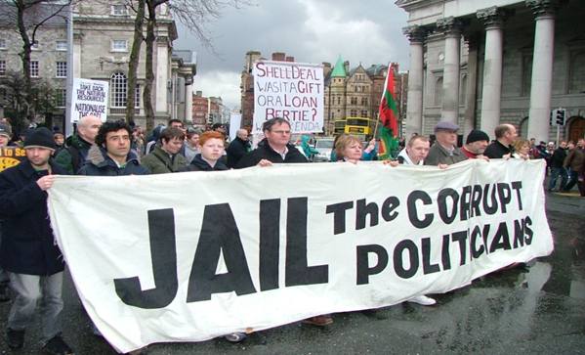
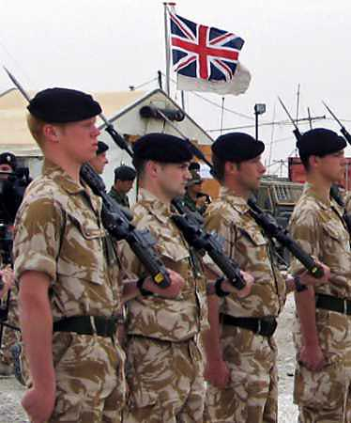
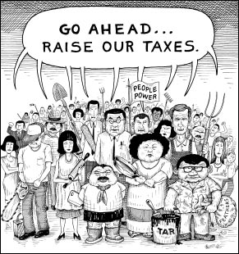
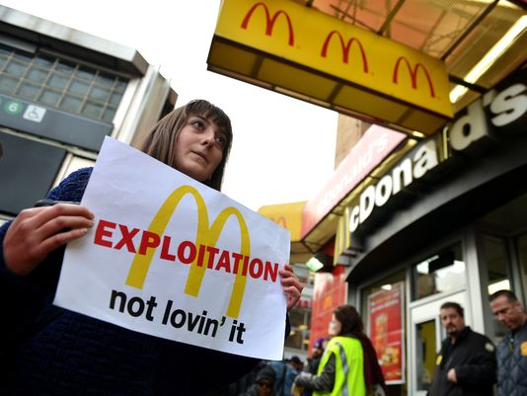
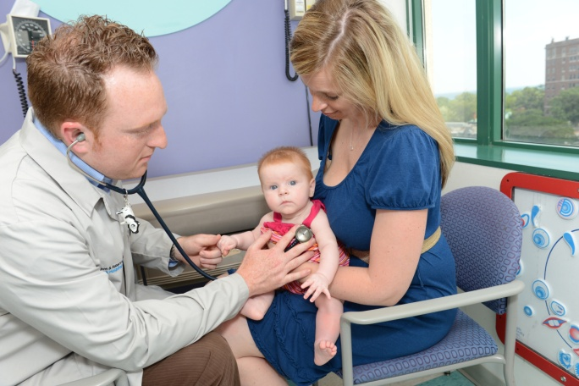
How does Politics affect Me?
“ J u s t b e c a u s e y o u d o n o t t a k e a n in t e r e s t in politics d o e s n’t m e a n p olitic s w o n’t t a k e a n in t e r e s t in y o u."
P e ricle s, C5th c B C
Well, Politics affects EVERYONE
Politicians make laws that affect every aspect of our lives
As our elected representatives, politicians are a major link between us and real power and influence
Without participation, we lose knowledge, accountability, and an ability to influence events
List 5 ways politics has affected you and your family

Slide 3
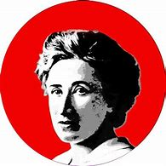
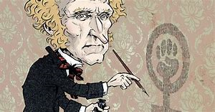
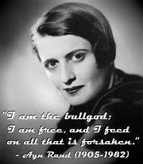
Political thinkers
Submit the following activities:
Read the following summaries of these 3 key political thinkers on the Tutor2U website. Then create one of the following to illustrate their key ideas about how society works, either:
A storyboard or cartoon, or
A poster presentation, or
A 3D model using play-doh, plasticine or junk from the recycling bin (take a photo of it!).
1.Rosa Luxemburg
2.John Stuart Mill
3. Ayn Rand

Slide 4
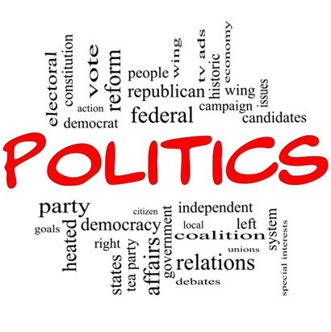

Download the following booklet: https://assets-learning.parliament.uk/uploads/2019/12/How-it-Works-booklet.pdf
Read through the booklet and complete the following activities:
Task 2:​ In your own words write a VERY short definition for each of these keywords/ phrases:
Keyword/ phrase Definition
Politics
Suffrage
Political Participation
Democracy
Direct Democracy
Representative Democracy
Member of Parliament (MP)
General Election
Devolution
Parliament
By-election
Referendum

Slide 5
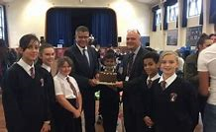
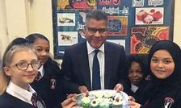
Research your local MP,
who is he/she;
which party do they represent;
which constituency do they represent;
what have they recently shown an interest in;
research their voting history to see where they stand on key issues. https://members.parliament.uk/ b.)
investigate the role of an MP by playing the game in the link below. https://learning.parliament.uk/resources/mp-for-a-week/#cta-target
Findings
My local MP
b.) The role of an MP

Slide 6
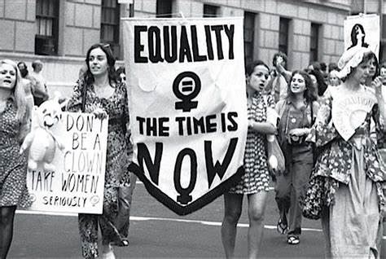
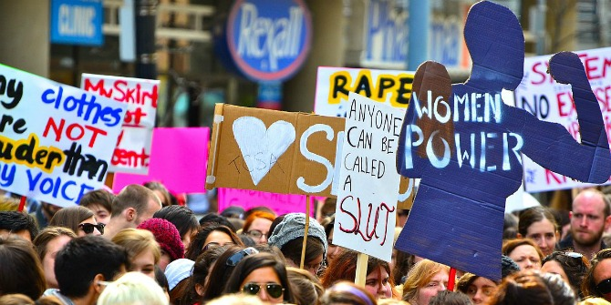
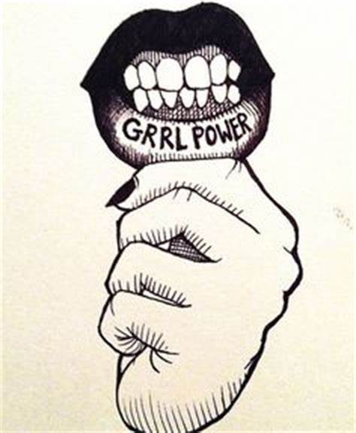
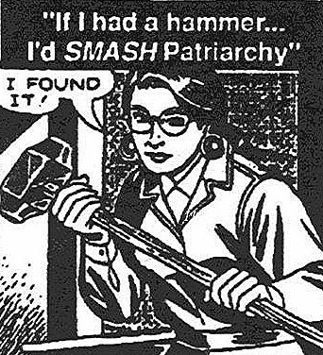
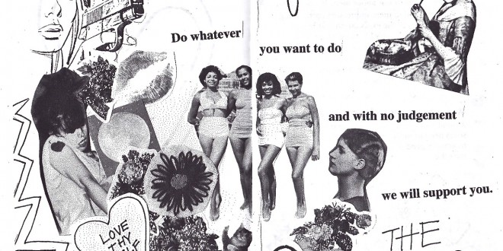
Walt To be understand the origins of Feminism
Make political points about each picture
Explain the term patriarchy means
Explain why origins of Feminism
To be able to evaluate the most important era for Feminism.

Slide 7

Feminism is not…
Hating all men.
A fight for a secular all-female society
Promotion of same-sex ideas and values.
Feminism is diverse.
https://www.youtube.com/watch?v=X7aM1x103EM

Slide 8
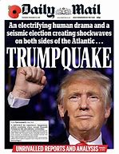
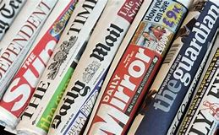
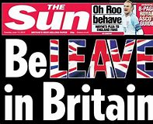
A level Politics Content analysis
NEWSPAPER NAME – DATE (tabloid or broadsheet) buy 2 !
Headline / Splash - front page
Positive or negative?
Number of pages dedicated to political stories
Political Bias? Positive or negative news – Partisan paper? Spin? examples
Target reader – this reader would vote for…..

Slide 9
True or False Quiz
Voting Rights and Responsibilities – True or False Quiz
Decide whether the following statements are true or false. You have 5 minutes!
In 1918 women in the UK were allowed the same voting rights as men; those over 21 could vote.
Under current voting laws, all UK residents over the age of 18 are allowed to vote in General Elections.
The UK’s Prime Minister can be voted in to serve any number of terms; there is no limit on how many times they can be elected Prime Minister.
The UK is in the top ten globally for the highest percentage of women in parliament.
In 10 countries in the world it is illegal not to vote if eligible.
In the last General Election in 2017, fewer than three quarters of the population entitled to vote actually did.

Slide 10
Voting Rights and Responsibilities – True or False Quiz Answers
In 1918 women were allowed the same voting rights as men; those over 21 could vote. (False, it was women over 30 until 1928.)
Under current voting laws, all UK residents over the age of 18 are allowed to vote in General Elections. (False, there are a number of exceptions, including members of the House of Lords, EU citizens of other countries living in the UK, convicted prisoners and people who are deemed mentally unfit to vote.)
The UK’s Prime Minister can be voted in to serve any number of terms; there is no limit on how many times they can be elected Prime Minister. (True, unlike in the US where there is a limit of two successive terms for the President.)
False. The UK is 39th. Rwanda is highest in the world; 61% of their lower house (the equivalent of our House of Commons) are women, whereas the figure is 32% in the UK. Only 26.4% of the House of Lords is female. Countries above the UK for female representation in Parliament include Costa Rica, Bolivia, North Macedonia, Belarus, Timor Leste, Burundi, Tanzania, Uganda and Nepal.
In 10 countries in the world it is illegal not to vote if eligible. (False, it is 22, though not all countries enforce this. Australia is one that does though! In some countries there are fines and even removal of citizenship rights if you don’t vote!)
In the last General Election in 2017, fewer than three quarters of the population entitled to vote actually did. (True, only 69 percent voted. At least this was higher than the 59% in 2001!)

