Slide 1
Year 6-7 Transition
Welcome to History at
Prospect School!

Slide 2




What is History and how do we learn about it?
History is basically a story about the past, the things that happened and the people who lived in different periods of time
It tells us about how the world developed to become the society we live in today
We learn about it like detectives – we have a problem to solve, we ask questions and we use evidence, like pieces of a puzzle, to find answers. The steps we take to do this form a story or journey…..

Slide 3
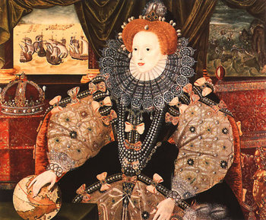
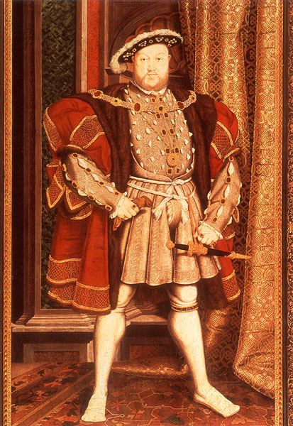
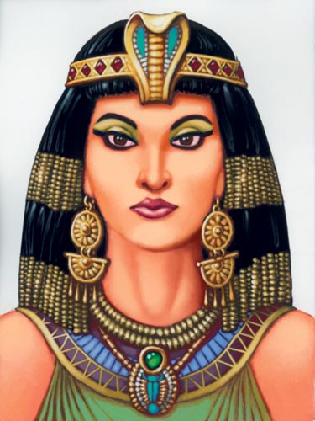
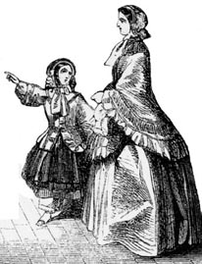
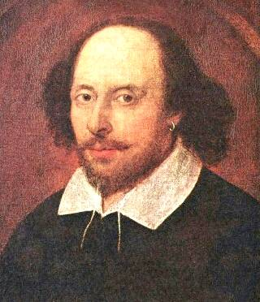
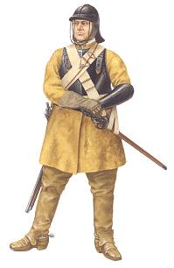
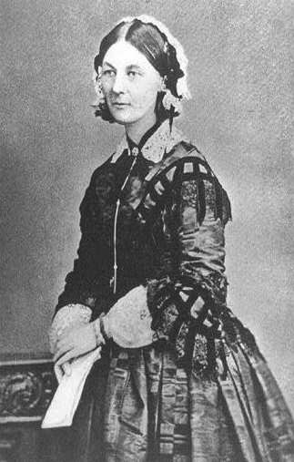
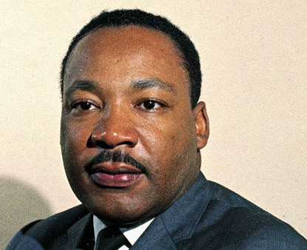
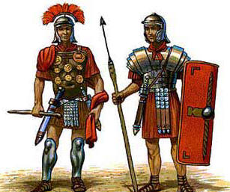
What is History?
History is about people…. Do you know who these individuals are or which time periods they come from?

Slide 4
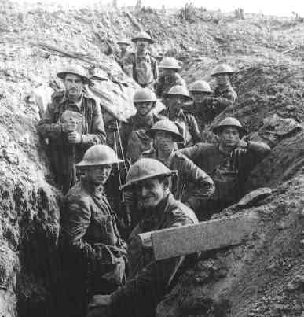
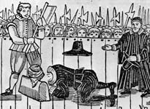
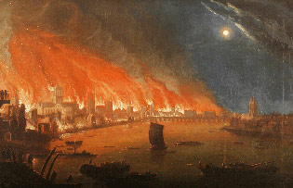
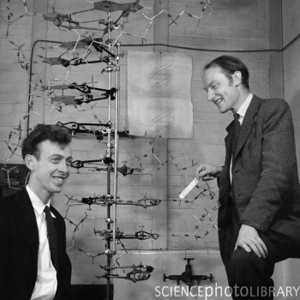

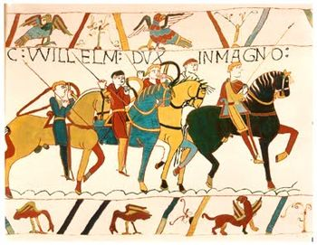
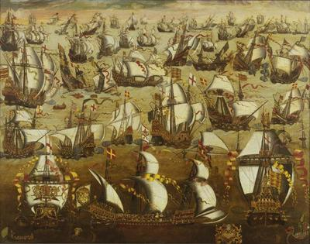
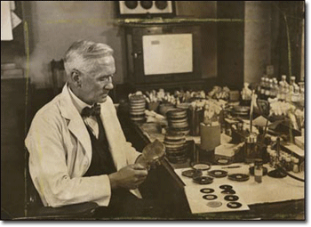
What is History?
History is about key events…..like discoveries, inventions, wars and invasions….. Do you know any of the events shown here?

Slide 5

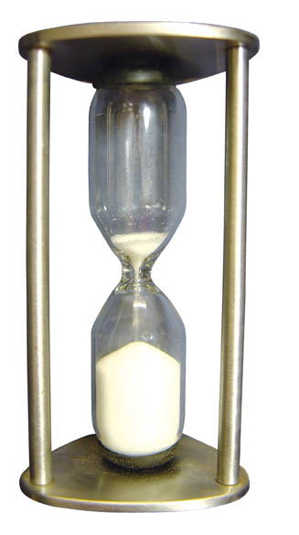

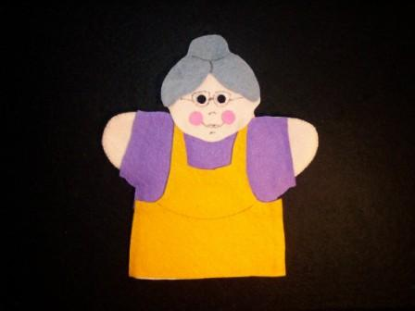
What is History?
History is about time and changes which take place over time….
24/7

Slide 6


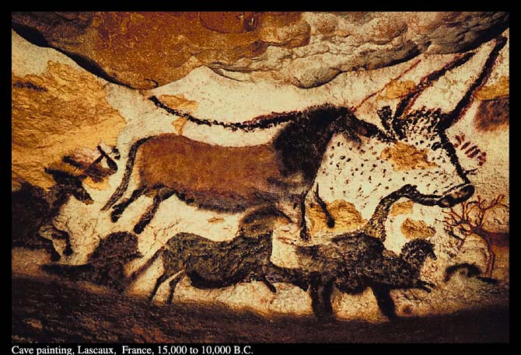

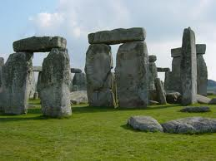

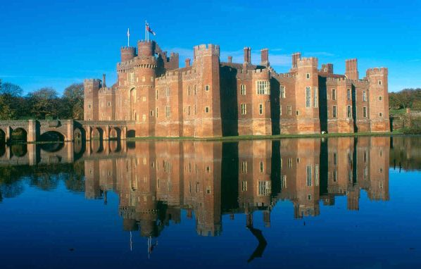
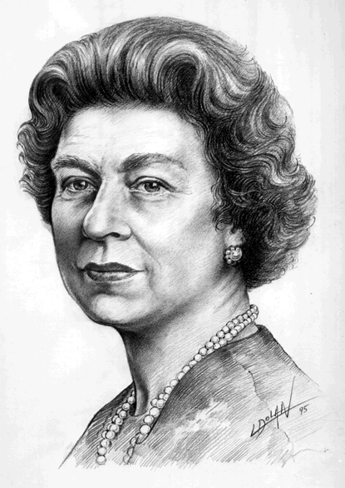
What is History?
We can learn about history by looking at lots of different types of evidence…

Slide 7
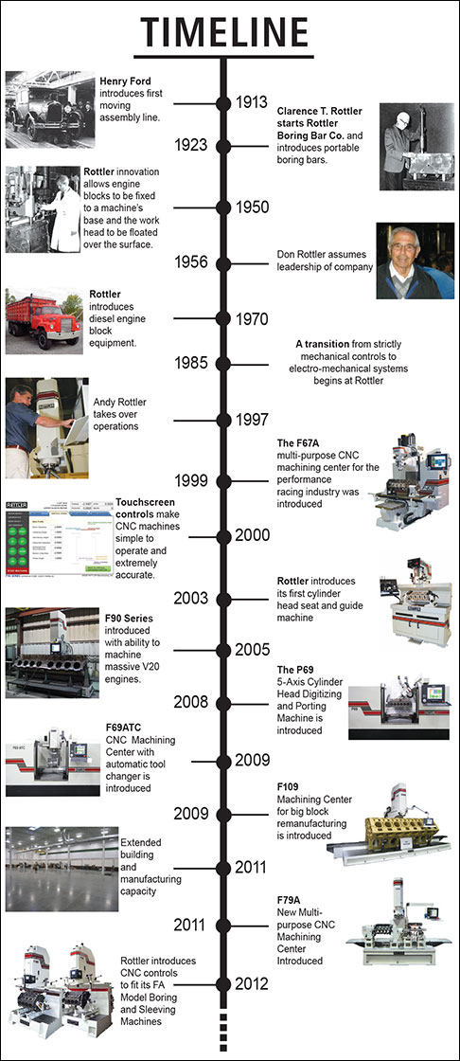
Part 1: History Skills: The Tool Box
Time and the timeline!
Humans have been around for a very long
time and as a result, historians have had to
think of a clever way to divide up all of that
time. They divide time into periods and
they use a timeline.

Slide 8
Key words:
Century Before Christ
B.C. Anno Domini
Decade A section of time
A.D 10 years
Periods 1000 Years
Millennium 100 years
* Link up the right words with the right answers.
The first is done for you:

Slide 9
What is a timeline?
How is it useful?
Timelines help us understand history. They also tell us what happened, when and how much time went by between events.
Below is an example of
a timeline for British
History
1066
NORMANS
1485
TUDORS
100 AD
100 BC
Before Christ
(Christ is born)
Anno Domini

Slide 10
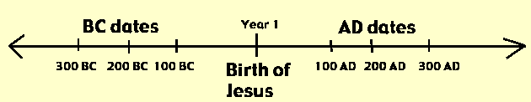
Can you do these tasks?
Explain what a timeline is
Draw a timeline
Explain on your timeline what
BC and AD is
4) Add the dates below on the timeline
Dates to put on your timeline:
1066 AD- Normans
42 AD- Romans
1603 AD- Stuarts
1325 BC –Egyptians
1837 AD- Victorians
480 BC- Greek Spartans alive
BC: Before Christ was born
AD: After Christ was born.

Slide 11
What is a century?
A century is a period of 100 years.
If we are talking about the period we live in today, the date is 2020. We are in the 21st Century.
If you want to group a series of years together you call them a century. Whatever the number of years is, you count one after it to call it a century:
Date/Year: 2010 Century: 21st
Date/Year: 1750 Century: 18th
Date/Year: 150 Century: 2nd
Date/Year: 1900 Century: 20th
Activity: On your timeline for each year, add the century they belong to.

Slide 12

Most importantly, history helps us to understand where we are today…..Part 2: The History of you!
So tell me about your history…. What’s your story and what evidence can I find about you?
Create a timeline of the key dates in your life.
Please include lots of interesting information – so I can learn more about you!
Draw pictures to illustrate your timeline.
P.S. If you feel a bit unsure about doing a timeline of your own life, you could do a famous person you admire.
Important dates you may like to use:
Birth date
Started Prospect School
Brother/sister was born
Lost your first tooth/broke your arm
Moved house
Moved to Reading/the UK
Learnt to swim/ride a bike
Went on holiday somewhere
Won an award or competition

Slide 13



Part 3: The history of something I’m interested in….
At primary school, it is very likely that you have all learned about history in different ways.
Your new history teacher would like to find out a little bit more about the things you like by creating a ‘History of something I’m interested’ in project (see next page for example)
The focus can literally be anything – your family, the area where you live, your favourite sport or team, an individual person or place... weird and wonderful are very welcome!
The requirements are that you answer the questions: Who? When? What? Why? Where? How? It can be typed or handwritten and drawn. It should be about 5
    pages or slides. Try to demonstrate the key features of history – people, places, events, evidence and change over time.
    Good Luck, we look forward to learning about you and your histories!

Slide 14
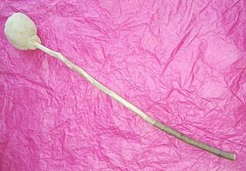
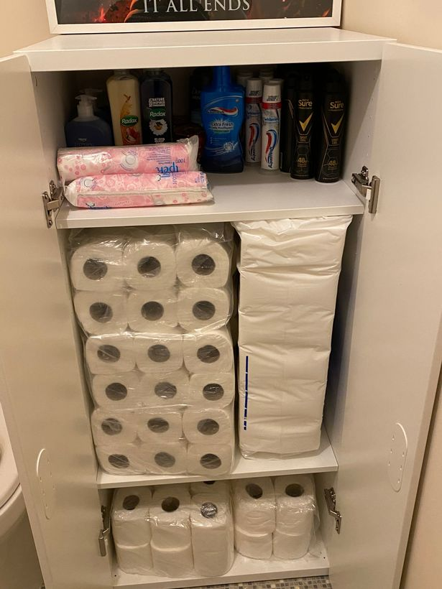
Part 4: Writing History… With a little example (remember you can choose any topic!)
What links this object…
To these?

Slide 15
An example of a topic you could research:
A brief history of toilet roll...!
43AD-410AD: The Romans who occupied Britain at this time used spongia after
using the toilet (some other people used leaves or moss)
2020: when the government asked people to stay at home during the
Coronavirus epidemic, the item which most people stockpiled was toilet paper.
To complete the timeline you would need to research the steps between 43AD and 2020AD

