Slide 1
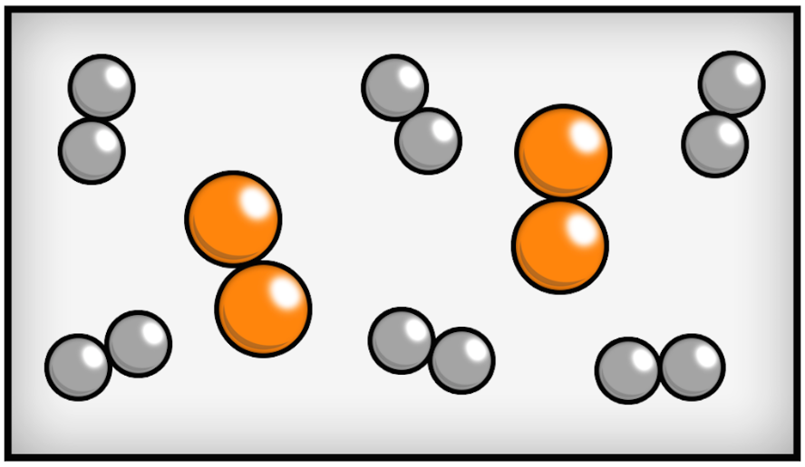

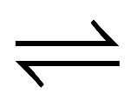
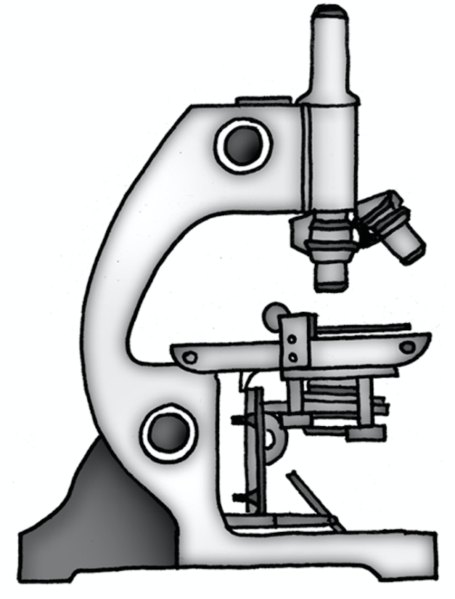
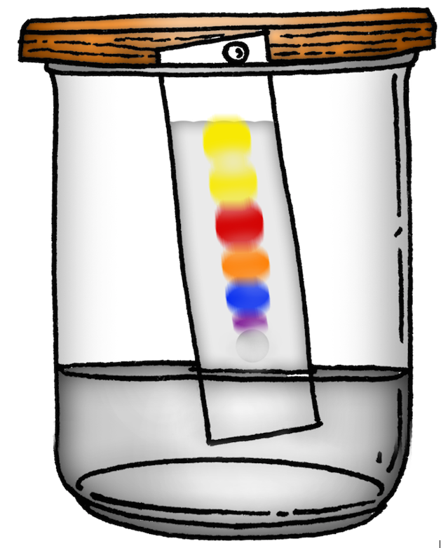

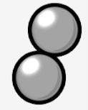
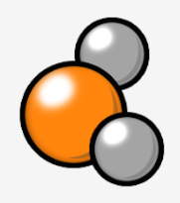
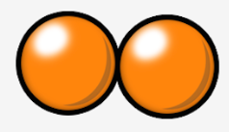
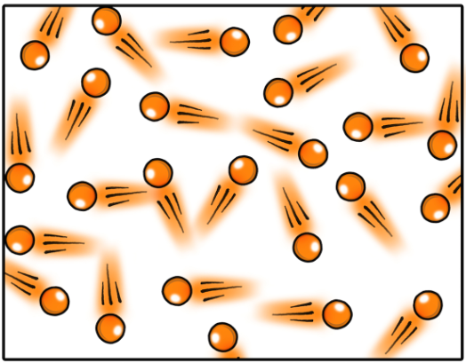
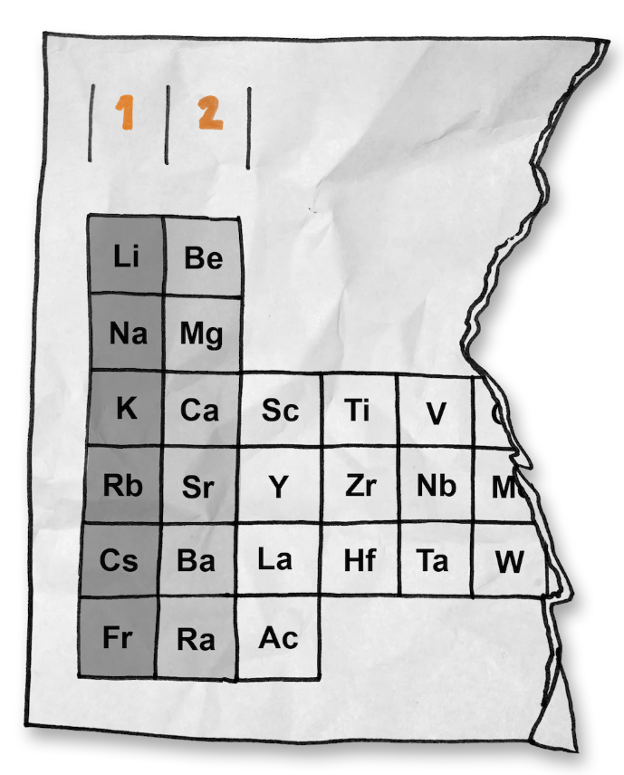
1. Particles
If we could divide any substance down into smaller and smaller pieces we could see it is made of tiny particles.
These particles are so small they could
not be seen using a microscope.
We can represent these particles in
models using spheres.
4. Changes in states of matter
A solid melts when it is heated because the particles are gaining energy. This energy is used to break the forces of attraction between the molecules. The more energy a particle has the faster it can move.
6. Elements and mixtures
This diagram shows a mixture
of elements.
Mixtures can be easily separated
using techniques such as:
  Filtration
  Distillation
  Chromatography
Melting
Evaporating
Freezing
Condensing
2. States of matter
Three states of matter are solid, liquid and gas.
7. Compounds
Atoms of different elements can combine together to form a very large number of compounds.
All matter in the
universe is made of
small particles
Solid | Liquid | Gas
+
Elements
Compounds
3. Differences in states of matter
In solids the particles are closely spaced and vibrating. In liquids there is random motion but the particles are in contact.
In a gas there is random motion
and the particles are widely spaced.
Liquids and gases flow and completely
fill their container. Gases can be
compressed.
5. Atoms and elements
Atoms are the basic building blocks of all living and
non-living things anywhere in the universe.
There are just over 100 different types of atom.
Substances made of only one kind of atom are called elements.
All the known elements are listed
in the periodic table of elements.
8. Reactions and properties
A chemical reaction involves the rearrangement of atoms to form new substances, while the total number of atoms stays the same (see image above).
The properties of different materials can be explained in terms of the behaviour of the atoms and groups of atoms of which they are made.
  © March 2019 PiXL Spine Strategy and templates: The PiXL Club Ltd. All rights reserved.

Slide 2
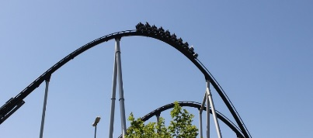
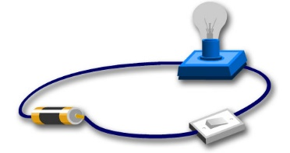

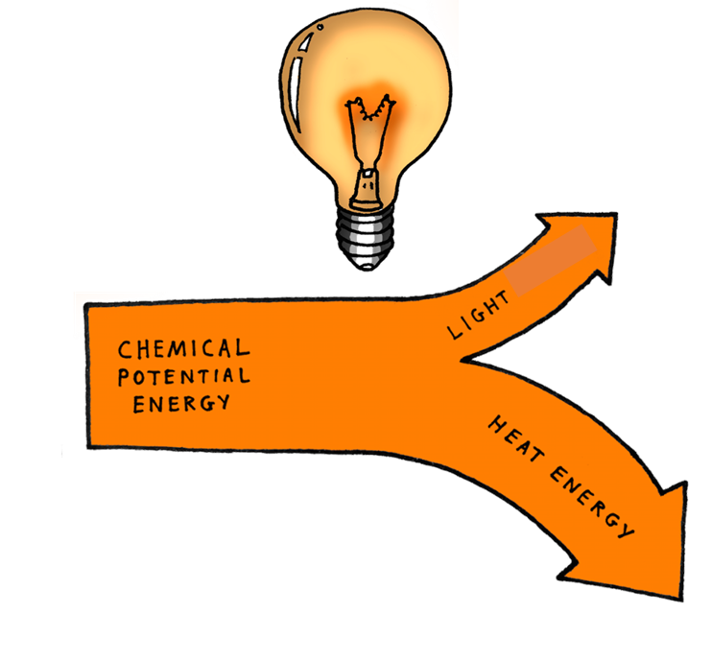
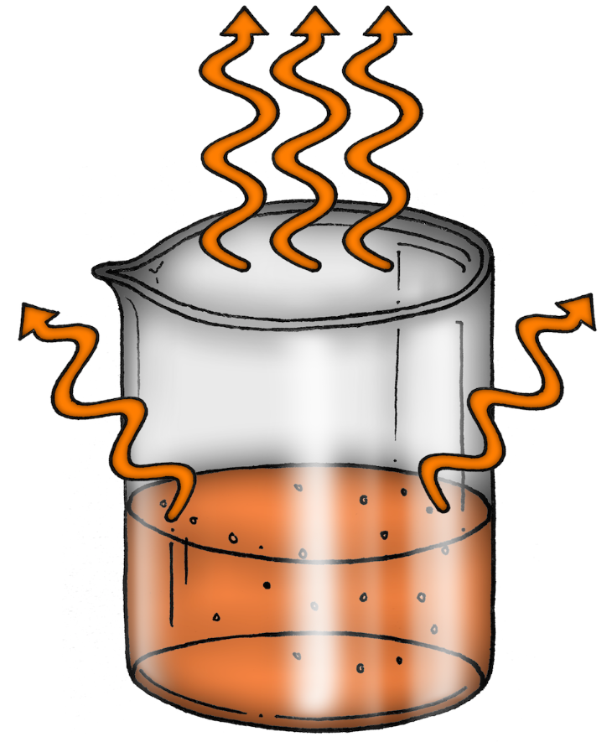
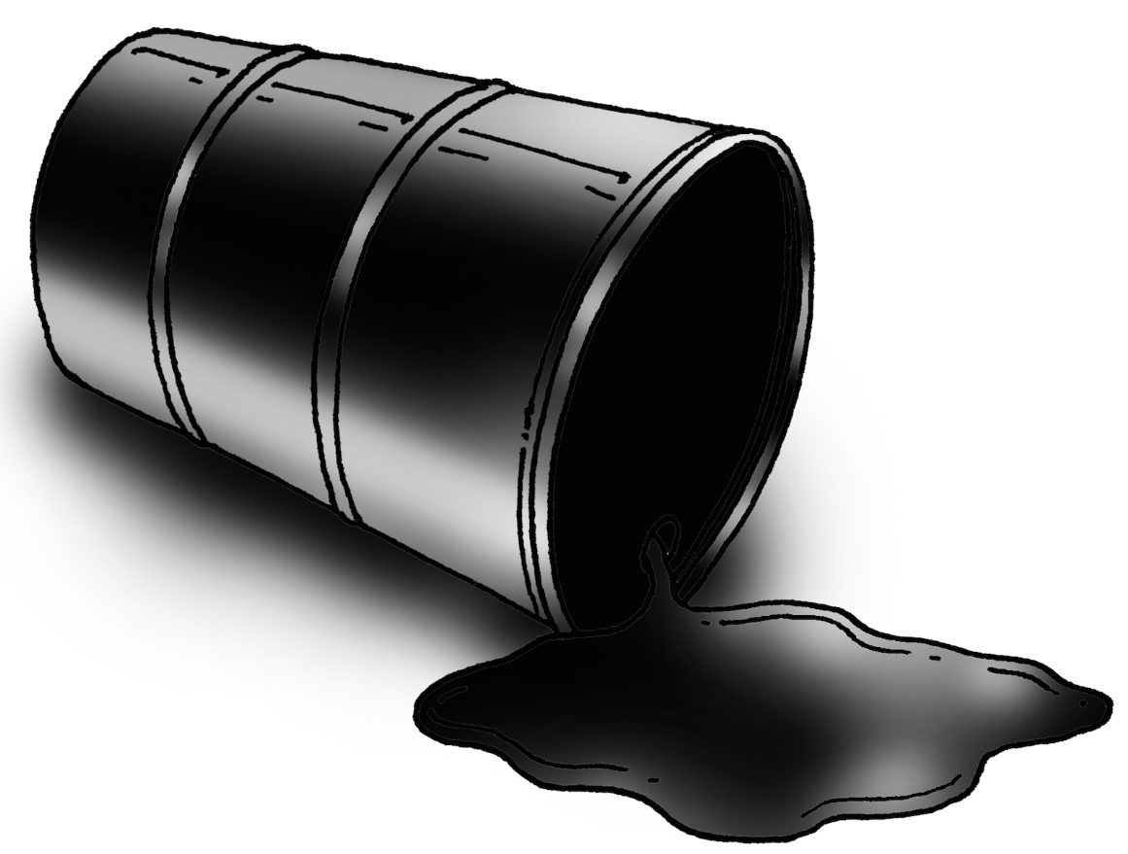
1. Energy stores
Objects can have stored energy either because of:
  Their chemical composition – chemical
  Their movement – kinetic
  Their temperature – thermal
  Their position in a field – gravitational potential, magnetic, electric
  Compression or distortion of an elastic material – elastic potential
4. Lifting objects above the ground
Energy can be stored by lifting it higher above ground – gravitational potential.
When it is released and falls, this energy is stored in its motion – kinetic.
During this transfer some
energy will be dissipated.
6. Batteries and electrical current
The chemicals in the cells of a battery store energy.
This energy is transferred to charged particles when the battery is connected to a complete circuit.
This causes the current to flow, transferring energy to other parts of the circuit.
2. Work
When work is done by a force, it results in an energy transfer and leads to energy being stored by an object.
These books have been lifted
into the air; work has therefore
been done. Energy has been
transferred to the books and
is now stored in them.
7. Methods of thermal energy transfer
Thermal energy can be transferred by particles, using conduction and convection. It can also be transferred by radiation.
Internal energy is the energy stored in a system by the particles. When heat is added the internal energy of the particles increases.
Energy
5. Heat and temperature
Heat is an energy store whereas temperature is a measure of how hot something is.
An object at higher temperature transfers thermal energy to the surroundings until they are at the same temperature.
How quickly this happens
depends on the thermal
conductivity of the materials.
3. Energy transfers and dissipation
The unit for energy is the joule.
Energy cannot be created or destroyed.
Energy can be transferred to
other useful energy stores
or dissipated.
We can use diagrams to
show these transfers.
8. Energy resources
Fuels such as oil, gas, coal and wood are energy resources.
Some energy resources are renewable, such as those produced by wind, waves, sunlight and tides.
Others are non-renewable such as those formed by burning fossil fuels with oxygen.
  © March 2019 PiXL Spine Strategy and templates: The PiXL Club Ltd. All rights reserved.

Slide 3
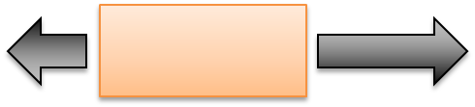

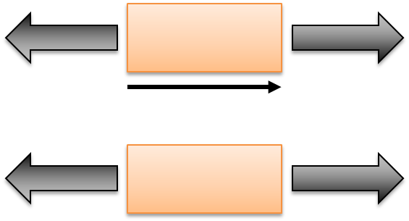
1. Speed
Speed (m/s) = distance (m) ÷ time (s)
The speed of a moving object is a measure of how far it will travel in a certain time.
How quickly an object travels depends on its mass and the force acting on it.
The greater the mass of an object the longer it takes to speed up or slow down, a property of mass called inertia.
4. Unbalanced forces
If the forces acting on an object are unbalanced the object will either speed up (acceleration), slow down (deceleration) or change direction.
Unbalanced forces cause change.
6. Floating
Objects float on water because they are less dense than the water.
An object floating on a liquid, or in air, does not move because there is an upward force balancing the downward force of gravity.
The upward force is equal to the weight of the fluid displaced. So heavy objects can float if they are hollowed out to displace a large weight of water.
2. Gravitational forces
All objects on Earth are affected by gravitational forces. An object which stays at rest on the surface of the Earth has one or more forces acting on it, thus balancing the force of gravity.
A book lying on a table does not fall because the atoms in the table are pushing upwards on the book with a force equal to the force of gravity.
7. Moments
Moment (Nm) = force (N) x distance (m)
A moment is the turning effect of a force around a pivot.
Forces and motion
Pivot
3. Force diagrams
We can show the forces acting
on an object using force arrows.
These arrows show the
size (magnitude) and
direction of the force.
5. Balanced forces
Equal and opposite forces are found on stationary objects and those travelling at a steady speed.
An object with equal and opposite forces acting on it will carry on doing what
it is already doing.
Balanced forces
cause no change.
8. Density
Density = mass ÷ volume
Density is a measure of how closely the particles are packed together in a particular space. The closer the particles are packed together, the heavier the object feels for its size.
The volume of an irregular shaped object, like a stone, can be found by measuring the volume of the water displaced by the object.
  © March 2019 PiXL Spine Strategy and templates: The PiXL Club Ltd. All rights reserved.

Slide 4
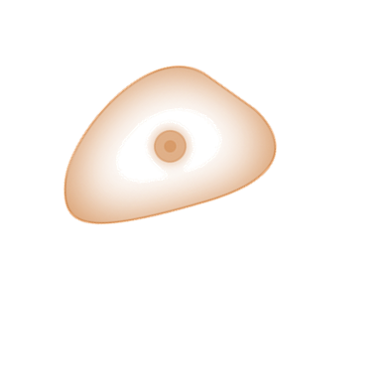
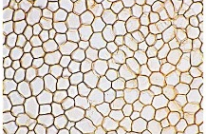
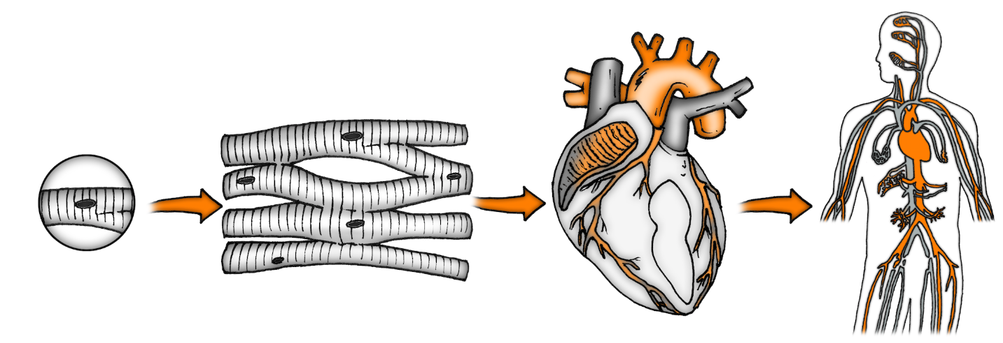
1. Cells
All living things are made of one or more cells which can only be seen through a microscope.
All the basic properties of life are the result of what happens inside cells. This includes:
    Reproduction
    Respiration
    Photosynthesis
4. Cell division
Cells divide for growth and repair.
For an organism to grow the cells need to divide to make more cells. Growth happens because the cells inside the organism divide, not because all the cells become bigger.
6. Tissues and organs
Cells are often organised into tissues.
Tissues contain lots of the same type of cell.
Organs contain groups of tissues with the same function.
Organs can be grouped into organ systems with specific functions.
2. Parts of a cell
7. Organ systems
In the body, organ systems carry out key functions such as respiration, digestion, elimination of waste and temperature control.
The circulatory system takes substances to and from cells.
The digestive system breaks down food into smaller pieces which can be absorbed into the body.
Nucleus | Controls the cell
Cell membrane | Controls movement in and out of a cell
Cytoplasm | Where chemical reactions happen
Mitochondria | Respiration
Chloroplast | Photosynthesis
Cell wall | Strengthens the cell
Vacuole | Filled with cell sap
Cells and organisms
3. Plant and animal cells
5. Specialised cells
In multi-cellular organisms there are many different types of cell.
These cells are specialised and are slightly different to the ‘standard’ plant and animal cells. These differences help the cell to carry out its function.
For example, muscle, blood and nerve cells carry out specific functions in an organism.
8. Stem cells
Stem cells are not specialised.
They can repair cells by being programmed for different functions.
Stem cells can be found in adults in their bone marrow and in embryos.
As they are not specialised, stem cells could be used to treat certain health conditions by replacing damaged cells.
  © March 2019 PiXL Spine Strategy and templates: The PiXL Club Ltd. All rights reserved.

Slide 5
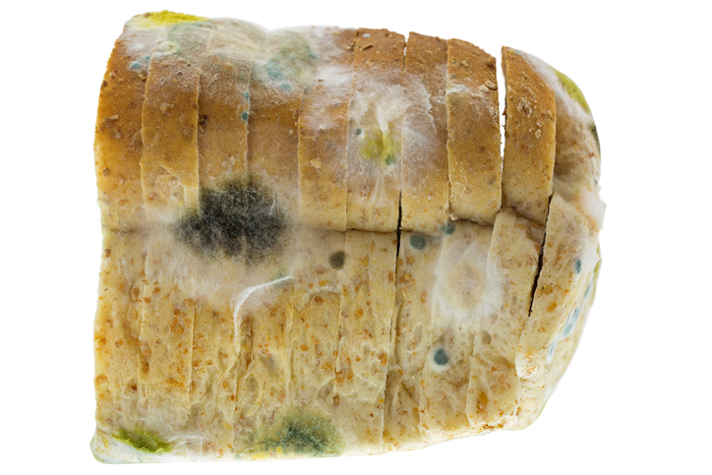
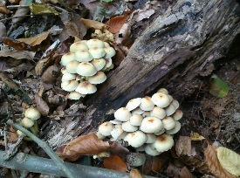
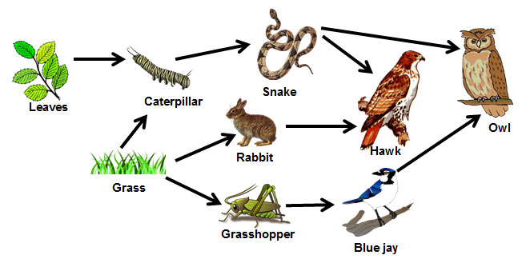
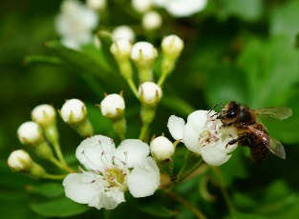
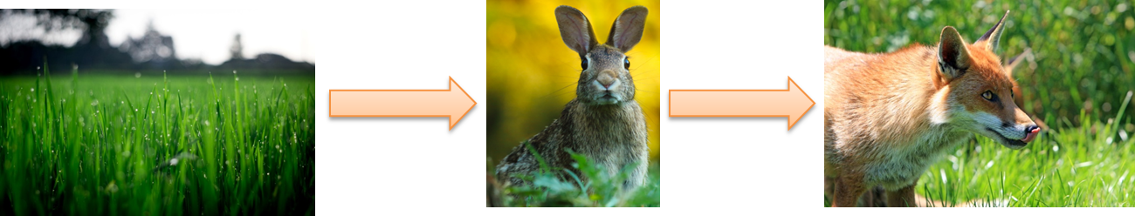
1. Ecosystems
Individual organisms which live together in particular environmental conditions in a habitat form an ecosystem.
In a stable ecosystem there are:
  Producers of food (plants)
  Consumers (animals)
  Decomposers (bacteria and fungi).
All animals depend on plants for their survival.
4. Energy and biomass in food chains
The arrows in a food chain show the flow of biomass or energy through the chain.
Not all the energy found in the biomass of plants at the start of a food chain makes it into the biomass of the top predator.
This is because not all of the organism is eaten (e.g. roots, bones) and some energy is transferred via faeces, urine, respiration, movement or heat.
6. Competition in plants and animals
In any ecosystem there is competition among species for the energy resources and the materials they need to live.
Plants compete for light, space, water and mineral ions.
Animals compete for food, mates and territory.
2. Decomposers
Decomposers are normally bacteria or fungi.
They breakdown dead plant and animal matter, releasing nutrients into the soil for plants to absorb.
If decomposers were removed from a habitat then organisms would not be broken down when they die.
7. Predator – prey relationships
Predators hunt and eat other organisms.
Prey are the organisms eaten by the predator.
The populations of predators and prey depend on each other.
If the population of prey decreases then so will the population of predators.
Interdependence and
Competition
3. Food chains
Food chains are feeding relationships between organisms in a habitat.
Food chains start with producers, normally plants, which produce food via photosynthesis.
Energy from the sun is used in photosynthesis.
5. Food webs
A food web shows all the food chains in an ecosystem joined together.
8. Pollination and food security
Pollinating insects are not just vital in food webs as a source of food, they are also needed to pollinate flowers to produce seeds and fruit.
The majority of food we eat
comes from food chains
which rely on plants which
need to be pollinated.
  © March 2019 PiXL Spine Strategy and templates: The PiXL Club Ltd. All rights reserved.

Slide 6
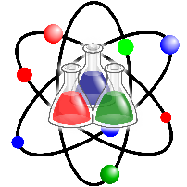
1. What is science?
Science is about finding explanations for why things happen or what makes things work.
An explanation is not a guess, there has be some basis for it.
Careful observation, including measurement where possible, can suggest what may be happening.
In some cases it is possible to make a change and observe what happens.
4. Repeats, repeatable and reproducible
Repeating an experiment enables us to calculate an average and shows the experiment is repeatable. A measurement is repeatable if the same scientist uses the same method and gets the same result.
What people expect to happen can influence what they observe. It is good for the same experiment to be repeated by a different person. If they get the same result then the measurement is reproducible.
6. Graphs
Data can be displayed in a graph to help identify trends or correlations.
Data points should be marked with a cross. The plotted points should fill at least half the paper.
Axes should be labelled with the variable and the unit.
The line of best fit can ignore anomalous data and can form a curve, not just a straight line.
2. Hypothesis and prediction
A hypothesis is a possible explanation or reason for why something happens.
A prediction is what a scientist thinks will happen if the independent variable in an experiment is changed.
7. Averages and decimal places
Calculating an average in science usually involves finding the mean, but can also include the mode or median value.
When calculating a mean, make sure the answer never has more decimal places than any of the data values you used.
When rounding up, use the deciding digit to decide whether to round up or down.
Scientific method
3. Variables
The independent variable is the variable the scientist changes to observe what happens.
The dependent variable is the one which is measured to see if changing the independent variable had an effect.
The control variables are kept constant so that the result can only be the effect of changing the independent variable.
5. Recording data
Data should be recorded during any practical work; this is normally in a table. Tables should have:
  Clear headings with units
  Independent variable in the first column
  No units in the body of the table
  Consistent number of decimal places
8. Conclusion and evaluation
A conclusion contains a description and explanation of any trends or patterns in the data. It also looks back at the hypothesis and related prediction to see if they were correct.
An evaluation looks at the data to see how precise or accurate it is. It identifies any anomalous data and identifies sources of error in the method.
  © March 2019 PiXL Spine Strategy and templates: The PiXL Club Ltd. All rights reserved.

