Slide 1

Prospect MFL department
MFL stands for Modern Foreign Languages
When you join year 7 at Prospect school, you will be learning either French or German.
On the following slides you will find some activities to do which will develop your knowledge of the countries where these two languages are spoken.

Slide 2

Francophone countries
Did you know that French is spoken by as many as 235 million people around the world?
French is not only spoken in France.
On the map on the following slide, some of the countries in the world where French is spoken have been coloured in orange. Can you find out the names of the numbered countries on a map and fill them in on the next slide?

Slide 3

Part 1
Français (French)
Pronounced a bit like this: Fronsay

Slide 4
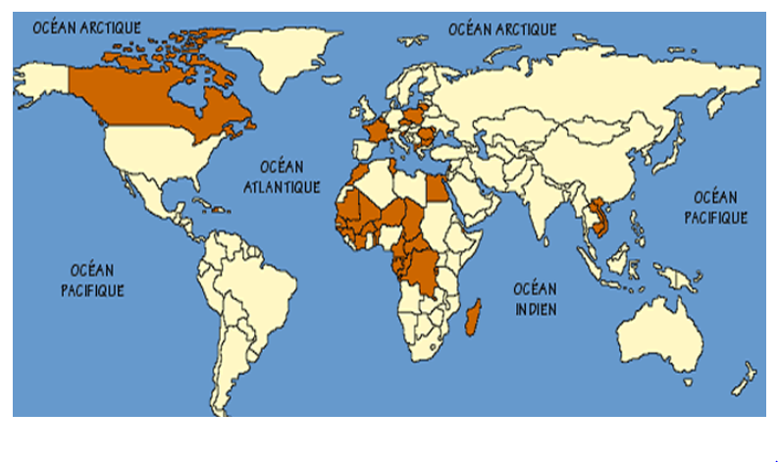
3&4
1
2
5
6
21
11
7
8
19
20
14
9
10
15
12
16
17
13
18

Slide 5
Francophone (French-speaking) countries
Type the names of the countries here:
1 | 11
2 | 12
3 | 13
4 | 14
5 | 15
6 | 16
7 | 17
8 | 18
9 | 19
10 | 20
 | 21

Slide 6
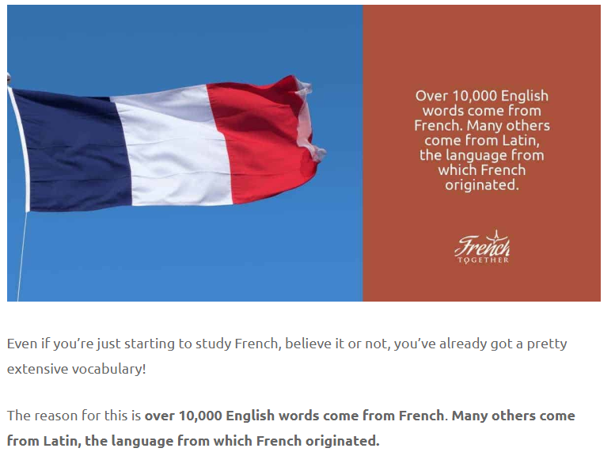

Slide 7
Here is a list of words we use in English which we have borrowed from French. Can you find any more to add to the list?
restaurant
café
omelette
menu
courgette
aubergine
silhouette
brunette
chauffeur
déjà-vu (that feeling you get when you think you’ve experienced something before).
entrepreneur
fiancé
souvenir
bouquet
ballet

Slide 8
These French words have a VERY similar English translation. Can you work out what they mean?
hôpital -
forêt -
dîner -
pique-nique -
chocolat -
aéroport -
famille -
histoire -
oncle -
musique -
horreur -
théâtre -
tigre -
magique -
carotte -

Slide 9
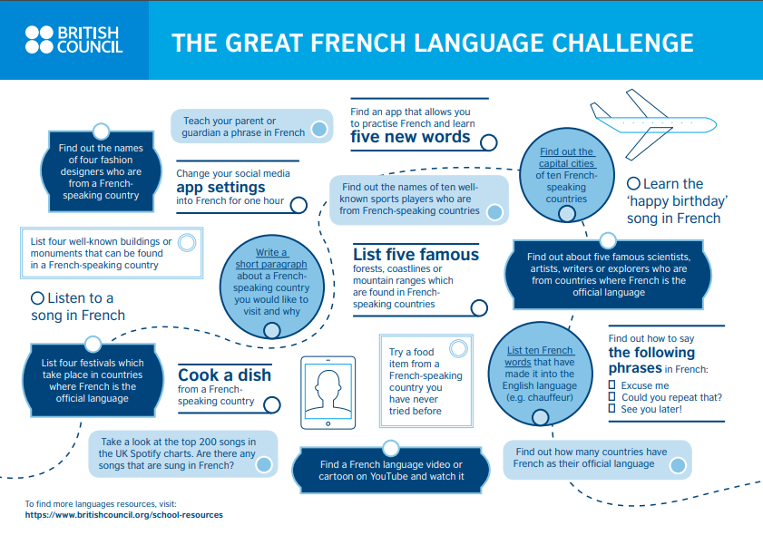

Slide 10
Part 2
Deutsch (German)
Pronounced a bit like this: doy-ch

Slide 11
German is one of the world’s top ten most commonly spoken languages, with over 132 million speakers worldwide.
Officially, there are six German speaking countries in Europe. Can you work them out from these anagrams? (Rearrange the words to find the name of the country. Answers at the end of this booklet)
angry me
tau sari
lizards newt
lime bug
box gum rule
stitch eel nine

Slide 12
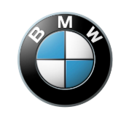

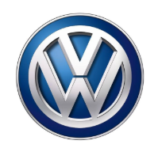


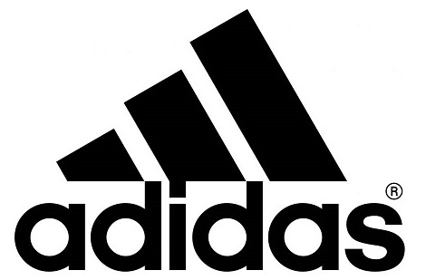

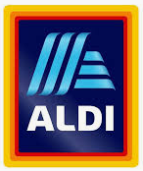

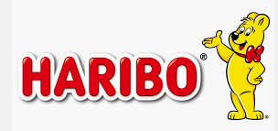

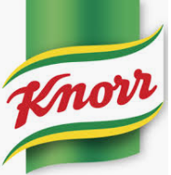


There are many German brands and companies that we are very familiar with in the UK. Do you recognise them from these logos (part of them has been hidden)? Answers at the end of the booklet.

Slide 13
There are many German words which we use in English. Do you know what these mean? Can you find any others?
Poltergeist
Rucksack
Abseil
Delicatessen (Delikatessen)
Kindergarten
Waltz
Dachsund
Eiderdown
Bagel
Schnauzer
Knapsack
Hamster
Angst

Slide 14
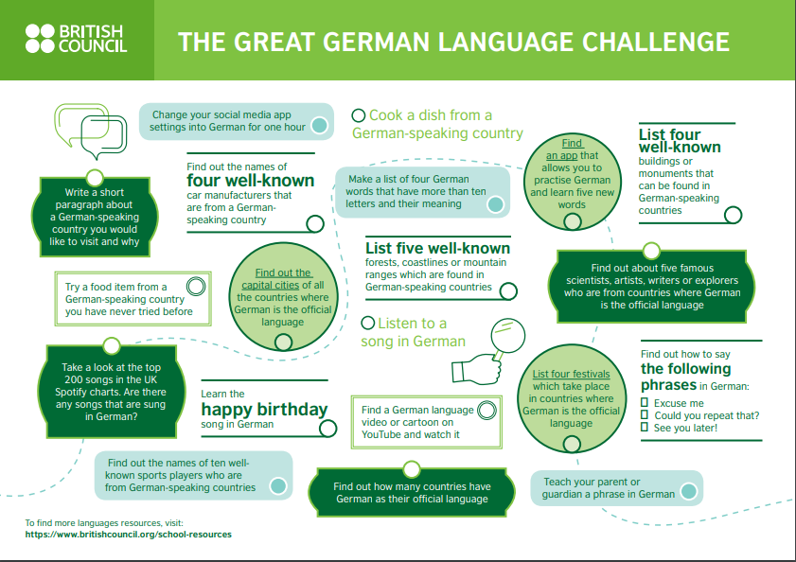

Slide 15
What can you remember? Test yourself
How many people in the world speak French?
Name an African French-speaking country.
Name 3 French words which we use in English.
How do you spell the French word for picnic?
Name 3 countries in Europe where German is an official language.
Name 5 German brands or companies that are popular in the UK.
What is the German word for back pack?
How do you spell the German word for a type of ghost? (Begins with P)

Slide 16
Mini research project.
Choose a French or German speaking country
Find out as much as you can about this country:
What is the population?
What is the capital city?
Find out what the flag is, draw it and colour in.
What currency is used in the country?
Find a map of the country – where in the world is it?
What is the main religion practised in the country?
What are some of the traditional foods?
What are the famous places/interesting places to visit?
What are the most popular sports?
Who is in charge of the country?
Any other interesting information.

Slide 17
Answers to tasks

Slide 18
Francophone (French-speaking) countries
Type the names of the countries here:
1 Canada | 11 Egypt
2 France | 12 Central African Republic
3 Belgium | 13 Democratic Republic of Congo
4 Switzerland | 14 Senegal
5 Morocco | 15 Guinea
6 Tunisia | 16 Ivory Coast
7 Mauritania | 17 Burkina Faso
8 Mali | 18 Madagascar
9 Niger | 19 Cambodia
10 Chad | 20 Vietnam
 | 21 Haiti

Slide 19
These French words have a VERY similar English translation. Can you work out what they mean?
hôpital – hospital
forêt – forest
dîner – dinner
pique-nique – picnic
chocolat – chocolate
aéroport - airport
famille – family
histoire – history
oncle – uncle
musique – music
horreur – horror
théâtre – theatre
tigre – tiger
magique – magic
carotte - carrot

Slide 20
German is one of the world’s top ten most commonly spoken languages, with over 132 million speakers worldwide.
Officially, there are six German speaking countries in Europe. Can you work them out from these anagrams? (Rearrange the words to find the name of the country. Answers at the end of this presentation)
angry me = Germany
tau sari = Austria
lizards newt = Switzerland
lime bug = Belgium
box gum rule = Luxembourg
stitch eel nine = Liechtenstein

Slide 21
There are many German brands and companies that we are very familiar with in the UK. Do you recognise them from these logos? Answers at the end of the presentation.

Slide 22
There are many German words which we use in English. Do you know what these mean? Can you find any others?
Poltergeist | type of ghost
Rucksack | back pack
Abseil | descend by rope
Delicatessen (Delikatessen) | proper name for a deli
Kindergarten | nursery school
Waltz | type of dance
Dachsund | breed of dog (sausage dog)
Eiderdown | a type of quilt filled with duck down
Bagel | a type of food
Schnauzer | a breed of dog
Knapsack | a type of bag
Hamster | small animal
Angst | fear/worry

