Slide 1
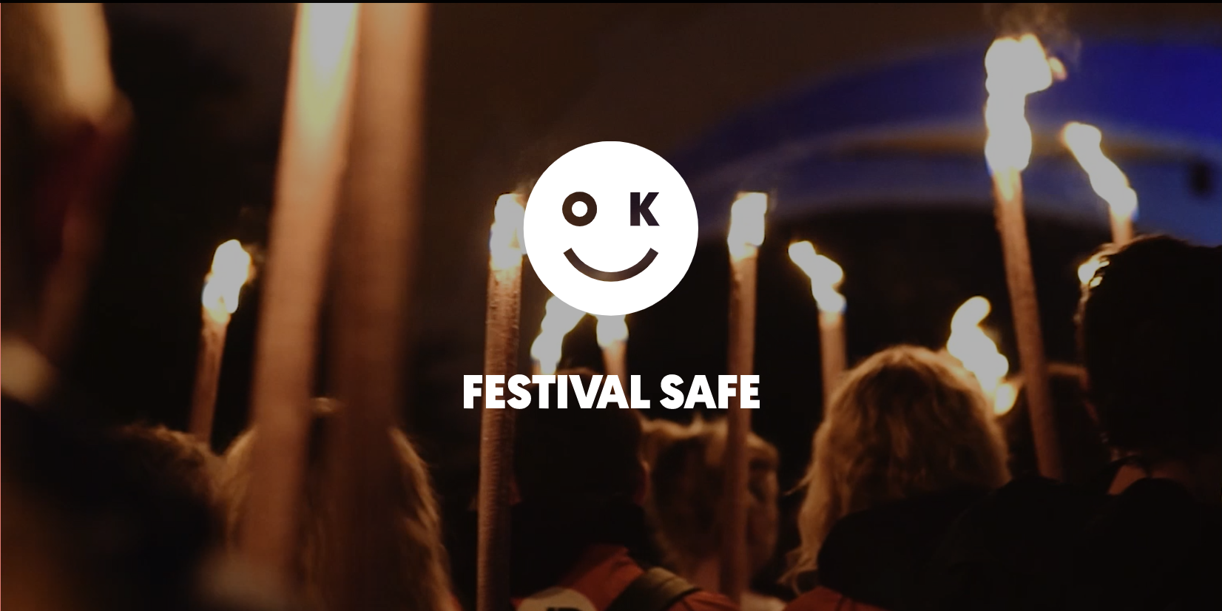
www.festivalsafe.com

Slide 2
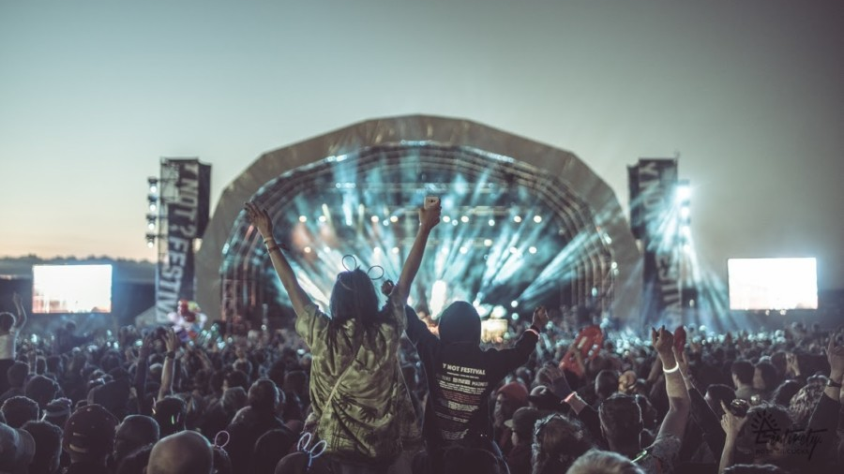
Festival First Timer
What to expect
Facilities
Festival welfare
Security
Getting around
Crowds
Toilets!!!

Slide 3
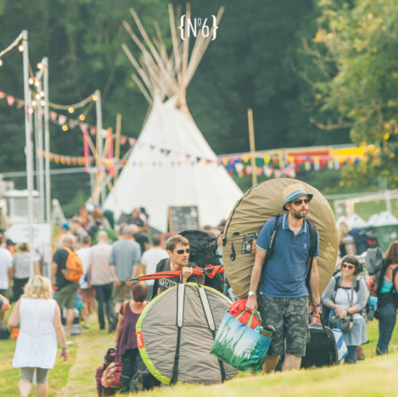
Be Prepared
Ticket Fraud
What to bring
Money
Kit List
Vaccinations
Transport
Registering for ID
Accessibility

Slide 4
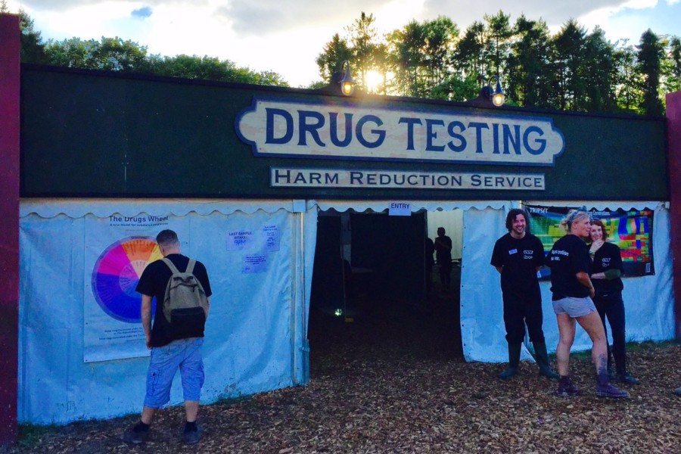
Alcohol and other drugs…
Understanding the law
Avoiding Harm
Drug Testing
Spiking
Further Info
  The Loop
  Talk to Frank
  Drink Aware

Slide 5
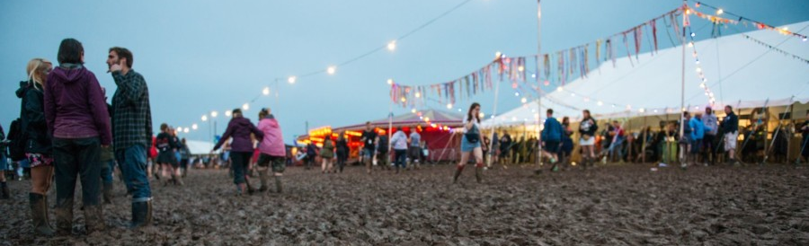
Well-Being
Mosh Pit Rules
Festival medics
Top 10 medical complaints
Sexual health
Mental health
Useful links
  Mind
  Samaritans
  Brook

Slide 6
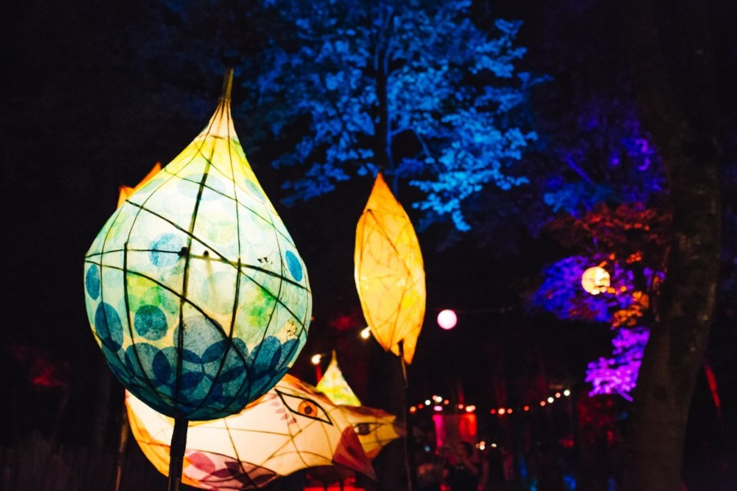
Safer Spaces
Zero Tolerance to assault and Harassment
AIF Safer Spaces at Festivals
Creating a Culture of Respect Consent is like a Cup of Tea
Reporting
Useful Links
  Rape Crisis
  Safe Gigs for Women
  Good Night Out
  Girls Against
  White Ribbon

Slide 7
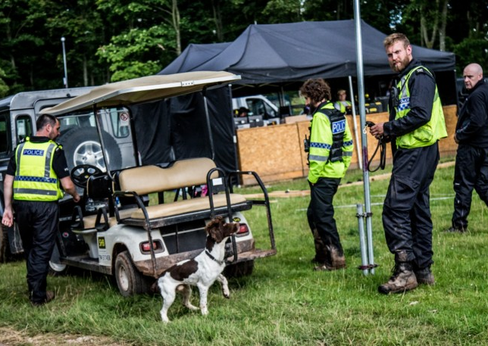
Crime
Theft and Robbery
Antisocial behaviour and violence
Sexual assault and harassment
Drugs
Drink and drug driving
Counter terrorism
Thames Valley Police

Slide 8
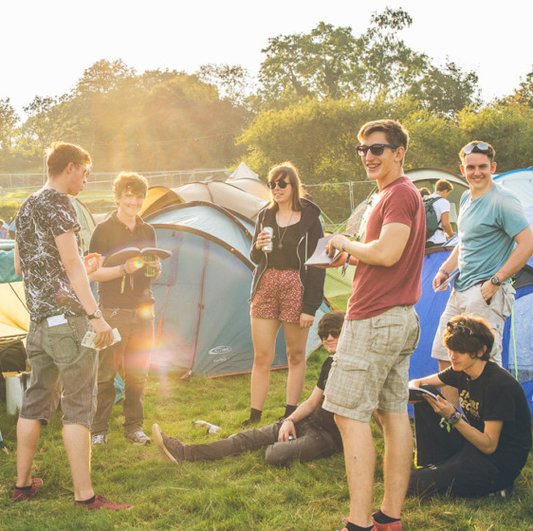
Sustainability
Be a Green Festival Goer
Useful links
  Friends of the Earth
  A Greener Festival
  Festival Essentials

Slide 9
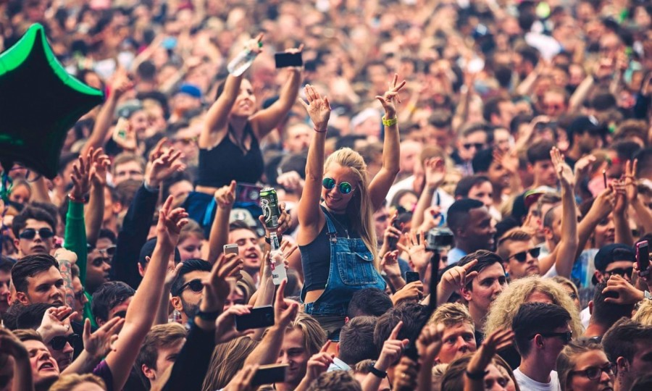
Have an amazing summer!

