Slide 1
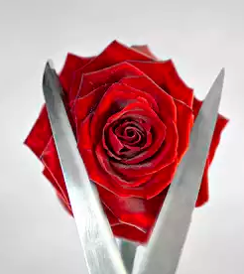
Female Circumcision,
Female Genital Mutilation and
Cutting

Slide 2
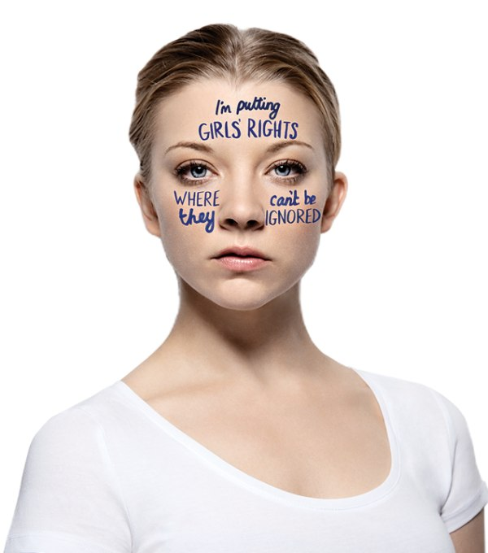
Female Genital Mutilation (FGM), also called female circumcision, cutting or sunna, is when a girl's external genitals (private parts) are cut away. Sometimes their vagina is sewn up too.

Slide 3
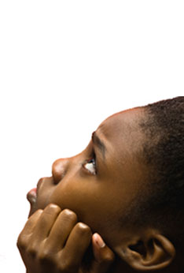
Female Genital Mutilation (FGM) is abuse
It’s wrong and it shouldn’t be happening.
FGM is illegal in the UK – it’s also illegal to arrange for someone to be taken out of the country to be cut.
There are no medical reasons to carry out FGM.
Religious, social or cultural reasons are sometimes given however FGM is dangerous and a criminal offence.
The police can protect you if you think you are at risk of being cut (FGM).

Slide 4
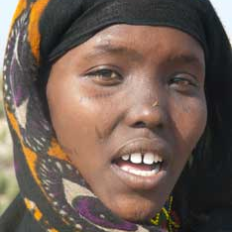
Hadas’ Story
Hadas is from a country in Africa called Eritrea. She underwent FGM when she was a baby. This is her story.
Notes:
I come from a country called Eritrea. In Eritrea we call circumcision ‘girizat’. The word is a slang term for both the circumcision of boys and the female genital mutilation of girls.
Circumcision is a religious thing for boys. For girls it is a cultural thing, and it involves a girl’s vagina being cut in different ways in a dangerous procedure. I didn’t know this until I came to the UK, as I was too young to remember having it done myself.
Back home, we never talk about this kind of thing. It is strange to speak about it now.
In my culture, it's believed that when the vagina is cut, the desire to have sex is cut as well. My culture believes that sex is only something a woman does with her husband to have children.
Most people in Eritrea think that if a girl is cut, she will grow up to be a good girl— that she will not bring shame on her family and she will marry well. If a girl is not cut, they think she will grow up to be a ‘slut’— a girl who thinks about sex and will not be satisfied by one man. Most people feel this way in my country and it is only those who are educated that disagree with cutting. My mother used to warn me that bad things would happen to a girl who was not cut.
I was cut when I was only a few months old so it is something I have no memory of. The first time that I became aware that I had been cut was when I overheard my parents fighting. My father was an educated and modern man who disagreed with the belief and culture of cutting. My mother was from a traditional family and from a different community of people to my father. My father blamed my mother for my 'girizat'.
My mother had taken me to be cut while my father was away on business, as she knew he would not have allowed it. I was cut and sewn up when I was just a few months old, and when my father found out he was furious. The first time I heard about cutting was from overhearing my parents fight about it, which they did throughout my childhood. I am not angry with my mother for taking me to get cut. My mother is a traditional person and hasn't been educated about it. She thought she was doing the best for me.
I believe cutting is something that should be stopped. It is a disgusting practice that many people only do because they believe that the stories around it are true and they are uneducated. I do not think that people really understand the problems which female genital mutilation can cause for girls. I didn’t understand myself until I was told.
I look ahead and see problems in my future with any relationships that I choose to have because I'm afraid that sex will hurt. My periods are painful too and I’ve been told it will be very painful to give birth.
I think that education is the most important thing in helping people to change their views about cutting. I think they should have more information on female genital mutilation in clinics. Nurses give talks to all people on AIDS back home, and they need to do the same thing with female genital mutilation to tell people the truth. If you teach people that they can still keep their culture without mutilating girls, this would be better.
When I am with my friends from Eritrea like me, we still don’t mention female genital mutilation. My friends and other young people will talk about boyfriends and sex, but they are embarrassed to talk about cutting, even though it is something that we have all been through. I've never been told about a girl having female genital mutilation in the UK as we don't talk about this kind of stuff.

Slide 5
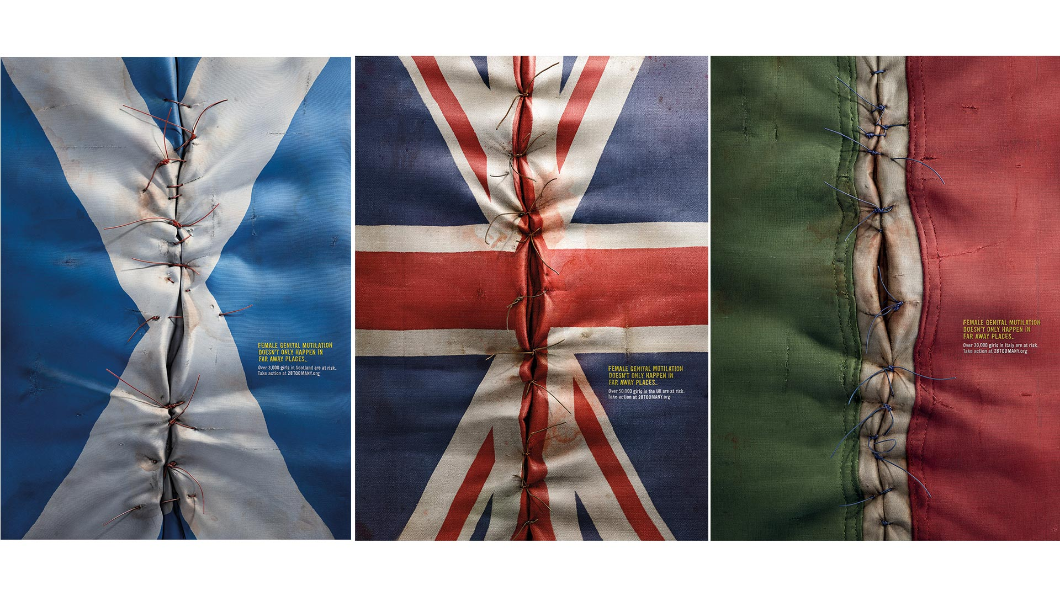
What’s this got to do with me in the UK?

Slide 6
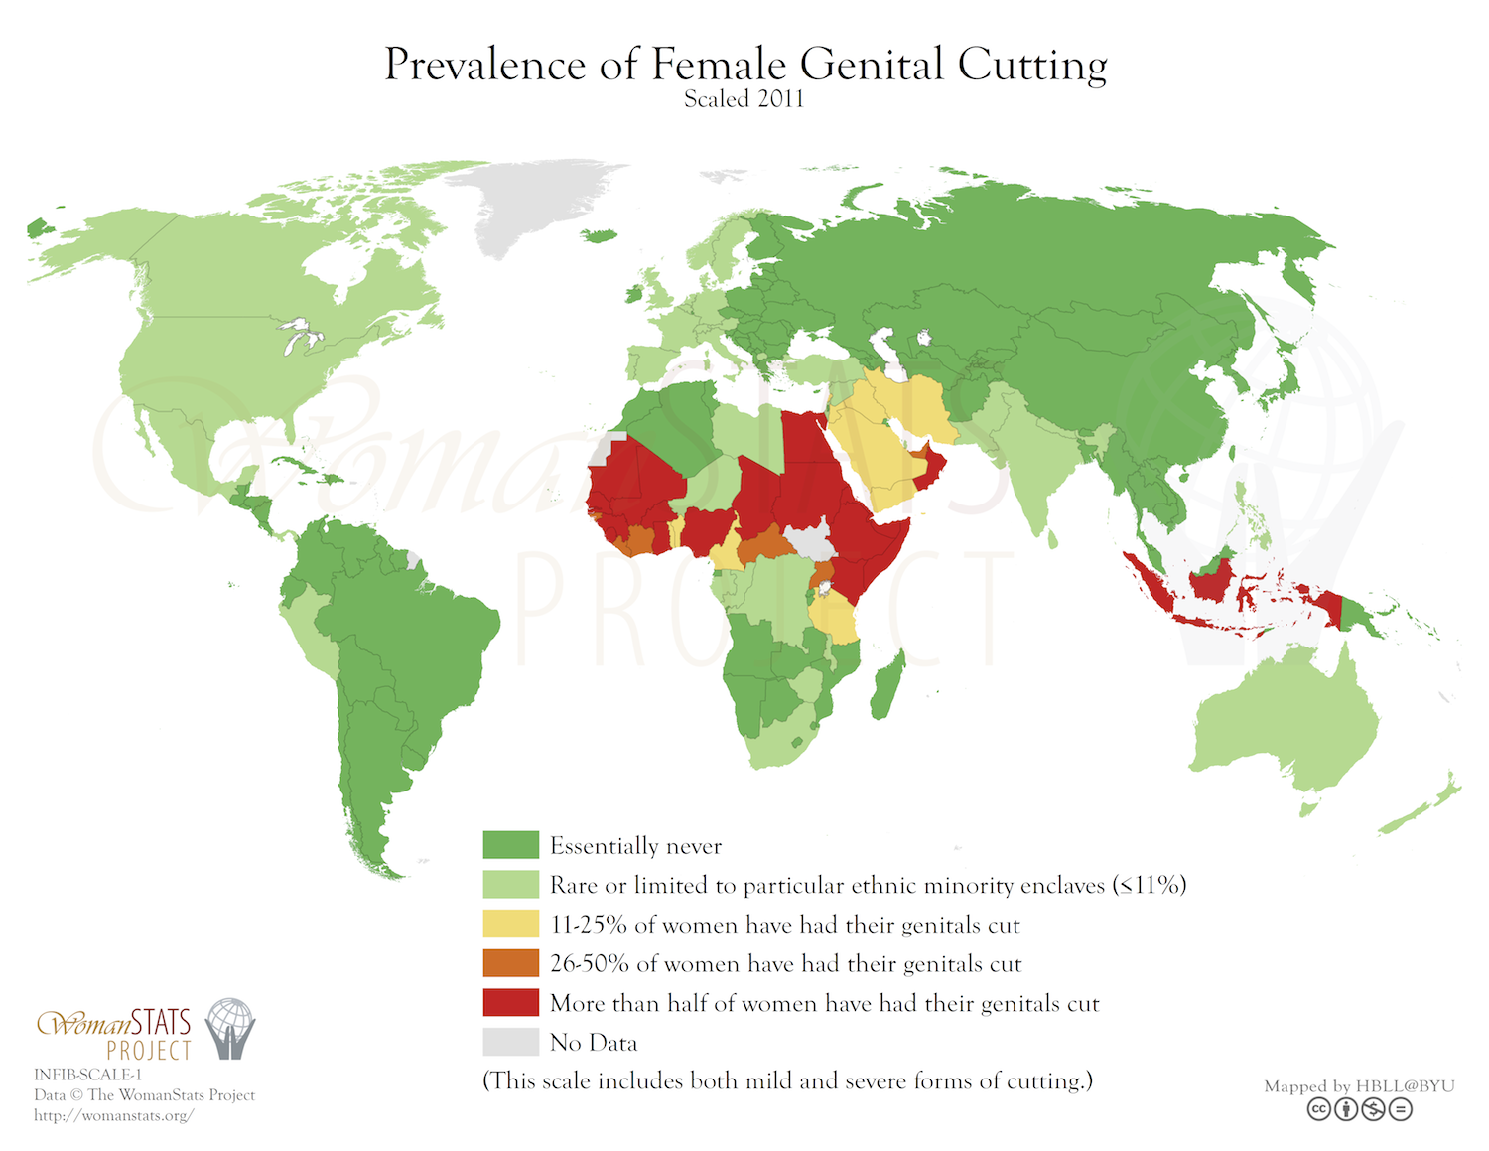

Slide 7
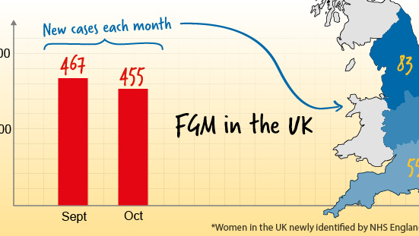
Where is FGM happening in the UK?
FGM is an issue in the UK because so many people have settled here from countries where FGM is commonly practiced. It is estimated that 170,000 girls and women living in England and Wales are survivors of FGM. Many of these had FGM before coming to this country. Approximately 65,000 girls under the age of 13 who have been born in England and Wales are at risk of FGM.
There are more cases of FGM in large cities and towns, for example, London, Cardiff, Manchester, Sheffield, Northampton, Birmingham, Reading, and Coventry as they are home to high numbers of people from countries where FGM is practised

Slide 8
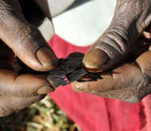
How is FGM carried out?
FGM is usually carried out by an older woman, sometimes known as a "cutter". In nearly all cases girls are not given any pain relief. Girls are usually held down so that they cannot move while their private parts are being cut.

Slide 9
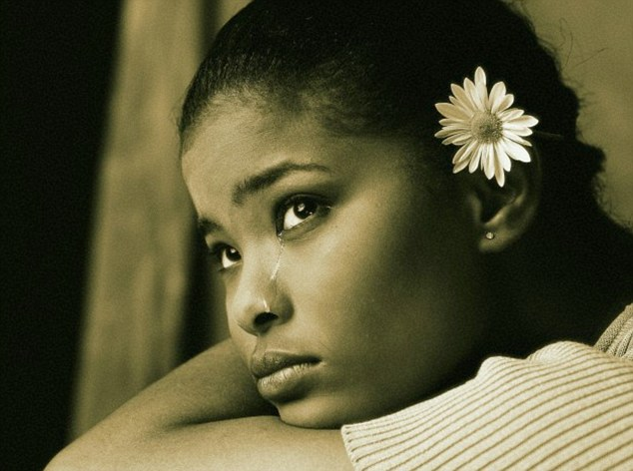
How will FGM affect my health?
FGM has NO health benefits and causes lots of problems.
Physical Problems
These include problems from actually being cut and problems which happen afterwards. Some of these problems are:
Extreme pain
Infection
Severe bleeding
Pain when having a wee
Constant urine infections
Problems in becoming pregnant
Difficulties when in labour and childbirth
Difficulties with physical relationships
Death from bleeding
Psychological Problems
FGM can also cause psychological or mental health problems for girls, which may stay with them for life. These can include:
Feeling frightened
Feeling worried or anxious
Feeling depressed
Feeling traumatised or in shock
Feeling alone
These problems can sometimes lead to difficulties at school and college and future relationships with sexual partners. They can also cause girls to feel betrayed by their families.

Slide 10
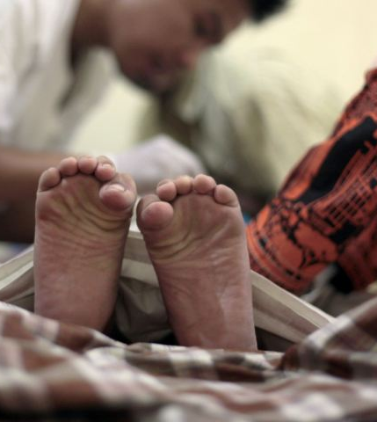
Why is FGM practised?
FGM has been practiced by many ethnic groups across the world for hundreds of years. It is a cultural practice and is passed on from generation to generation. In these communities families tend to accept what their elders e.g. grandmothers and grandfathers tell them to do as they are seen as "wise" people.
Cultural tradition often means that FGM is seen as an important part of raising a daughter. One of the reasons for this is that families believe that a girl, who is cut, is pure and clean and will find a good husband who will look after her in the future.
Parents of girls who are not cut say they may find it hard to find a husband for their daughters and will find themselves and their family cut off and ignored by the community. Many mothers and fathers believe FGM is normal and that they are doing the "right" thing by allowing their daughters to be cut.
It is very difficult for anyone to speak out against the cultural traditions of their community

Slide 11
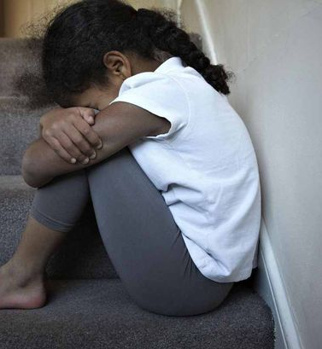
Across the world it is estimated that 125 million girls and women are survivors of FGM. Most of these live in just 29 African and Middle Eastern countries.
However FGM can be found in other regions, including SE Asia, and of course in Europe including the UK.
In some communities, a girl who is not cut is seen as unclean. FGM is seen as a way of making sure that girls are pure and remain virgins until they marry.
Mothers know that FGM is extremely painful and dangerous, because they have experienced it themselves. However, they believe that it makes their daughters tougher and prepares them for future challenges such as childbirth.

Slide 12
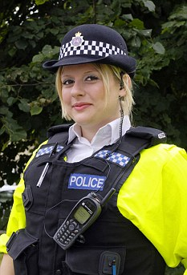
FGM is illegal in the UK
In the UK FGM has been a criminal offence since 1985 (Female Circumcision Act). In 2003 the law was updated and renamed the Female Genital Mutilation Act. This means that anyone found to be involved in FGM including sending girls abroad for FGM can be prosecuted and sent to prison for up to 14 years.
Under UK law FGM is regarded as a human rights issue. When it involves a girl under 18 years it is regarded as child abuse and when it involves a women over the age of 18 it is treated as violence against women.

Slide 13
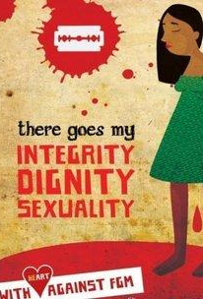
Someone I know is at risk of being cut, what can I do?
If you are worried about someone and think they might be at risk of being cut, you could try to talk to them about it, in private, when there's enough time to chat properly.
It would be helpful to suggest they could contact ChildLine or talk to an adult they trust.
You could also think about telling someone what is happening, it’s a lot to cope with on your own and an adult should be able to help you get support. You could talk to a trusted adult like a teacher, a youth worker or a doctor.

Slide 14

What to look for: Signs of FGM
A girl or woman may:
- have difficulty walking, sitting or standing
- spend longer than normal in the bathroom or toilet
- have unusual behaviour after an absence from school or college
- be particularly reluctant to have normal medical check-ups
- ask for help but not tell you exactly what the problem is due to embarrassment or fear
You can always talk to ChildLine, we can help you think about how to support your friend.

Slide 15

I think I'm in danger of being cut (undergoing FGM), what do I do?
If you think you are in immediate danger of being cut or being taken abroad for this to happen you can call the police (dial 999).
ChildLine are here for you too. You can contact us online for a 1-2-1 chat or phone free on 0800 1111.

