Slide 1
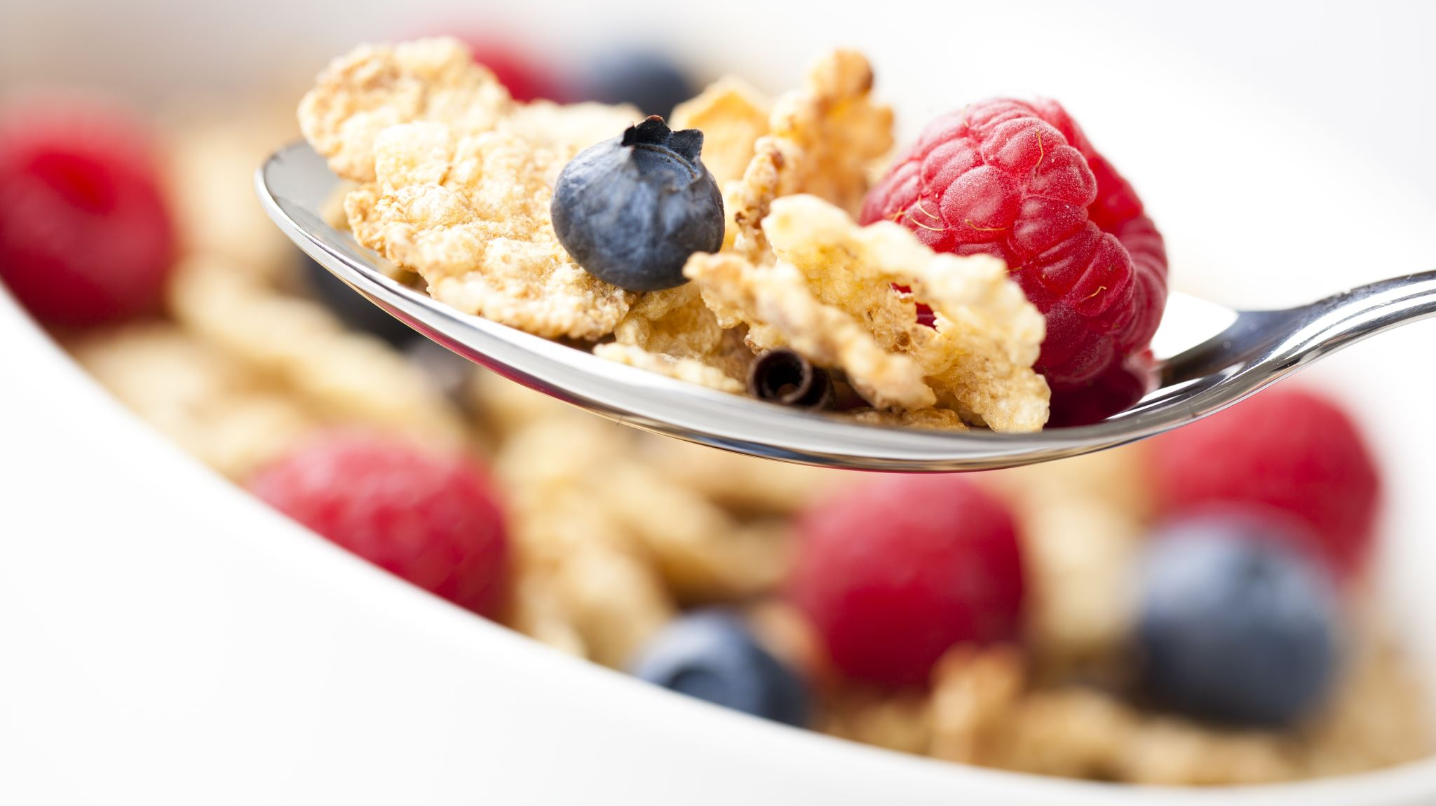
Healthy Eating
Welcome year 7

Slide 2

Why do we need to eat healthily?
Think about what you had for breakfast this morning and what you have for your lunch?

Slide 3
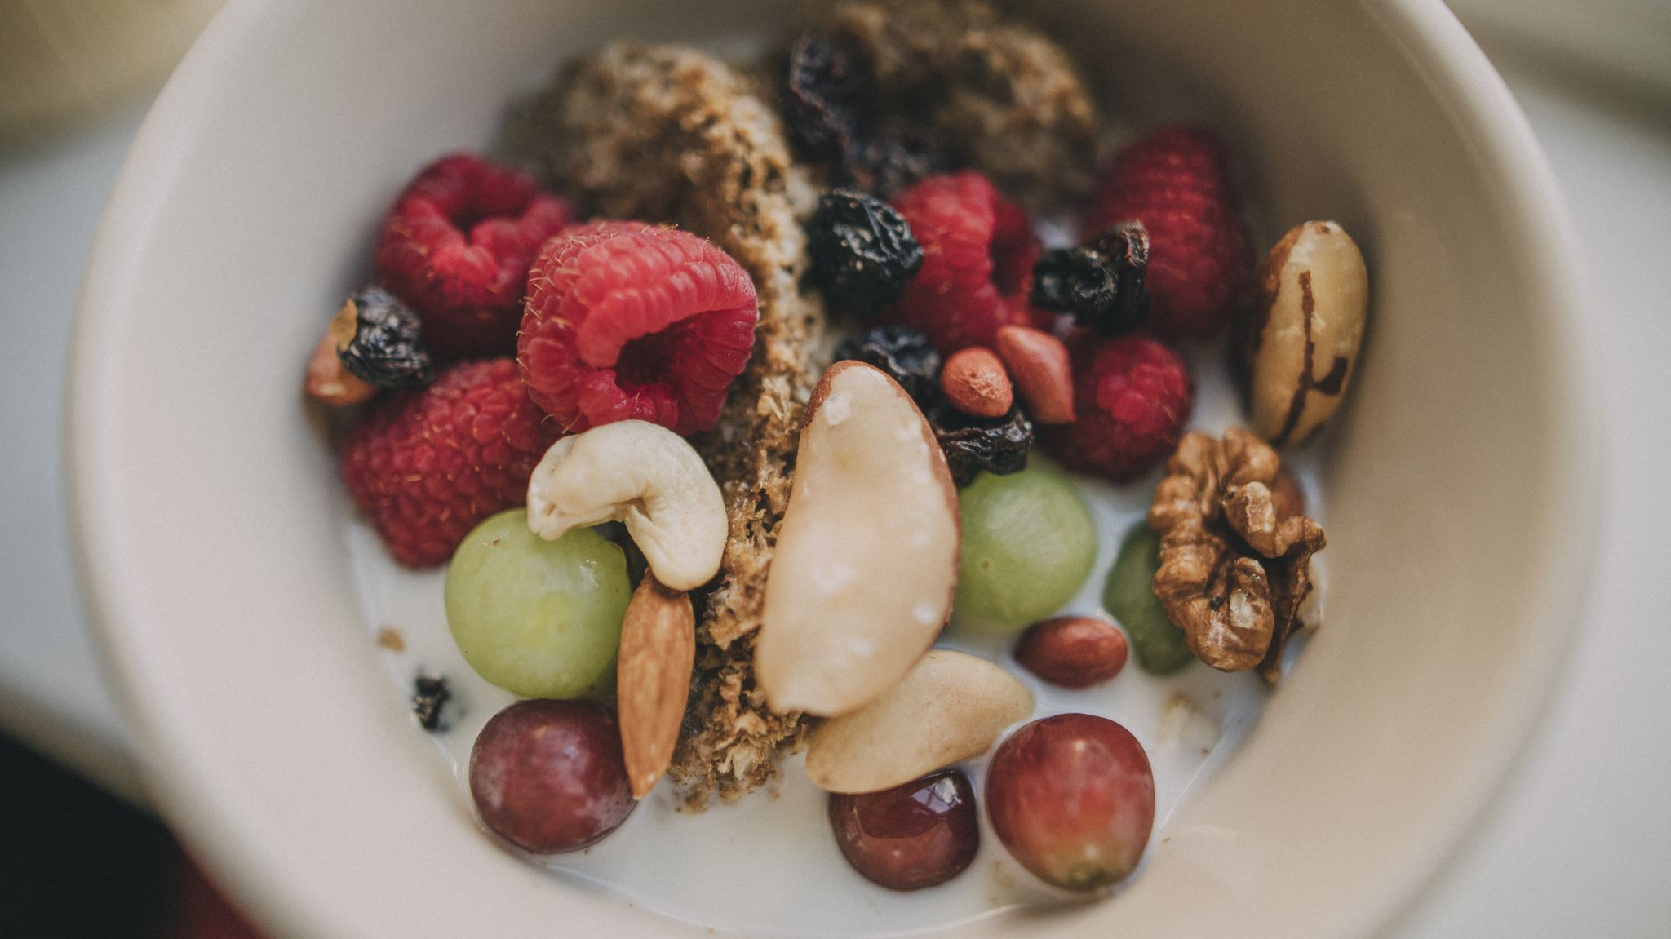
Healthy eating
Food is essential for life and necessary for health and well being

Slide 4

What do you know about the food you eat?

Slide 5

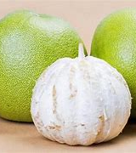
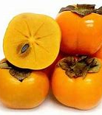
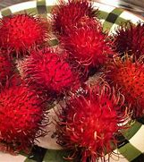
Do you know what these foods are?

Slide 6
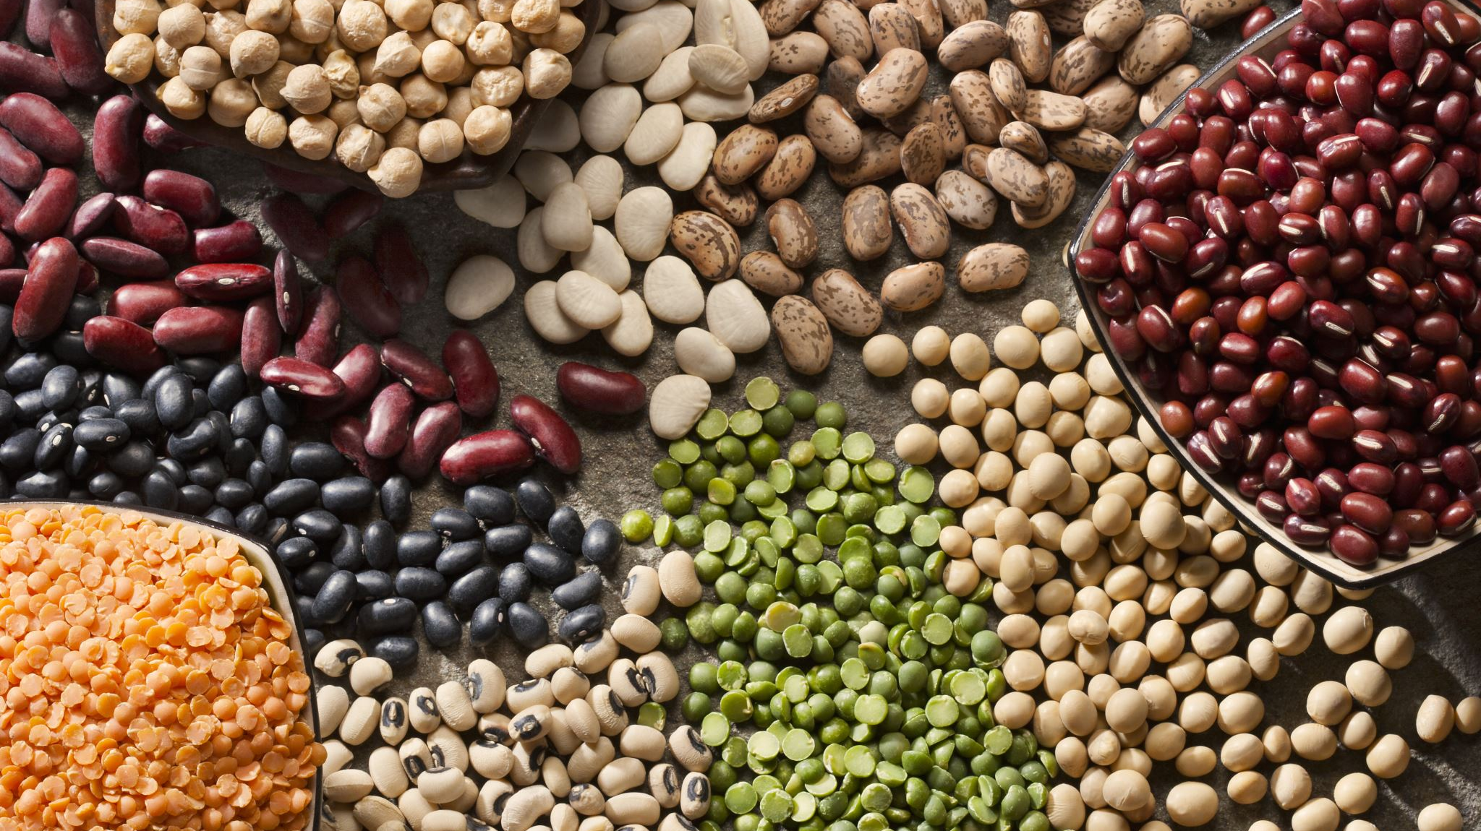
Do you know what the different food groups are?

Slide 7
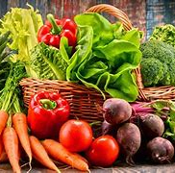
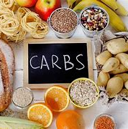
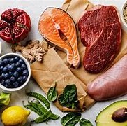

They are
Fruits and vegetables – at least 5 portions a day. It should be up to a third of your daily diet
Starchy carbohydrates – potatoes, bread, pasta. This gives you energy.
Dairy (or dairy alternatives) – this is an important source of calcium which keeps our bones healthy
Protein – beans, pulses, meat and fish. This is important for growth and repair of tissues in the body.
Fats and sugars – these need to be eaten less often and in small amounts

Slide 8

Also drink lots of water
6 – 8 cups or glasses a day

Slide 9
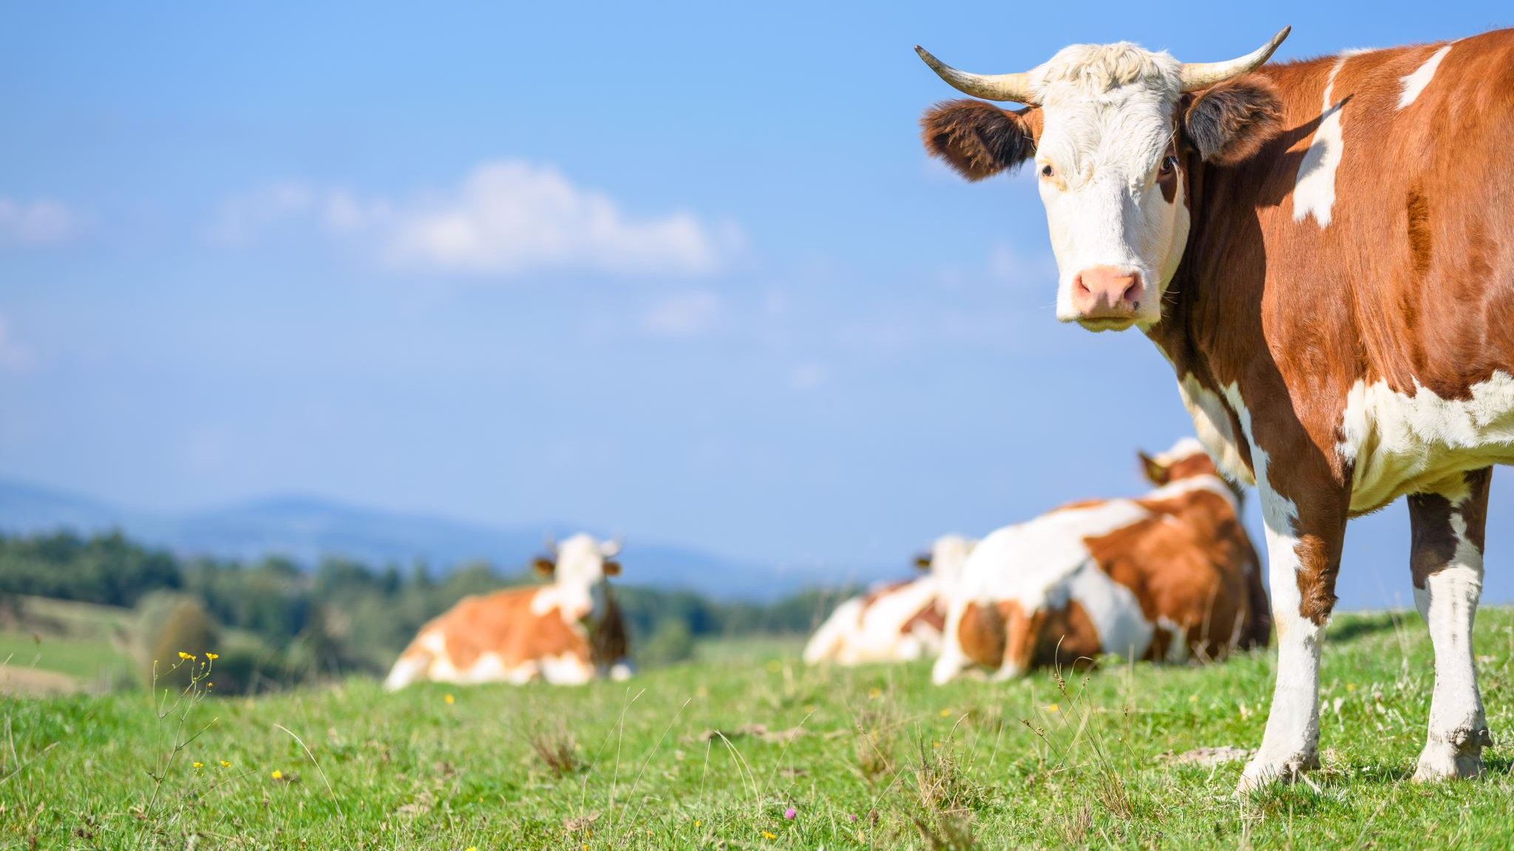
Question 1
Cows are usually milked once a week
False: they are milked twice a day

Slide 10
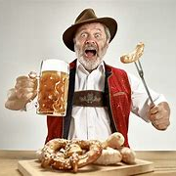
Question 2
Sauerkraut is a German dish made from cauliflower
False – it is made from cabbage

Slide 11
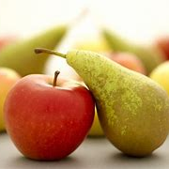
Question 3
The peel of apples and pears are very nutritious
True – but wash them thoroughly

Slide 12

Question 4
Welsh rarebit is suitable for vegetarians
True it is actually a toasted cheese sandwich

Slide 13
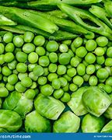
Question 5
Beansprouts are a cross between runner beans and brussel sprouts
False – they grow from mung beans

Slide 14

Question 6
Whole milk has more calcium than semi-skimmed milk
False – semi skimmed milk has more calcium

Slide 15

Question 7
Cereals that include the whole grain are more nutritious than those without
True – these are better for you

Slide 16
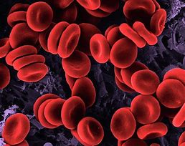
Question 8
Iron is needed to help form red blood cells
True – a lack of iron could mean you are anaemic

Slide 17
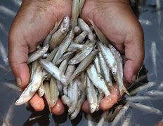
Question 9
Salmonella are small fish
False – it is one of the food poisoning bacteria and can be found in eggs and meat

Slide 18
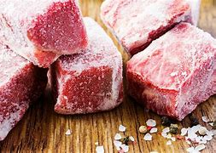
Question 10
Meat that is frozen is not as good for you as fresh meat
False – it can be just as nutritious

Slide 19
Why is it important to eat healthily?
To stop you from getting diseases such as
Obesity - Obesity elevates the growth risk of major types of health issues such as type 2 Diabetes, hypertension, heart diseases, fatty liver concern, kidney diseases, osteoporosis, cancer,
Osteoporosis
People who avoid the consumption of calcium and vitamin D rich foods in their day to day life are more likely to develop osteoporosis under which the bone density or bone mineral density get reduced in the affected person resulting in a weak and fragile bone.

Slide 20
Other diseases
High blood cholesterol - As a result of an infrequent flow of blood, the affected person can get a victim of chronic heart diseases, stroke, diabetes, metabolic syndrome, high blood pressure,
Cardio vascular diseases - cardiovascular diseases, stroke and heart diseases are the primary killers which started to develop along with obesity, high blood pressure, and high cholesterol level
Depression and anxiety - Some foods intake works as a mental health booster as it boosts the supply and production of the happy hormone in your brains such as serotonin and dopamine. These hormones are responsible for happy and positive feelings in your brain and body.

Slide 21
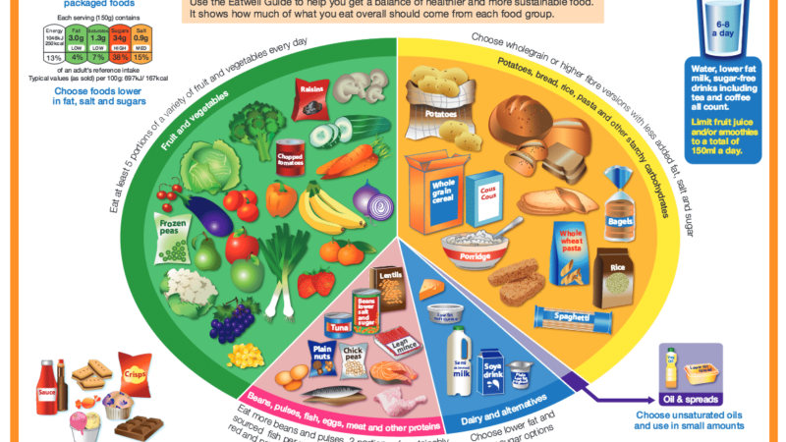
So it is really important that we all eat healthily
On your paper plates – create your own Eatwell plate so that you know what foods you should be eating and the amounts

