Slide 1
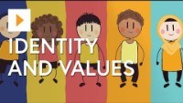

Wellbeing July 2021
Year 7 Our Values
First, what is a “value” anyway??
#careers2021 Careers
Notes:
Or rather what are your values?
Who can think of the school values why does the school have these do you think?
What Are Your Core Values?
To get a sense of what your core values are, ask yourself what activities bring you the most joy, or what you couldn’t live without. What gives your life meaning or what do you want to achieve?
Starting to think about your values is what guides companies and many successful people. At the heart of a healthy mental state is knowing your own mind. What influences you, Why you prefer one situation over an other? For instantons you might ask your self do you prefer being employed by a company or working for yourself? When we make decisions we all have a core of our character that defines us – this is our personal value system.
It can stop you agreeing to thinks you don’t like or feeling that you are going against what is important to you?
Can we think of any examples where Human Rights were and the simple value of human life was forgotten?
Taking responsibility
Understanding yourself and valuing who you are and what is important to you in life.
Values “are the principles that give our lives meaning and allow us to persevere through adversity,” according to psychologist Barb Markway and Celia Ampel in The Self-Confidence Workbook
I want you to take a piece of paper and draw your hand and on it put down the things in life that matter to you
Could be the people who you admire
Could be what YOU want out of YOUR life or what you want to achieve either at school or in life
Here is mine….teachers I would like you to do this too please…..
In order to do that you need to think about what is important to you and for you

Slide 2
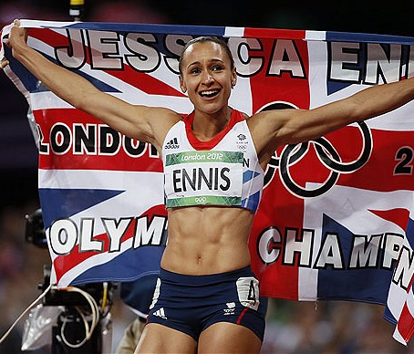
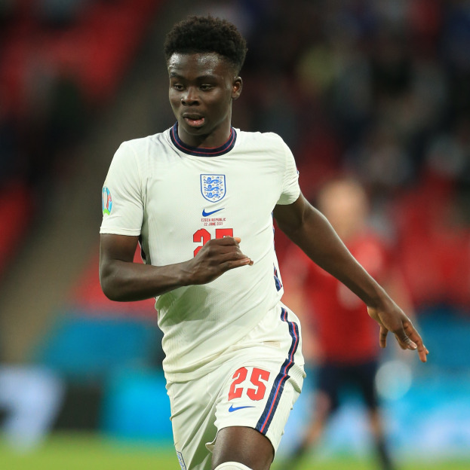
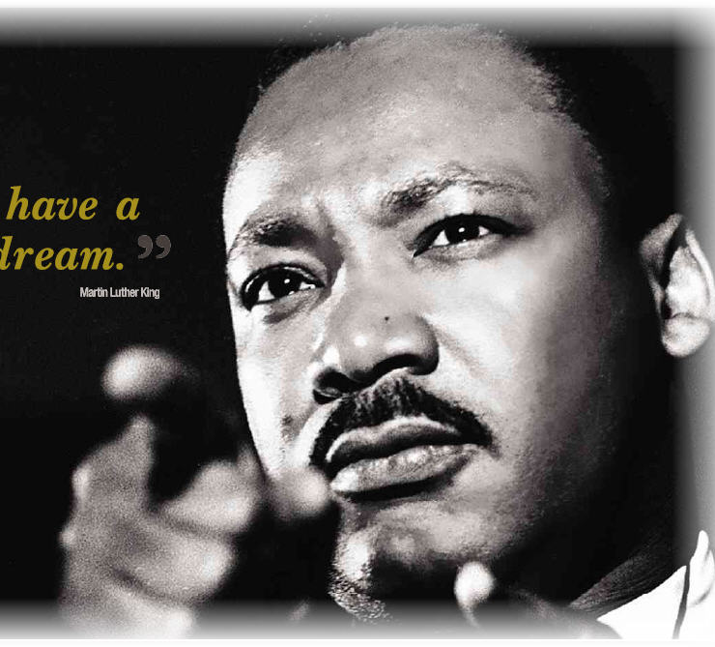
What do these people value?
You?
What do you value?
Notes:
Wanted every American person to have equal rights and opportunities. He valued equality and freedom
Bullied at school for being small
In 2008 broke ankle and couldn’t compete in Beijing Olympic Games.
Overcame this, rebuilt her career and became Olympic champion in the heptathlon Resilience
He valued his parents and the importance of an education he says that he knew that just like his football he needed to practice work hard and not give up He talks about practi

Slide 3
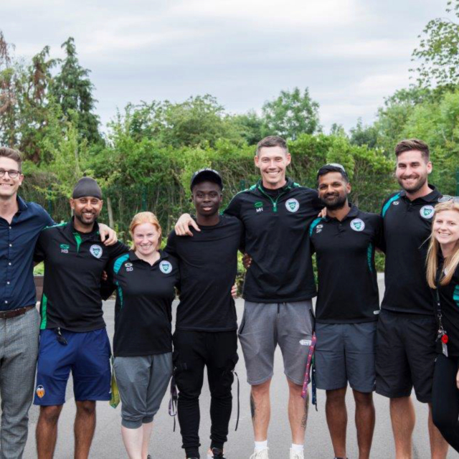
Notes:
His teachers say he was an A student (his parents pushed him to study) Appearing for England at the Euros has made Saka's school proud he talks about his time at school and how he valued being a team player and feeling like he needed to try hard a work value would be hard work he talks about how important it is to help people and really to be not just someone who helps himself but helps others - humble kind hard working the importance of learning and ambitions . He said that the reason he practiced and studied hard wasn’t because he felt smart of great at football he knew he had to work hard to achieve his goald he gained

Slide 4
Top 10 personal values:
Fulfilment I need to do a job that has meaning and rewarding
Inspiration I need to feel like I am inspired to try Health Is something we all take for granted
Family They inspire me everyday
Love I need to love and be loved
Creativity I need to be able to think outside the box
Success I need to feel like I am good at what I do
Truth I value this as an important part of a person myself
Integrity I just need to do the right thing

Slide 5
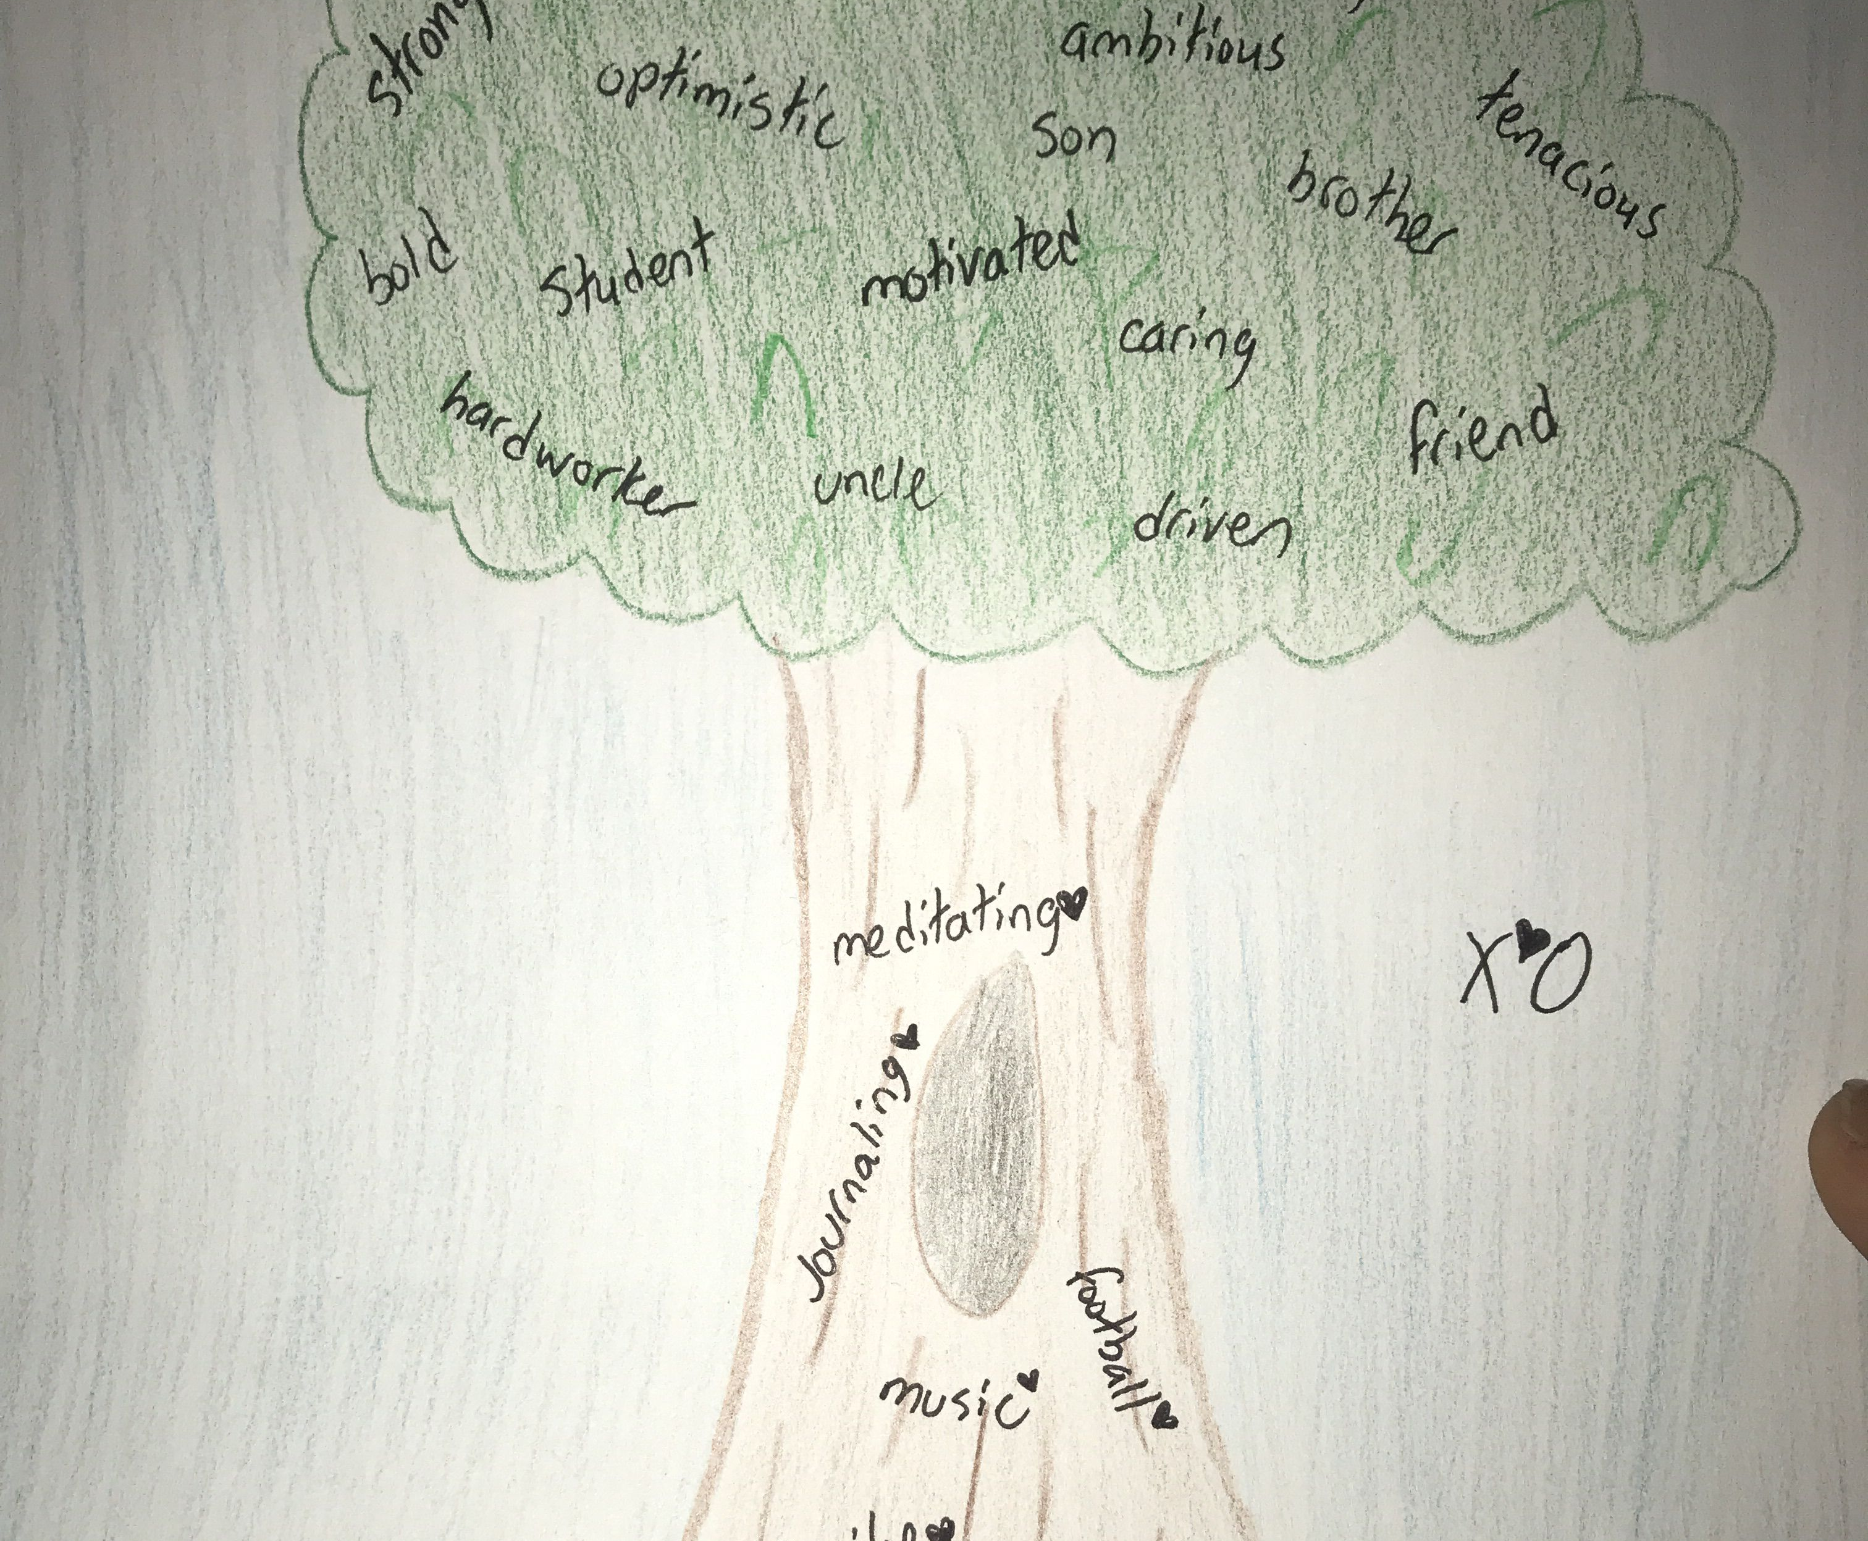
Notes:
I want you to draw a tree you can give it branches or just write the things that are important to you in life
What is important to you draw a TREE and on there I would like you put all the things that are important to you
Don’t worry about your drawing just think about what you love then think about subjects motivates you what are your ambitions for your life.
Don’t be afraid to be different to be unique to have ambitions for travelling the world gong to university getting a trade or running your own business I would to see some trees
Remember your values that we core wont change stay true to your core values as this is your compass
I would like to display these trees so make them look fabulous these are the Trees of Life – your life

Slide 6
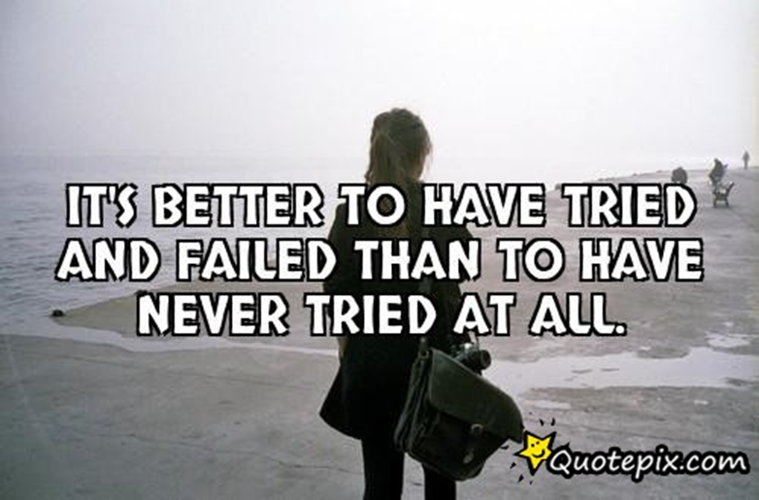
What about you?
Are you happy to –
Just make do
Hope for the best
Just get by
Or would you rather –
Be successful
Inspire others
Make yourself proud
Notes:
Starting to think about your values is what guides companies and many successful people. At the heart of a healthy mental state is knowing your own mind. What influences you, Why you prefer one situation over an other? For instantance you might ask your self do you prefer being employed by a company or working for yourself? When we make decisions we all have a core of our character that defines us – this is our personal value system.
It can stop you agreeing to thinks you don’t like or feeling that you are going against what is important to you?
Can we think of any examples where Human Rights were and the simple value of human life was forgotten?

Slide 7

Notes:
No matter how many people believe or don’t believe in you, you must be the ultimate believer in yourself
Values are a part of us. They highlight what we stand for. They can represent our unique, individual essence.
Values guide our behaviour, providing us with a personal code of conduct.
When we honour our personal core values consistently, we experience fulfilment.
When we don’t, we are incongruent and are more likely to escape into bad habits and regress into childish behaviour to uplift ourselves.

Slide 8
Values + goals= motivation= success !
Do you set goals for yourself?
What are your goals for this year?
How about 3 years, 5 years, 10 years from now?
Do they align with your values?
Notes:
I would like you to write down at the bottom of the tree your goals for next year? While goals may change, values are more often anchoring and consistent. They connect us to a greater purpose in life. They differentiate the important from the unimportant. They are an inexhaustible source of motivation and energy they must match your values otherwise you will struggle to meet them.

Slide 9
Who can help you?
Careers Team – Based in C Block
Friends – share your interests and hobbies
Teachers – if you like a subject then they can tell you where this might lead
Tutors – if you need pastoral support
Parents – talk about your dreams and ambitions
Career Pilot – research all the endless opportunities there are it is never to early to stary plotting your career.
Most important of all YOU!
Notes:
Understanding your own personal values, your strengths people or hobbies that interest to inspire you. Is a key component of a happy meaningful life.
I would like us to now use the PCS to register for our School based career programme

Slide 10

Notes:
Use your school email address
Save your jobs that interest you
Look at the subject that interests you

