Slide 1
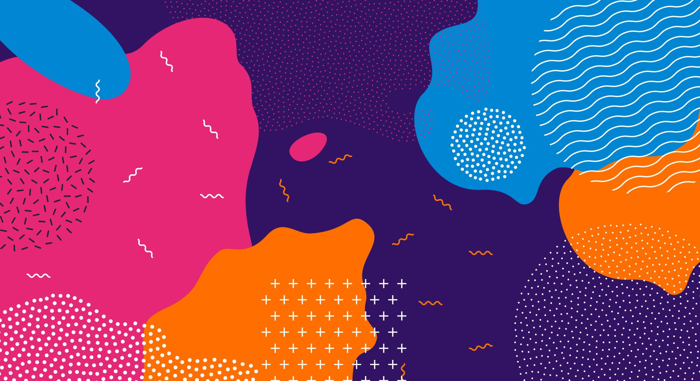
Art Therapy
Wellbeing
Day 2021

Slide 2
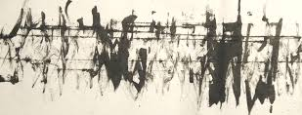
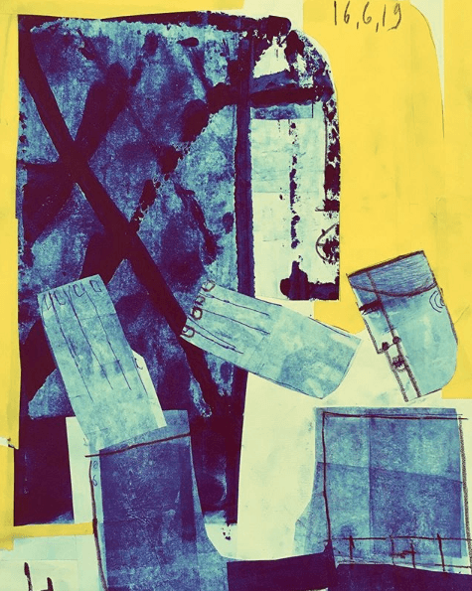
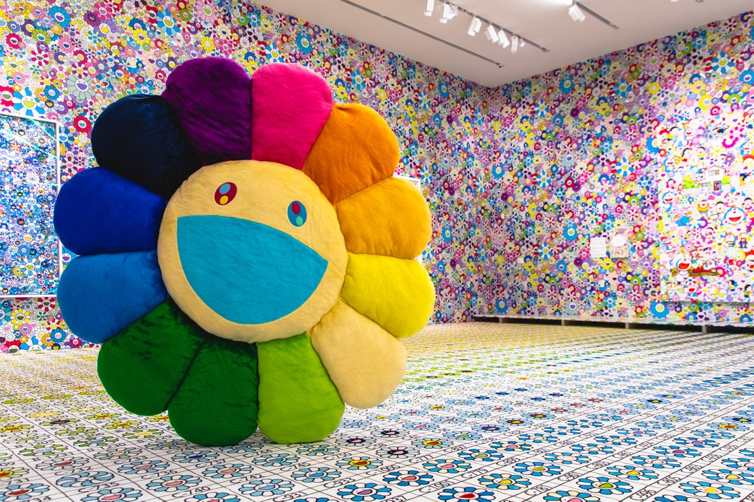
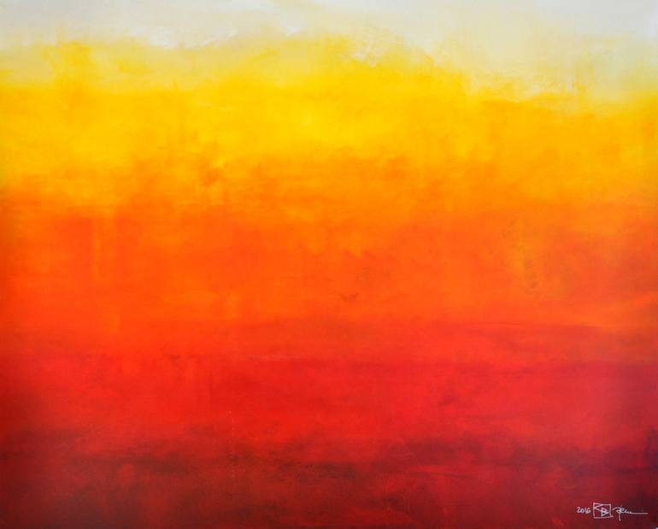
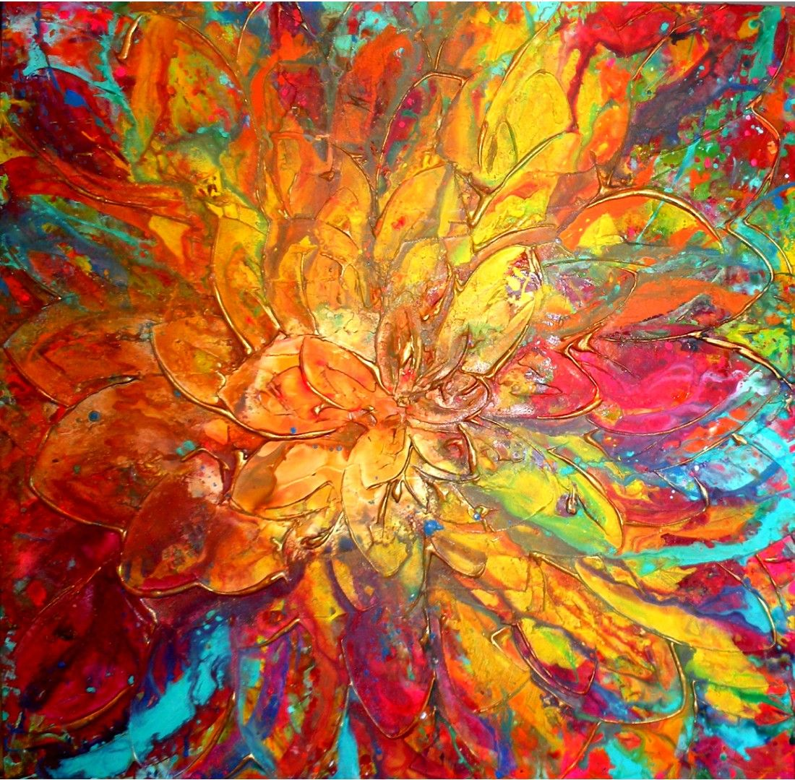
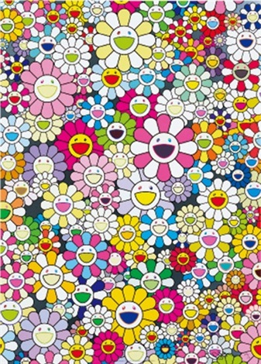
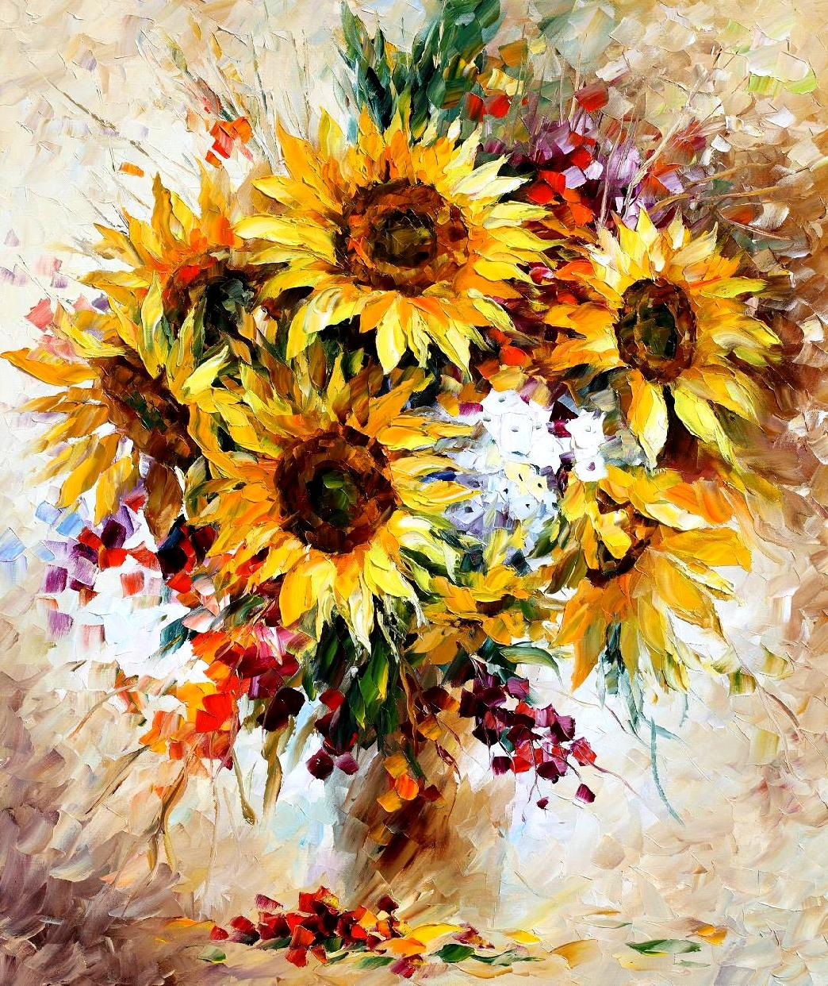
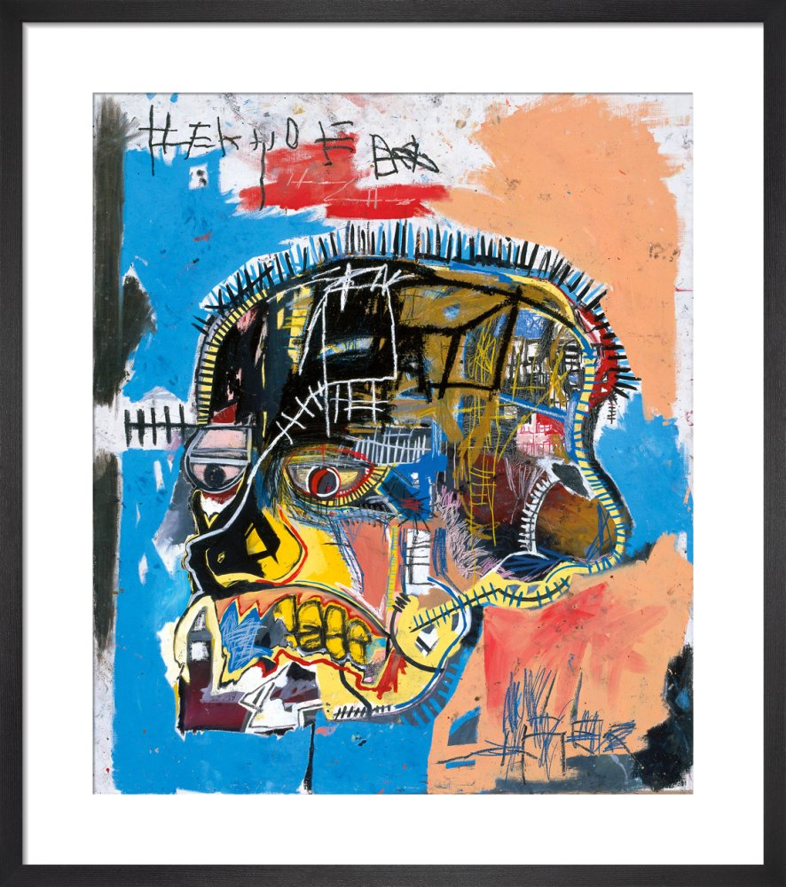
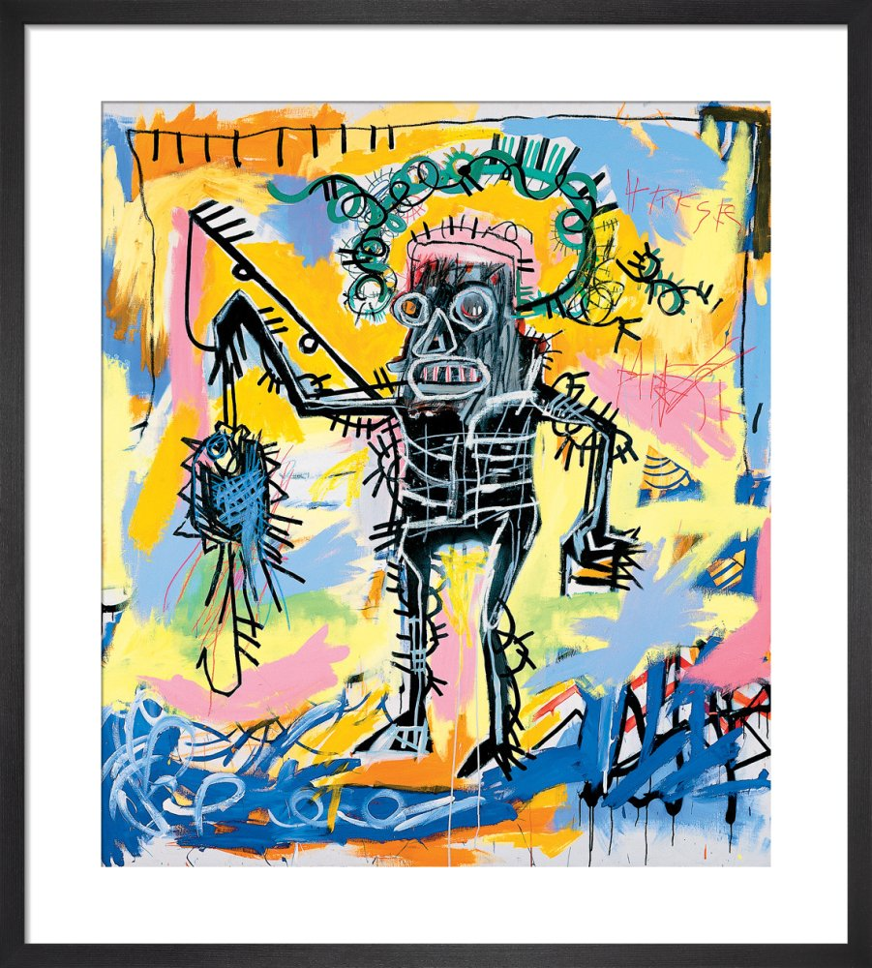
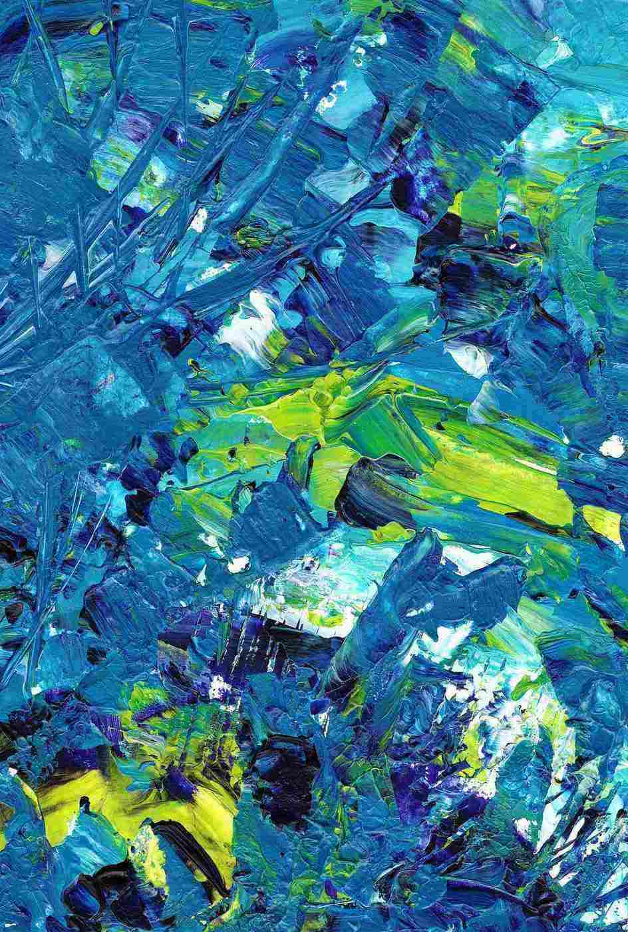
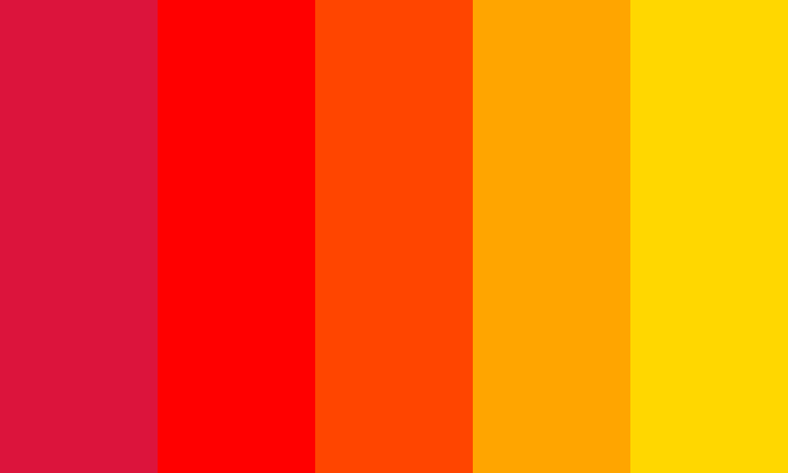
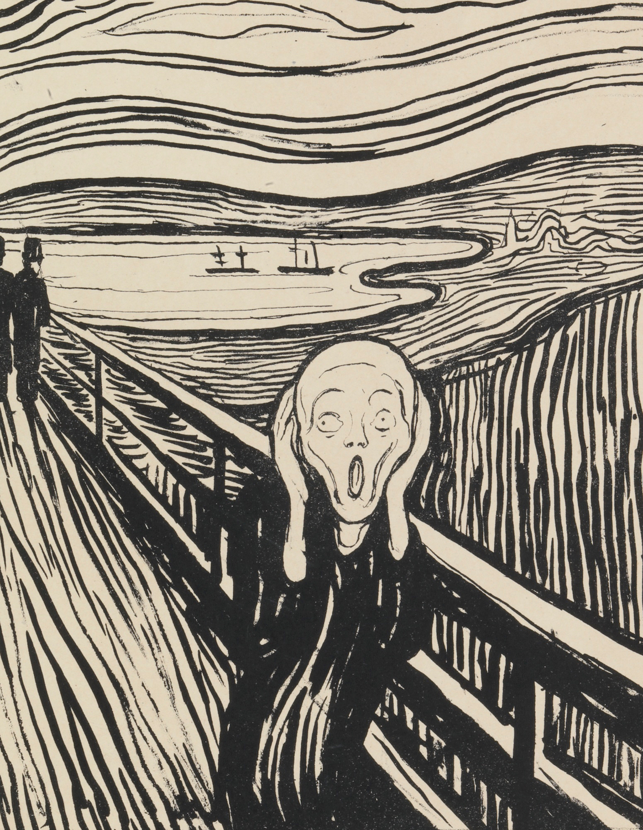
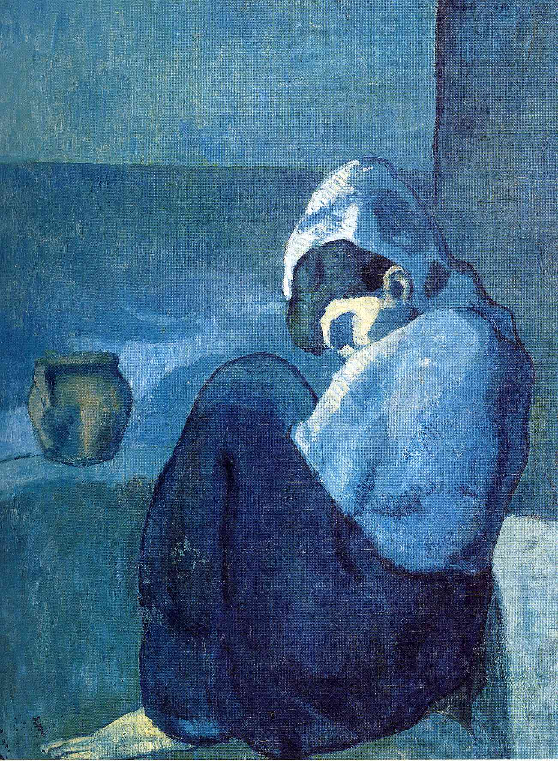
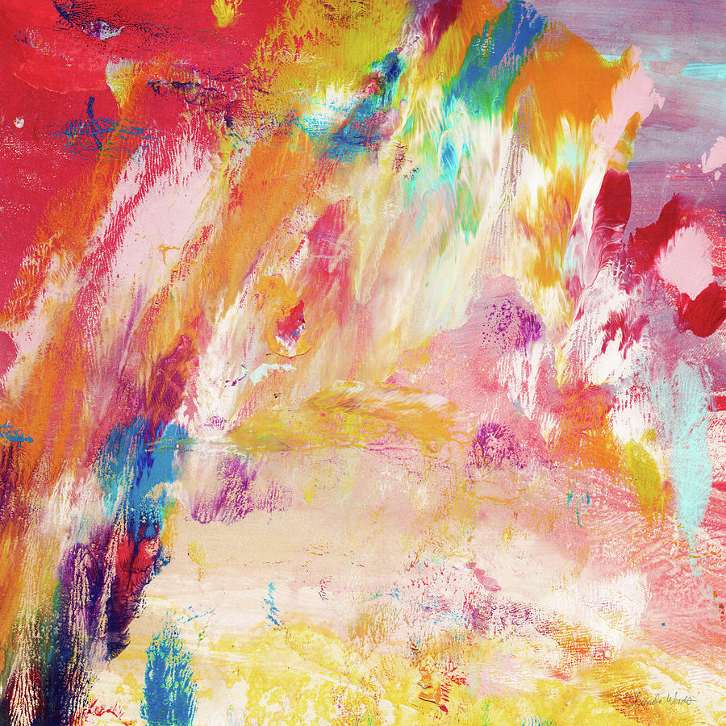
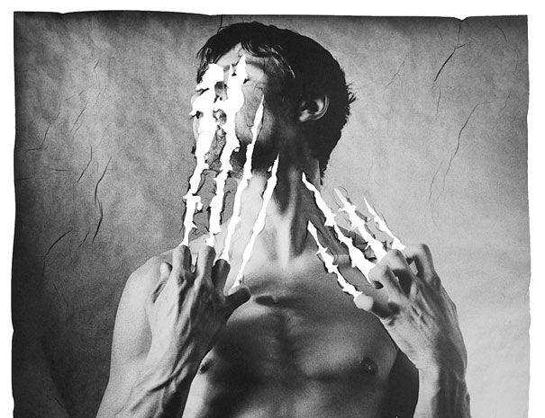
Takashi Murakami
Basquiat
Picasso
What can you see?
What do these make you think?
What do they make you feel?
Edvard Munch

Slide 3
What is Art Therapy?
Art therapy is an established form of psychotherapy with its beginnings in the 1940s.
The overall aim of its practitioners is to enable a client to change and grow on a personal level through the use of art materials in a safe and facilitating environment.
Art therapy can support people facing a range of issues, such as emotional or mental health problems, learning or physical disabilities, life-limiting conditions, neurological conditions, or physical illness. It offers a valuable alternative to talking therapies for people who may find it too difficult or painful to speak about their emotions or experiences. This is because art therapy uses art as the main form of expression and communication

Slide 4
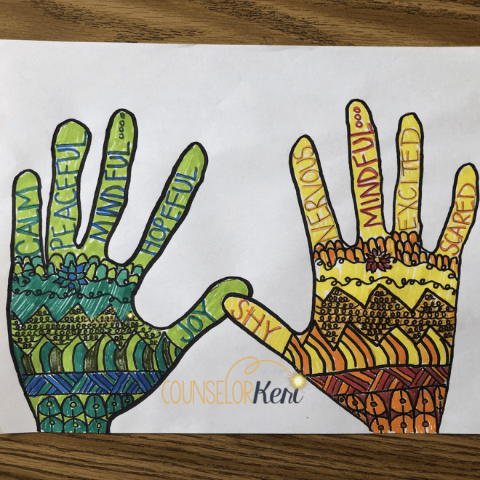
Paint your emotions
Positive Negative
Warm
Neat
Smooth
Blended
Light
Cold
Sharp
Scratched
Scrunched
Jagged edges
Dark

Slide 5
Colour emotions
Positive
Negative
Warm
Neat
Smooth
Blended
Light
Cold
Sharp
Scratched
Scrunched
Jagged edges
Dark

Slide 6
Task – Think First
Choose one or two recent events/changes in your life and think how you felt about it
One hand could represent positive thoughts and one hand could represent negative thoughts for the same situation/event
Or
One hand could represent thoughts about a positive event and one hand could represent thoughts for a negative event
Use colours/shapes/textures to represent the different types of emotions.

Slide 7
Task - Activity
Trace each hand on a separate A4 piece of paper - choose your colour wisely
Now design the detail of each hand - One hand will be positive and one hand negative but for the same situation/event or a different event
Choose relevant: colours, marks, edges, shapes to decorate.
Cut out the tracing of your hands and glue them to the A3 paper
Bronze: Each hand represents a positive or negative emotion related to an event or events in your life. Colour and shapes represent your feelings.
Silver: The way you apply patterns, shapes, brush marks and marks represent your feelings.
Gold: You could add words or codes in relevant fonts that represent specifics about the specific event.

Slide 8
Task - Plenery
Think about the emotions and identify where in your bodies these emotions were most felt.
How did creating your ‘emotional hands’ make you feel? Do you feel differently after creating your art work?
What have you learnt about textures/colours and how they link to emotions?

