Slide 1
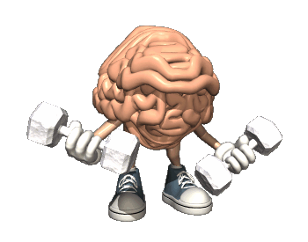
Mindfulness
Notes:
Please use this lesson to provide an open culture to the idea of Mindfulness.
It has so many benefits and can really impact students concentration and overall learning.
The philosophy is about providing yourself with some headspace- recognising our thoughts and being free to make a decision not to develop that thought and therefore being able to focus on the task at hand.
There are notes throughout to guide you through the powerpoint.
No incense or candles needed!

Slide 2
Discussion
Select a class or an activity during which you have difficulty concentrating.
What do you find distracting?
What happens during that time?
What do you do to get focused?
Notes:
Get students to talk in pairs by answering the questions.
Discuss as a class- get thoughts from students.
Talk about- ‘actually when we learn we always at some point get distracted’
It is about how we manage that distraction or thought

Slide 3
Characteristics of a good learner
The nine characteristics that good learners share are:
    1. Open-mindedness
    2. Self-awareness
    3. Tolerance
    4. An alert mind
    5. Good energy levels
    6. An ability to set goals
    7. A willingness to take risks
    8. Self-discipline – ability to remain focussed on the task in hand
    9. The capacity to value, accept and undergo change
Notes:
Having the characteristics that good learners display is about training our minds to strengthen these skills.
Not all of them will be easy to us but they can be practiced.
It is about mental fitness.

Slide 4
Are you fit?
We train our bodies to get physically fit, we rest when we are unwell.
What would you do to get physically fit?
“Just as going for a run is a well-known way of protecting general physical health, mindfulness exercises develop mental fitness and resilience”
Notes:
CLASS discussion – Encourage students to produce a list:
What would you do to get physically fit?
Run
Go to the gym
Exercise class
Walk
Swim
Join a club

Slide 5
Is your mind fit?
What do we do to get our minds fit?
How do we know when our mind is unfit?
Notes:
We all have times when we are not feeling at our best mentally, when we struggle to focus on a task.
What about when our mind feels crowded and we lack focus and struggle to cope with the day?
Ask question to students
Encourage responses- perhaps give an example
What is it we do to encourage mental fitness & resilience?
“Just as going for a run is a well-known way of protecting general physical health, mindfulness exercises develop mental fitness and resilience”

Slide 6
Your Mind
Everything you see
Everything you hear
Everything you taste, smell, touch, feel
Everything you experience is filtered though your mind.
Your mind can be your best friend or your worst enemy. It can make life wonderful or you can make it miserable.
Notes:
We use our mind for everything we experience. In lessons, conversations with our friends, eating our lunch, playing sports, listening to music, we use our mind to filter our experiences.
Our mind can influence this experience as being a positive or a negative experience.
Highlight how you are , to some extent, responsible for your own happiness.
You can physically change the way your brain works for the better.

Slide 7
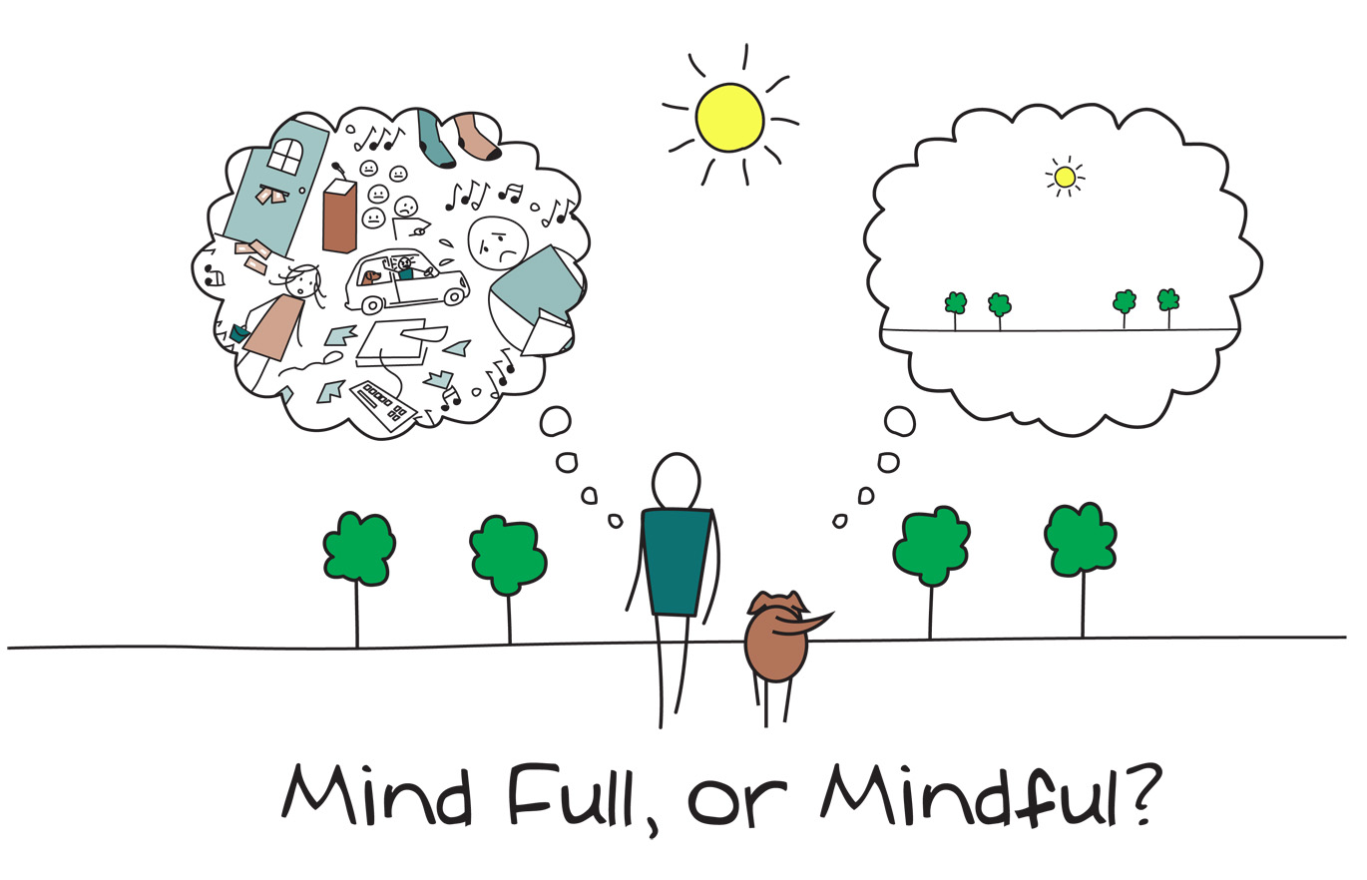
Where is your mind?
Notes:
Where is your mind?
We talk about the “mind”. Where is the mind? Your mind and body are inextricably linked.
Sometimes our minds are full of everyday thoughts- what happened at break, our next lesson, home learning, what happened at home, what lesson we have next, our friends, our feelings…. We can fill our minds with lots of thoughts of just a thought. We can choose. Is your mind full or are you mindful?
Class discussion-
where is your mind?
What are you thinking about?
Is your mind full of thoughts?
Are you ever mindful, where you are just thinking about right now?
The next slide gives some ideas/ discussion points about having mind full!

Slide 8
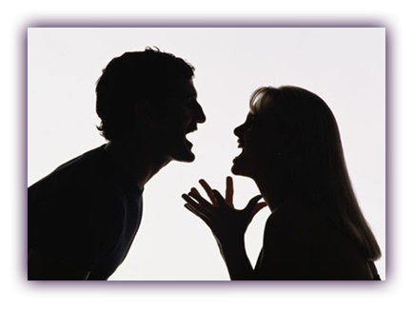
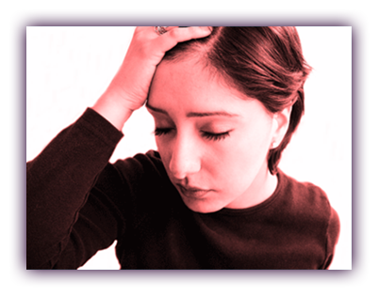
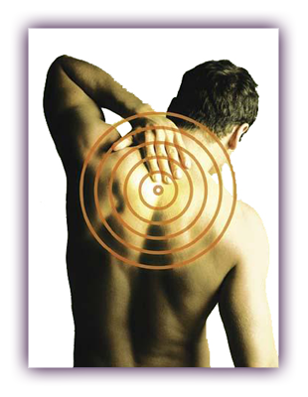

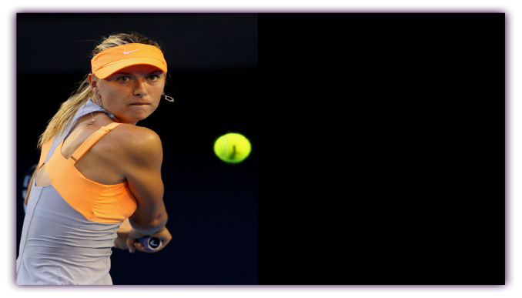

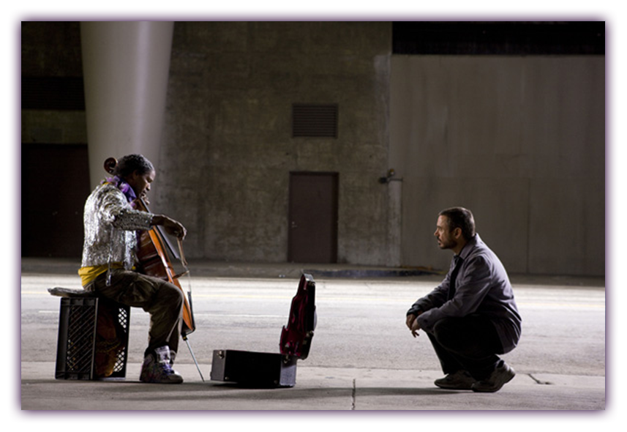
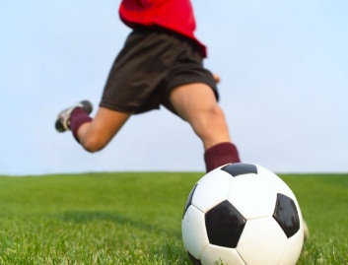
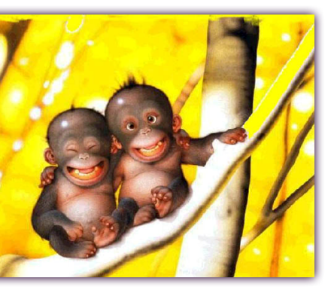
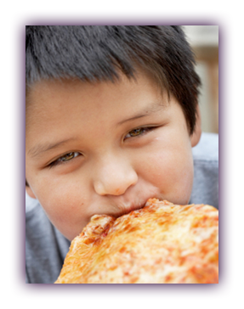
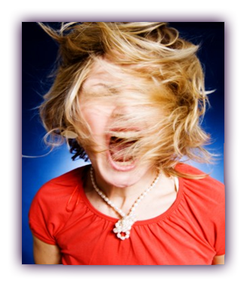

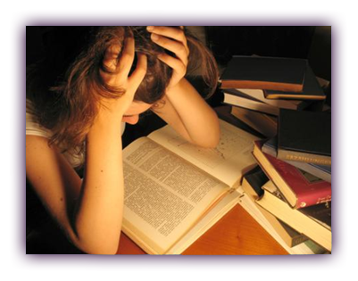
Mind full
Our mind can process 126 pieces of information every second.
Sleeping
Relationships
Stress
Concentration
Pain
Music
Sport
Happiness
Exams
Eating
Anger
Depression
Notes:
Our minds can be full of thoughts, thinking of things that have happened in the past or what can happen in the future.
This can make us feel stressed and we can find it difficult to concentrate on what is important.
We can struggle to focus, to learn or to spend time with our friends.
Our mind can process 126 pieces of information every second.

Slide 9
Mindful
Present moments last 3-4 seconds on average
Being mindful, being in the present.
Kung Fu Panda
Notes:
Kung fu panda. We have a panda that is not happy.
We have all felt like this at certain times in our lives.
The “It’s all gone wrong” feeling, things seems to be failing apart and not going the right way.
In this clip, our Panda, called Po, is very stressed about life.
You can see from his body, his gestures, his eating.
His misery is typical of modern day stress: he thinks he is rubbish at everything (low self esteem).
His mind is thinking about the past and about the future, that is until the wise old turtle, Oogway, arrives on the scene.
Ooogway delivers a message which is the essecense of Mindfulness! (Words on the next slide)

Slide 10

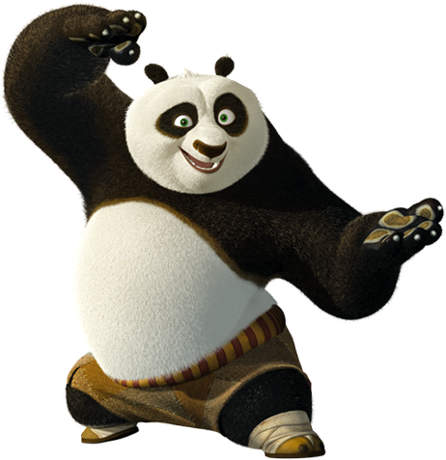
Mindfulness
Yesterday is history,
Tomorrow is a mystery,
But today is a gift,
And that’s why it is called the present.
Notes:
This is the core of mindfulness, which is paying PAYING ATTENTION TO THE PRESENT MOMENT.
It is about training the mind to be in the present moment, whatever is happening, be that good or bad.
It’s about giving yourself the headspace to notice what is happening right now.
That might be relaxing with friends, revising for an exam, spending time with your family or eating.

Slide 11
Training our mind
The wonderful thing is that you can shape this remarkable instrument.
You can, literally, change your mind.
We know that you can physiologically, change your brain by the way that you think.
We can train our brains to get better at certain things.
Fitness training for the brain, like the body, takes a bit of effort and a bit of self-discipline- but it pays off.
Brain tour
Notes:
Highlight how you are , to some extent, responsible for your own happiness. You can physically change the way your brain works for the better.
Look at the video ‘Brain train’- neuroplasticity – you have seen this before in the growth mind-set assembly delivered by the head teacher- it really gets the point across about changing our brain.
We can form new patterns/ habits and physically change our brains so that old habits die allowing the new habits to form.
LINK- https://www.youtube.com/watch?v=ELpfYCZa87g

Slide 12
Mindfulness
Being Mindful!
Paying attention to the present moment
Sitting in silence
Being aware of where your attention is at
HEAD SPACE
Notes:
Here is an animation that explains about your mind being Mindful or Mind Full. (2 minutes)
LINK- https://www.youtube.com/watch?v=7xAeJKgupPI

Slide 13
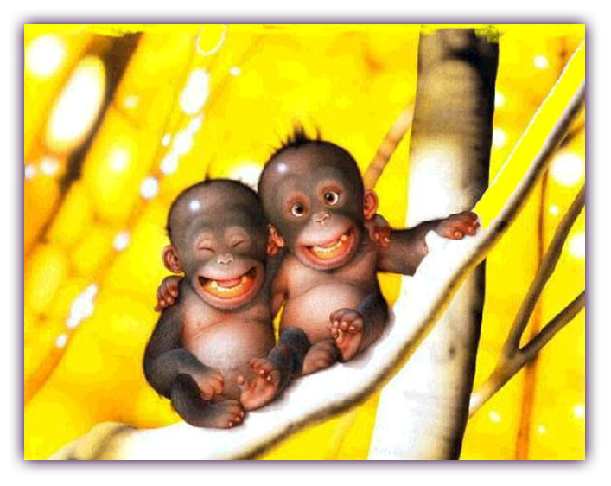
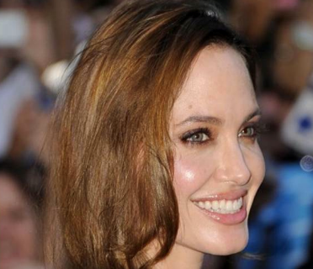
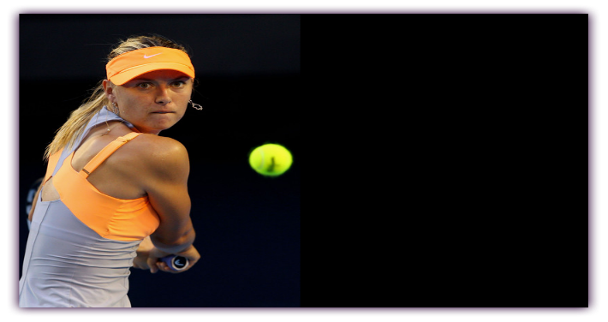
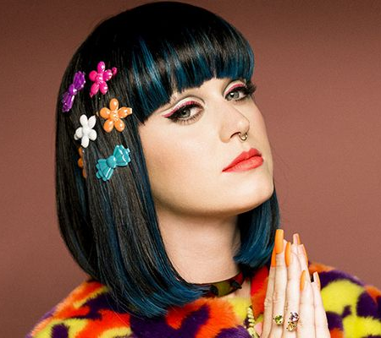

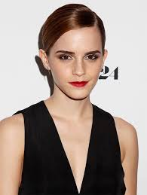
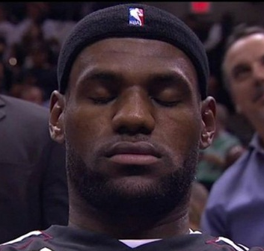
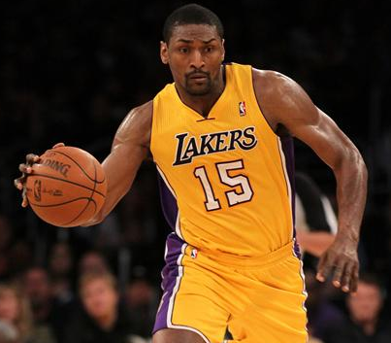

How can it help?
Music
Concentration
Happiness
Sleeping
Relationships
Pain
Stress
Anger
Exams
Sport
Depression
Eating
Notes:
People use mindfulness for different reasons, such as, improved concentration, happiness, depression, sleep, coping with pain, during exams and even to diet.
Lots of sports professionals use mindfulness meditation to ‘get in the zone’.

Slide 14
Let’s have a go
Sit comfortably in your chair and just listen
Mindfulness
Notes:
Play the headspace link – some students will keep their eyes open- but they will start to get involved as long as you encourage them the close their eyes.
Usually some students will laugh at first but later on join in when they see all eyes closed.
LINK - https://www.youtube.com/watch?v=oVzTnS_IONU

Slide 15
What now?
You can practice being mindful at anytime of the day, wherever you are.
Try using this app Headspace
Have a look at the booklet
We are offering a Mindfulness 8 week course here at school- coming soon!
Please let your tutor know if you are interested
Notes:
If you have time please discuss how it felt? How did it feel to stop and pause?
We will soon have a Mindfulness area in the school and there are lots of courses coming up that they can do.

