Slide 1

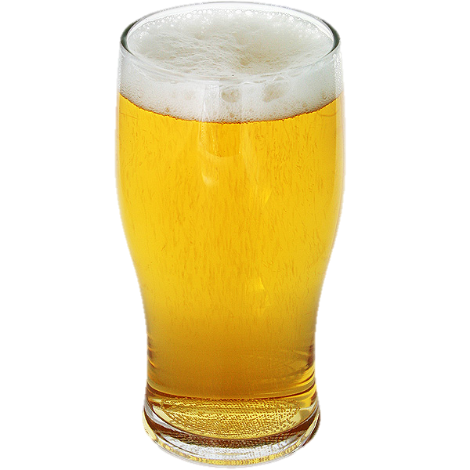
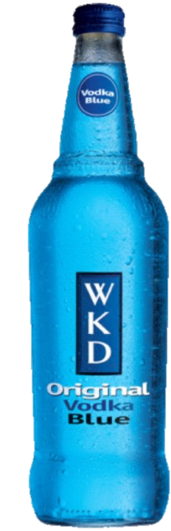
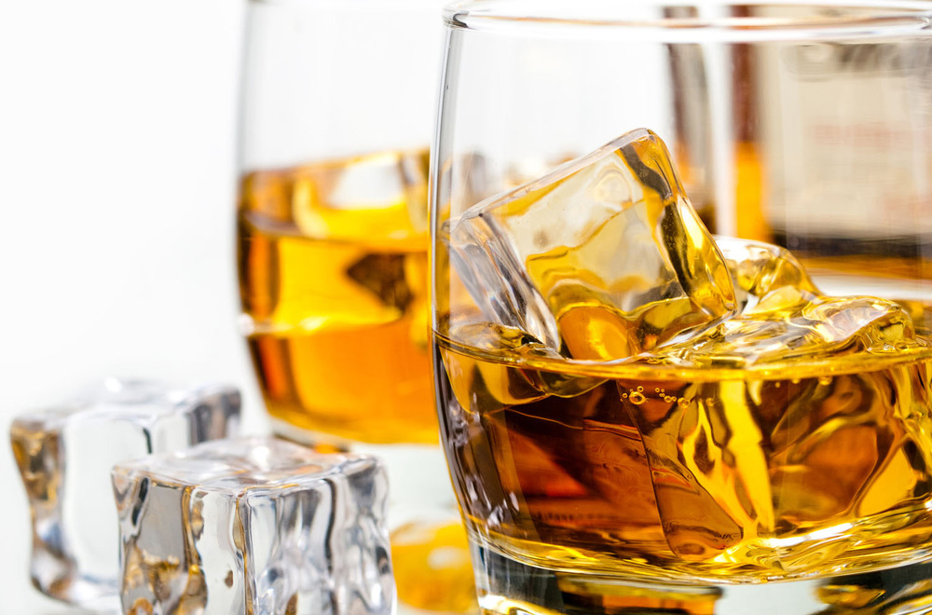
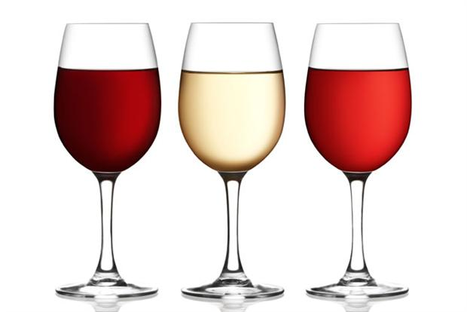

All of these are alcoholic drinks but how are they different?

Slide 2
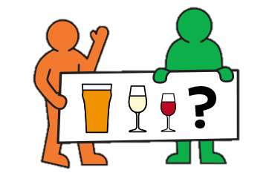
16th July 2021
Alcohol – Know your limits
Do you what a unit of alcohol is?
Can you compare the strengths of different types of alcohol?

Slide 3
What makes one alcoholic drink stronger than another?
Units are how we measure how much alcohol is in a drink. 1 unit is 10ml of pure alcohol.
Different drinks have different amounts of units and the more units, the stronger it is.
The amount of alcohol in a drink is also measured as a % of the total volume of a drink.
E.g. a 440ml can of cider could have 1.8 units of alcohol which is 4% of the entire can.
Tip: Think of alcohol as one of many ingredients in any aloholic drink.
Units

Slide 4
Task 1
In your table groups rank the drinks cards from strongest (number 1) to weakest (number 9). Put the cards in the right place on your 9 diamond.
Finished: Discuss which ones did you had difficulty deciding on and why?
Strongest drink
(Has the most alcohol in – measured in units)
1
2
3
4
5
6
7
8
9
Weakest drink
(Has the least alcohol in – measured in units)

Slide 5
Back to your diamond 9
1 Red Wine 3.5 units 125ml 14%
Is your diamond 9 correct?
1 minute to change any that you think are in the wrong place
Remember: Darker drinks tend to be stronger than lighter drinks
2 Beer 2.9 units 570ml 4.8%
3 Cider 2.5 units 570ml 4%
4 White wine 1.5 units 125ml 13%
5 Champagne 1.5 units 125ml 12%
6 WKD (alcopop) 1.5 units 275ml 5%
7 Whiskey 1 unit 25ml 40%
8 Vodka 1 unit 25ml 40%
9 Gin and tonic 1 unit 25ml 40%

Slide 6
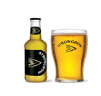








How would you change this order?

Slide 7
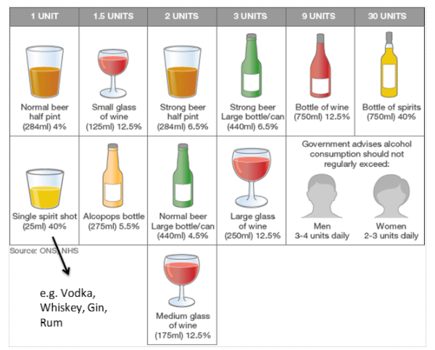
Are you surprised by any of this information?

Slide 8
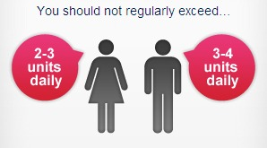
Know your limits
In the UK the NHS has recommended safe amounts of alcohol for people to drink. If you exceed (go over) these limits you can do serious damage to your body.
It takes the body 1 hour to process (get rid) of 1 unit of alcohol.
Why is it different for men and women?
How many in a week?

Slide 9
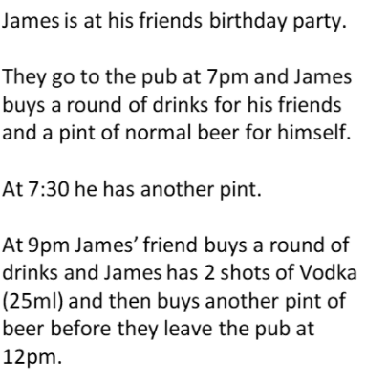
Read the following scenarios
What might be some short term and long term effects?
What could they have done differently?

Slide 10
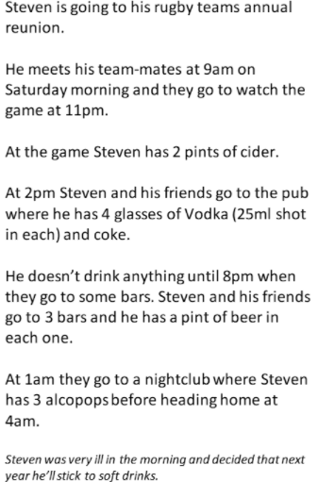
What might be some short term and long term effects?
What could they have done differently?

Slide 11
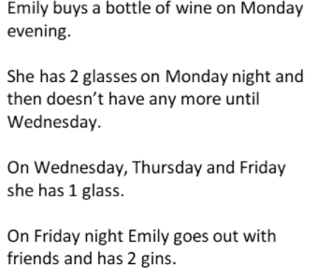
What might be some short term and long term effects?
What do they have done differently?

Slide 12
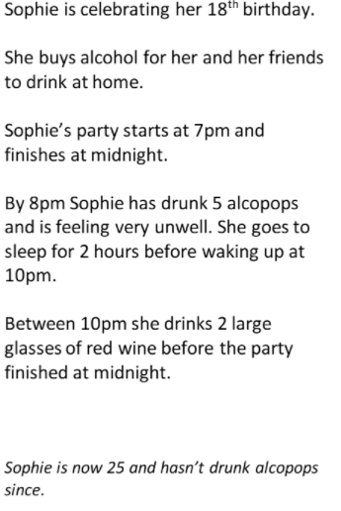
What might be some short term and long term effects?
What could they have done differently?

Slide 13
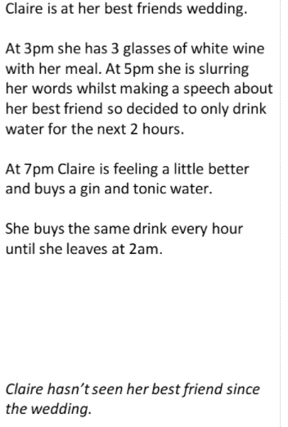
What might be some short term and long term effects?
What could they have done differently?

Slide 14
How does being drunk affect your senses?
Can you get around the classroom easily?

Slide 15


