Slide 1
WELLBEING DAY
JULY 2022

Slide 2

Hello Year 7
We are going to be learning about
the differences between
bullying and anti-bullying

Slide 3
We are anti-bullying ambassadors and we are going
to teach you for this lesson.
We are:
Eddie Khamis (Year 12, Assistant Student Vice-Predisent)
Ashlee Turner (Year 10)
Shannay Hyde (Year 9)
Layla Chaffey (Year 9)
Ruby Richardson (Year 8)
Paige Brooker (Year 8)
Zenat Hamidy (Year 7)
Ruby Reid (Year 7)
Our expectations to your behaviour and attitude towards learning are the same as the teacher. We expect you to be as respectable to us the same as how you respect your teacher.
Don’t worry, we won’t give out C1s (but Mr Lyddon might do!)

Slide 4

Our Role in The School
We are not the only anti-bullying ambassadors in the school – there is a whole group of us!
We help and support those who are suffering from any form of bullying and look at ways the school can improve everyone’s knowledge and understanding of bullying

Slide 5

What is bullying?

Slide 6
Bullying is :
‘an ongoing and deliberate misuse of power in relationships through repeated verbal, physical and/or social behaviour that intends to cause physical, social and/or psychological harm.’
The types of bullying are:
Physical – When they harm you by touching you (hitting, kicking)
Verbal – When the victim is called horrible names that can affect their mental health (name-calling, body-shaming, racism, homophobia etc.)
Indirect – when the victim is bullied behind their back or online (cyber-bullying, whispering)

Slide 7


Task (Game) 1:

Slide 8
LOOK AT THE FOLLOWING IMAGES AND TELL US (WITH YOUR THUMBS) WHETHER YOU THINK IT IS BULLYING OR NOT

Slide 9


Slide 10
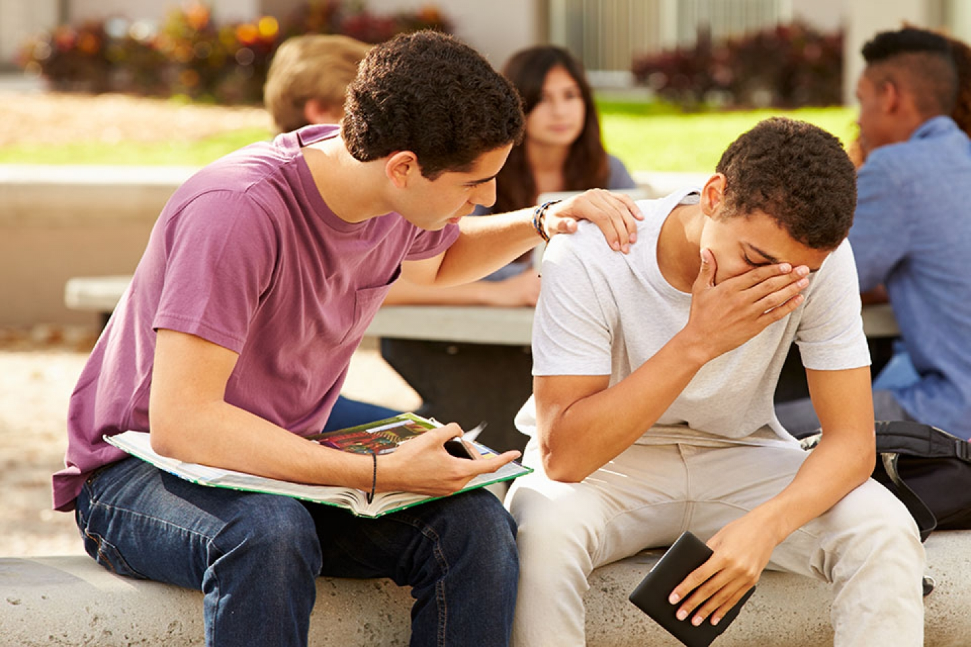

Slide 11
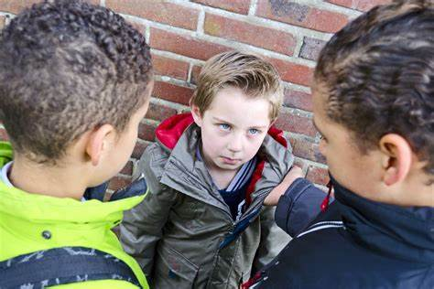

Slide 12
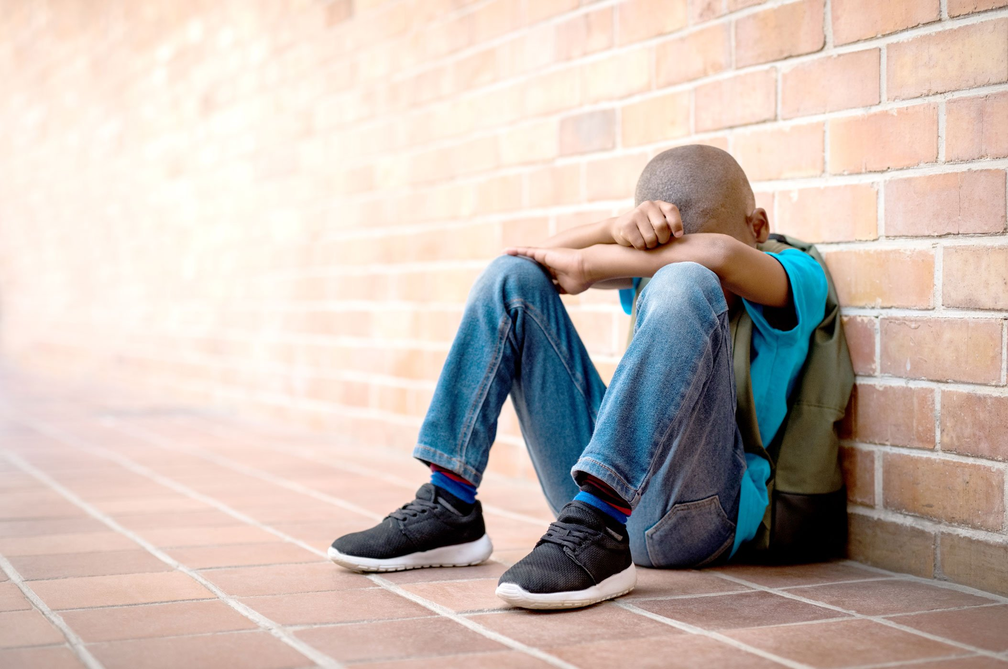

Slide 13
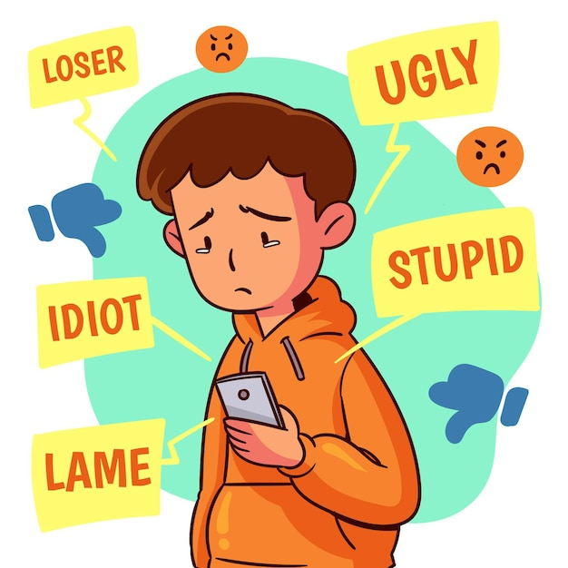

Slide 14
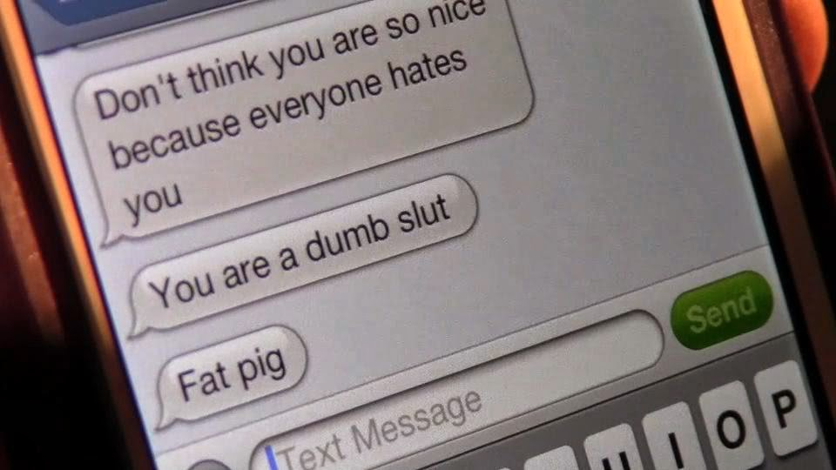

Slide 15


Slide 16
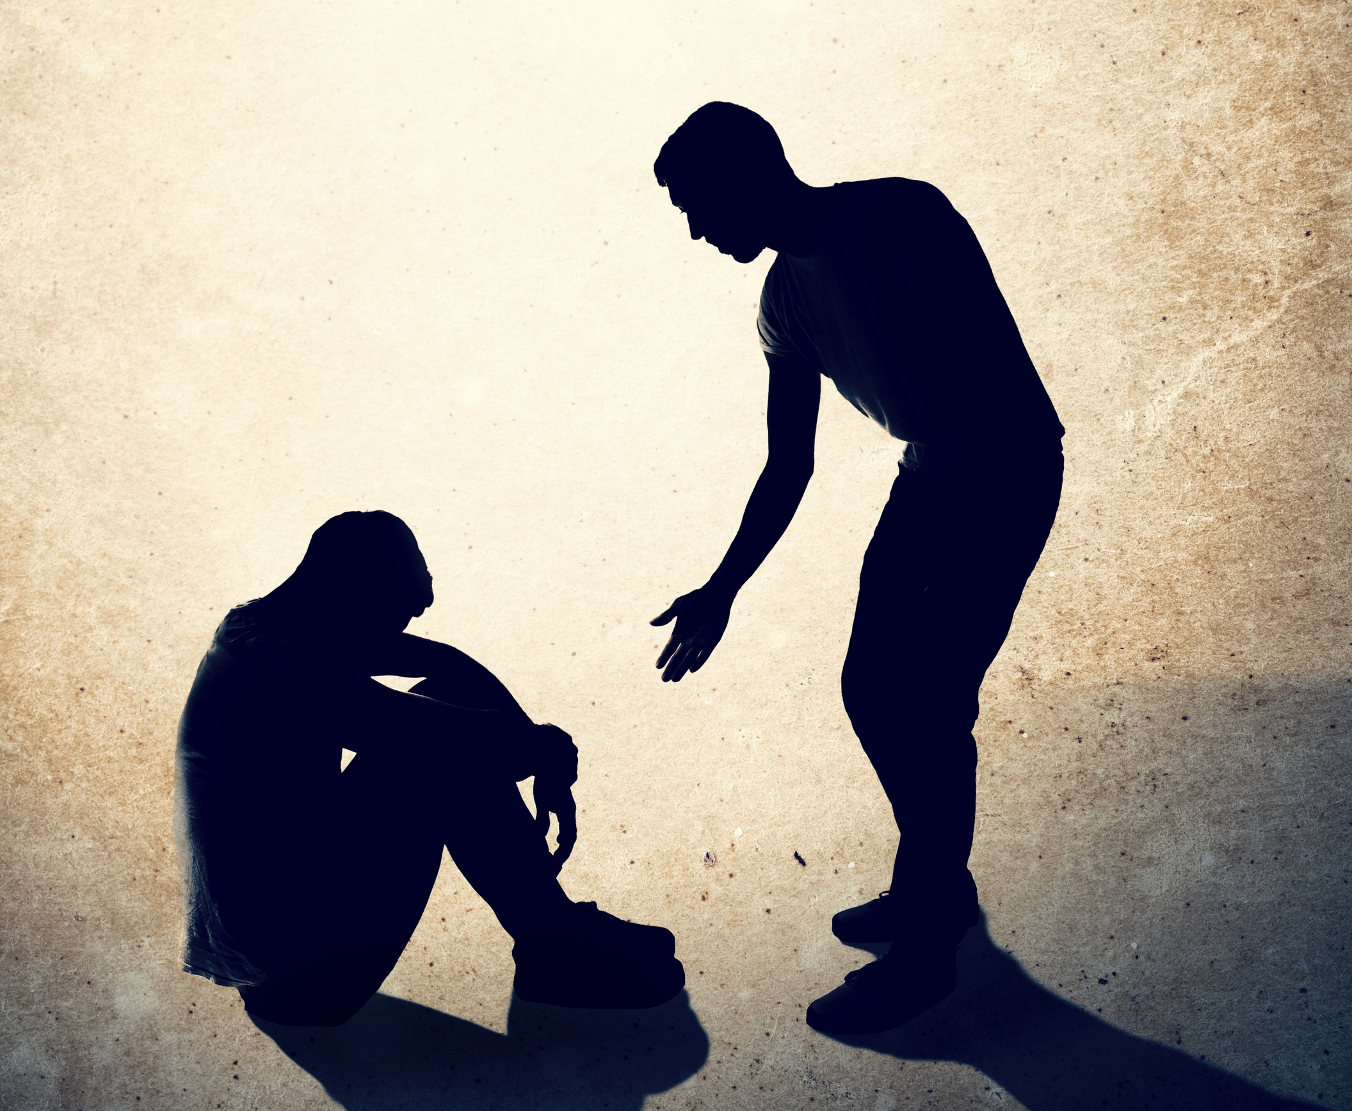

Slide 17
Protect Yourself Rules - Bullying – YouTube
Caught On Cam: Bystanders react to bullying experiment – YouTube

Slide 18
HERE ARE THE FACTS….
About 20% of all students ages 12-18 have experienced bullying.
About 46% of students ages 12-18 who were bullied at the school in the past year reported the bullying to an adult at the school.
Among students ages 12-18 who reported being bullied at school, 15% were bullied online or via text.
13.4% of students 12-18 have been victims of rumors or lies.
13% of students 12-18 were made fun of, called names, or insulted.
8 % of students 12-18 were threatened with harm.
Bullying impacts all youths, whether they are the bully, the one being bullied, or witnessing the bullying.

Slide 19


Slide 20
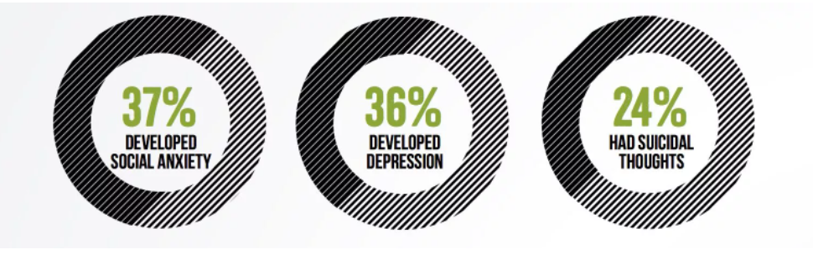

Slide 21
WHY DO BULLIES BULLY OTHERS?
Emotional Trauma
Insecurities
They have been bullied
Learned behaviour
Poor social skills
Attention seeking
Lack of empathy – they just don’t care

Slide 22
REASONS WHY PEOPLE ARE BULLIED
Race / Religion
Ethnicity
Looks
How you act
How you speak
You are different
Jealousy
Appear weak / easy target

Slide 23
If you saw a victim of bullying…
WHAT WOULD YOU DO?
WHAT WOULD YOU SAY?
WOULD YOU TELL ANYONE? (IF SO, WHO?)

Slide 24


