Slide 1



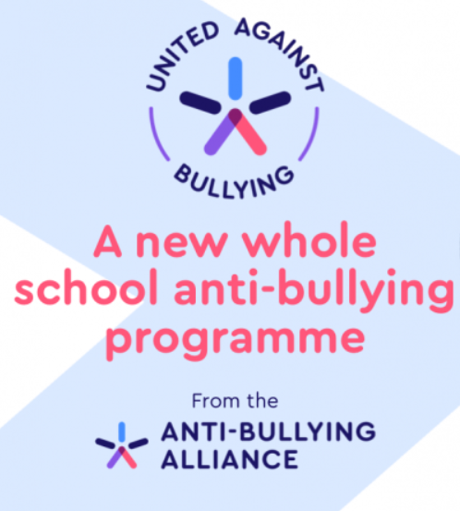
Anti-Bullying
Come to us if you need help
Message us on Teams if you’re in need of help
Come Talk To Us
If you are being victimised by someone else and you’ve had enough, come talk to an Anti-Bullying Ambassador for help and support

